Slide 1
Community Risk, Vulnerability, and Resilience Data Module
HIGHER EDUCATION PROGRAM
NATIONAL EMERGENCY TRAINING CENTER • EMMITSBURG, MD
NATIONAL TRAINING AND EDUCATION DIVISION / NATIONAL TRAINING AND EDUCATION SYSTEM

Slide 2
Course Outline
Introduction
Section 1. What are Risk, Resilience, & Vulnerability?
Section 2. How are Indices created?
Section 3. Overview of GIS and Mapping Technology
Section 4. Review of Available Indices and Tools
Section 5. Explore FEMA’s Resilience Analysis and Planning Tool (RAPT)

Slide 3
Introduction
As disasters continue to increase in frequency and cost,¹ researchers across academic disciplines, including anthropology, ecology, engineering, sociology, and psychology, have attempted to identify and quantify features that make a community more resilient to disasters.
Source: Community Resilience Indicator Analysis: County-Level Analysis of Commonly Used Indicators from Peer-Reviewed Research, September 2019 Update

Slide 4
Emergency Management
- the managerial function charged with creating the framework within which communities reduce vulnerability to threats/hazards and cope with disasters.
Communities can address the risks these threats and hazards pose by:
Taking a data-driven approach to a community’s risk assessment,
Developing plans and outreach strategies that address the people and infrastructure that are most vulnerable, and
Leveraging science-based research to assess the relative resilience of their citizens, built infrastructures, and local economies.

Slide 5
Data-Driven Approach
To support a more data-driven approach, numerous indices have emerged and are in development to help planners, emergency managers, and policymakers understand their community’s level of risk to different threats and hazards.
These indices also help planners and leaders identify the location and nature of vulnerabilities in their communities. Some indices also help decision-makers assess the relative resilience of their citizens, built infrastructures, and local economies.
These indices are often developed through academic, research & development (R&D) laboratories, and government agency collaborations – as a means to conduct scientific analysis and develop algorithms for comprehensive and reliable regional and national-level indices.

Slide 6
Data-Driven Community Assessment
Detailed community assessment can assist with:
Targeted outreach and assistance
Justify expenditures from all funding sources, including grant opportunities
Plan to conduct activities consistent with Core Capabilities to prepare for potential threats and hazards
Goal of improving a community's resiliency when a disaster occurs and shorten the impacts and time to recover.​
Notes:
Assistance: FEMA must streamline and integrate existing disaster assistance programs and processes, creating innovative and efficient solutions to provide the most effective survivor support. This starts with a review of the available forms of assistance and how survivors access the various programs. Furthermore, understanding barriers that limit or prevent access to programs, especially for vulnerable populations, remains essential to our mission. FEMA's Strategic Plan 2018-2011 Obj. 3.1
Grants: Preparedness grant recipients should engage with the whole community to advance individual and community preparedness and to work as a nation to build and sustain resilience. FEMA expects that the integration of the needs of people with disabilities and limited English proficiency will occur at all levels, including planning; alerting, notification, and public outreach; training; purchasing of equipment and supplies; protective action implementation; and exercises/drills. FEMA grant recipients can fund projects towards the resiliency of the whole community, including people with disabilities and limited English proficiency, such as training, outreach, and safety campaign. FEMA Preparedness Grants Manual 2020
Core Capabilities: The National Preparedness System outlines an organized process for everyone in the whole community to move forward with their preparedness activities and achieve the National Preparedness Goal. The Goal describes five mission areas: Prevention, Protection, Mitigation, Response, and Recovery. The mission areas and (32) core capabilities organize the community-wide activities and tasks performed before, during, and after disasters into a framework for achieving the goal of a secure and resilient Nation. FEMA’s Comprehensive Preparedness Guide (CPG) 201, 3rd Edition

Slide 7
Section 1.
What are Risk, Vulnerability, and Resilience?

Slide 8
Defining Risk, Resilience, and Vulnerability
Numerous definitions exist
Varies by context and discipline
Have evolved over time
Notes:
Definition: Risk Steering Committee, DHS Risk Lexicon: 2010 Edition, (Sept. 2010)
(http://www.dhs.gov/xlibrary/assets/dhs-risk-lexicon-2010.pdf).
Methodology: FEMA Preparedness Grants Manual 2020
https://www.fema.gov/sites/default/files/2020-06/fema_preparedness-grants-manual.pdf
A suite of assessment products that measures risk and capability across the nation in a standardized and coordinated process. https://www.fema.gov/emergency-managers/risk-management/risk-capability-assessment

Slide 9
Defining Risk
DHS/FEMA defines risk as:
The potential for an unwanted outcome resulting from an incident, event, or occurrence, as determined by its likelihood and the associated consequences.
The DHS/FEMA risk methodology is focused on three elements:
Threat: the likelihood of an attack being attempted by an adversary
Vulnerability: the likelihood that an attack is successful, given that it is attempted
Consequence: the effect of an event, incident, or occurrence
Calculating Risk:
DHS: Risk = Threat x Vulnerability x Consequence
National Risk Index: Risk = Expected Annual Loss x Social Vulnerability ÷ Community Resilience
Notes:
According to DHS Risk Management Fundamentals, “there is no single methodology that is appropriate for measuring the likelihood and consequences of every [homeland security] risk.” What is important to note here is that you understand the methodologies behind any of the variables used to calculate risk for your community and determine what makes sense for your intended use.
Additional Definitions: (DHS)
Likelihood is the chance of something happening, whether defined, measured or estimated in terms of general descriptors, frequencies, or probabilities.
Consequence, or impact, is the effect of an incident, event, or occurrence, whether direct or indirect. In homeland security risk analysis, consequences include (but are not limited to) loss of life, injuries, economic impacts, psychological consequences, environmental degradation, and inability to execute essential missions. - DHS Risk Lexicon, 2010 Edition
Sources:
Definition: Risk Steering Committee, DHS Risk Lexicon: 2010 Edition, (Sept. 2010)
http://www.dhs.gov/xlibrary/assets/dhs-risk-lexicon-2010.pdf.
Methodology: FEMA Preparedness Grants Manual 2020
https://www.fema.gov/sites/default/files/2020-06/fema_preparedness-grants-manual.pdf
DHS Risk formula: Risk Management Fundamentals: Homeland Security Risk Management Doctrine April 2011
https://www.dhs.gov/sites/default/files/publications/rma-risk-management-fundamentals.pdf

Slide 10
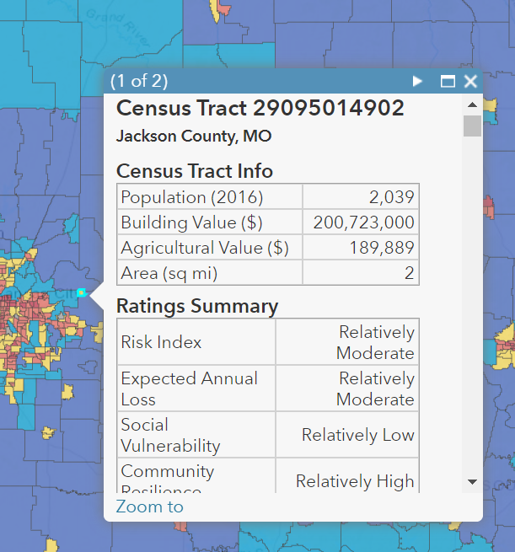
Community Risk Assessment
Tools and national guidance support a data-driven approach to understanding the threats and hazards that pose the greatest risk to a community and their potential impacts.
The National Risk and Capability Assessment (NRCA) – suite of assessment products that measures risk and capability across the nation in a standardized and coordinated process.
Threat and Hazard Identification and Risk Assessment (THIRA) – process that helps communities understand their risks to the most challenging threats and hazards and the capabilities needed to do to address them.
Hazard Mitigation Planning (HMP) – summarize the natural hazards that can affect a jurisdiction, the history of previous occurrences, the potential of future impacts of hazard events, and the infrastructure at risk.
FEMA’s National Risk Index (NRI)
National Risk and Capability Assessment (https://www.fema.gov/emergency-managers/risk-management/risk-capability-assessment)
Notes:
The National Risk and Capability Assessment (NRCA) is a suite of assessment products that measures risk and capability across the nation in a standardized and coordinated process. When analyzed together, these products will better measure national risks, capabilities, and gaps.
There are four key elements of the National Risk and Capability Assessment (NRCA), of which the THIRA is the first part. Additionally, communities may leverage the comprehensive hazard risk analysis performed as part of other planning activities such as the Hazard Mitigation Plan as a starting point.
The National Risk Index (pictured) is an online tool to help illustrate the nation’s communities most at risk of natural hazards. We will discuss this Index in more detail in a later section.
Additional Resources:
Increasing Resilience Using THIRA/SPR and Mitigation Planning, 3/21/20 https://www.fema.gov/sites/default/files/2020-09/fema_thira-hmp_jobaid.pdf

Slide 11
Defining Vulnerability
Physical feature or operational attribute that renders an entity open to exploitation or susceptible to a given hazard. – U.S. Department of Homeland Security Risk Lexicon
The conditions determined by physical, social, economic and environmental factors or processes which increase the susceptibility of an individual, a community, assets or systems to the impacts of hazards. – United Nations Office for Disaster Risk Reduction
“[The] susceptibility to injury or damage from hazards.” (Godschalk, 1991)
Notes:
We could say that vulnerability is:
the susceptibility of people to injury as the result of a hazardous event, and
the susceptibility of the things people value to damage as the result of a hazardous event.
We will touch briefly on these.
Full Source: Fothergill, A., Peek, L.A. Poverty and Disasters in the United States: A Review of Recent Sociological Findings. Natural Hazards 32, 89–110 (2004). https://doi.org/10.1023/B:NHAZ.0000026792.76181.d9
Godschalk, David R. (1991). “Disaster Mitigation and Hazard Management.” In Emergency Management: Principles and Practice for Local Government, ed. Thomas E. Drabek and Gerard J. Hoetmer, 131-60. Washington, DC: International City Management Association.

Slide 12
Social Vulnerability
Refers to the potential negative effects on communities caused by external stresses on human health. Such stresses include natural or human-caused disasters, or disease outbreaks. – Center for Disease Control
Susceptibility of social groups to the impacts of hazards such as disproportionate death, injury, loss, or disruption of livelihood – FEMA's National Risk Index
CDC Social Vulnerability Index (SVI) – Aggregated census data to derive relative social vulnerability.
Social Vulnerability Index for the US (SoVI) – A comparative social vulnerability score of counties across the USA.
Access and Functional Needs:
Persons who may have additional needs before, during, and after an incident in functional areas, including but not limited to maintaining health, independence, communication, transportation, support, services, self-determination, and medical care.
Individuals in need of additional response assistance may include those who have disabilities, live in institutionalized settings, are older adults, are children, are from diverse cultures, have limited English proficiency or are non-English speaking, or are transportation disadvantaged.
Source: National Response Framework 4th Edition
Notes:
CDC SVI is a database that can help emergency response planners and public health officials identify, map, and plan support for communities that will most likely need support before, during, and after a public health emergency.
SoVI provides a comparative social vulnerability score, comprised of 29 socioeconomic variables that contribute to a reduction in a community’s ability to prepare for, respond to, and recover from hazards. SoVI allows users to visualize (compare) the differences in social vulnerability among counties within their state and within the nation. http://artsandsciences.sc.edu/geog/hvri/sovi%C2%AE-0
Later sections will provide more details on these and other indices, including how data like SoVI is used to develop indices such as FEMA's National Risk Index.
Access and Functional Needs:
The National Response Framework details the roles and responsibilities of community members during day-to-day preparedness activities, through response and recovery. Emergency Managers oversee a jurisdiction's emergency plans and activities which require a thorough understanding of the social dimensions of the community and the functions provided for residents. This includes vital services, important social and economic institutions, and characteristics that make the community desirable to residents and businesses. In the conduct of a detailed Vulnerability Assessment, the Emergency Management team will:
Seek to identify - Where are the vulnerable? What are their specific needs? Are there language barriers? Elderly or lower income with transportation needs? Are there areas of more densely populated vulnerable populations? Understanding the unique needs will support more successful outreach and education programs.
Include members of these communities and the organizations (governmental, private, and NGO’s) that provide care and support to these specific segments of the population into the planning process.
Gain a better understanding of the social fabric and interdependencies of the community to build the restoration of those essential services into Recovery plans.
Emergency Managers https://www.fema.gov/sites/default/files/2020-04/NRF_FINALApproved_2011028.pdf

Slide 13
Connection to Disasters
“Socioeconomic status is a significant predictor … for physical and psychological impacts of disasters. [Vulnerable Populations] are … less likely to prepare for hazards … less likely to respond to warnings; more likely to die, suffer injuries, and have proportionally higher material losses; have more psychological trauma; and face more obstacles during phases of response, recovery, and reconstruction.”
Source: Fothergill, A., Peek, L.A. Poverty and Disasters in the United States: A Review of Recent Sociological Findings
Notes:
Full Source: Fothergill, A., Peek, L.A. Poverty and Disasters in the United States: A Review of Recent Sociological Findings. Natural Hazards 32, 89–110 (2004). https://doi.org/10.1023/B:NHAZ.0000026792.76181.d9

Slide 14
Physical and Cyber Vulnerability
Our Nation's well-being relies upon secure and resilient critical infrastructure—the assets, systems, and networks that underpin American society. - NIPP 2013
To manage risk to critical infrastructure, we must:
Identify, deter, detect, disrupt, and prepare for threats and hazards to the Nation’s critical infrastructure;
Reduce vulnerabilities of critical assets, systems, and networks; and
Mitigate the potential consequences to critical infrastructure of incidents or adverse events that do occur.
Source: Department of Homeland Security, NIPP 2013: Partnering for Critical Infrastructure Security and Resilience
Notes:
When assessing Vulnerability, this includes the physical features of our environment and cyber systems our communities rely on. The National Infrastructure Protection Plan, published in 2009, calls for infrastructure risks from any scenario to be considered “as a function of consequence, vulnerability, and threat.”
Department of Homeland Security, NIPP 2013: Partnering for Critical Infrastructure Security and Resilience, (Washington D.C.: DHS, 2013): 2–56, available at: https://www.cisa.gov/sites/default/files/publications/national-infrastructure-protection-plan-2013-508.pdf
Additional Resources:
The NIST Community Resilience Planning Guide for Buildings and Infrastructure Systems (Guide) and companion Playbook (https://www.nist.gov/publications/community-resilience-planning-guide-buildings-and-infrastructure-systems-playbook) *Discussed at the end of Section 1.

Slide 15
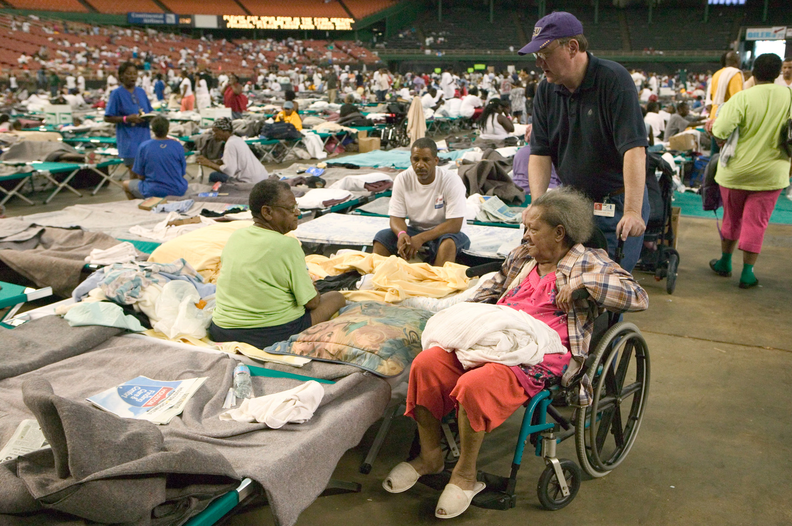
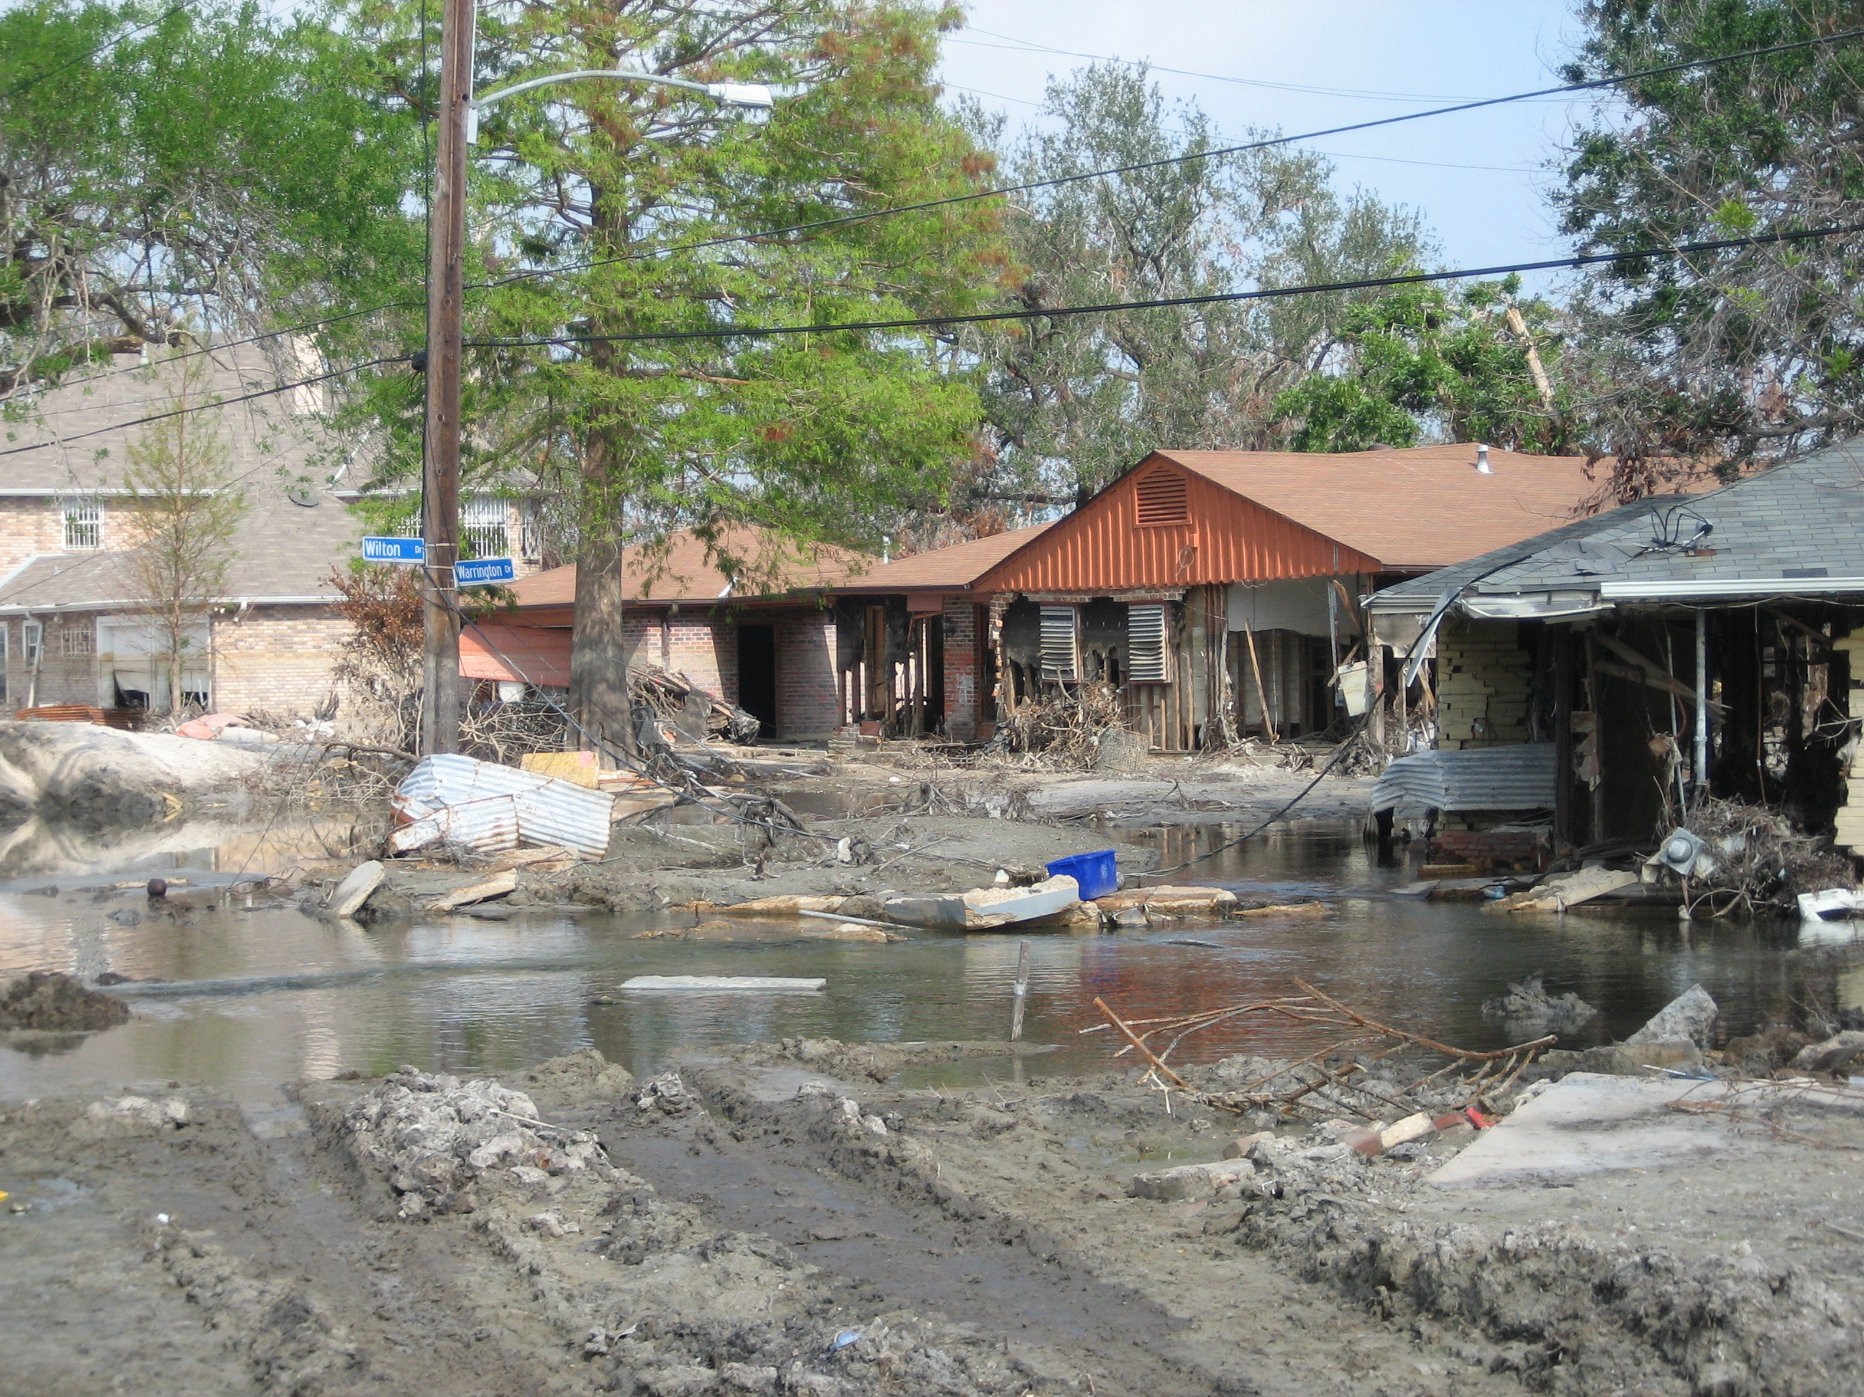
Case Study – Hurricane Katrina
Ecological upheavals are not egalitarian; they disproportionately affect those who are in lower socioeconomic levels. Many high-risk geographical areas have a disproportionately high percentage of marginalized populations; this same population is at a disadvantage preparation, evacuation, response, and recovery.
Andrea Booher, Public domain, via Wikimedia Commons
Research Findings:
Those of lower socioeconomic standing tend to live in more polluted, less secure, and high-risk environments.
Rental vs. Owned. Rental stock was impacted disproportionately, with damaged areas having a higher percentage of renters (46%) compared to the undamaged areas (31%).
Minority and Poverty. Areas identified as having the highest social risk according to the Social Vulnerability Index (SoVI) were generally the worst hit, i.e., damaged areas of New Orleans were disproportionately Black (46%) and below the poverty line (21%) compared to undamaged areas (26% and 15%, respectively).
Transportation. Poor and minorities, the elderly and disabled are much less likely to have access to vehicles than the general population for evacuation. 90% of White US Households may own a vehicle compared to 77% of minority households, and 65% for minority renters. (2000 US Census)
By Photo by Infrogmation, November 2005. CC BY 3.0,
Source: Zoraster RM: Vulnerable populations: Hurricane Katrina as a case study
Notes:
A February 2010 research article in Prehospital and Disaster Medicine online publication used multiple peer-reviewed articles and anecdotal reports along with Census Data to demonstrate how Hurricane Katrina disproportionately affected the most socially vulnerable. This paper reviews disaster vulnerability and compares known risk factors to what occurred.
Case Study Source: Zoraster RM: Vulnerable populations: Hurricane Katrina as a case study. Prehosp Disaster Med 2010;25(1):74–78.
https://pubmed.ncbi.nlm.nih.gov/20405467/
Top Image: Houston, TX., September 2, 2005 -- Approximately 18,000 hurricane Katrina survivors are housed in the Red Cross shelter at the Astrodome and Reliant center. New Orleans is being evacuated as a result of flooding caused by hurricane Katrina. FEMA photo/Andrea Booher
Bottom Image: New Orleans near the lower breech of the London Avenue Canal following Hurricane Katrina. Communities were devastated by the surge from the Canal flood as water continued seeping from the Canal despite over 2 months of efforts by the Army Corps of Engineers. Photo by Infrogmation, November 2005.

Slide 16
Defining Resilience
The ability of a community to adapt to changing conditions, withstand disruption, and rapidly recover from emergencies. – FEMA PPD-8
The ability of a system to resist disaster impacts, rapidly recover from those impacts, and enhance its abilities to both withstand and recover in the future … as part of the recovery process, a resilient system enhances its capacities by improving its mitigation status, reducing pre-existing vulnerabilities, and improving its sustainability. – NOAA Coastal Services Center Report
Advancing the Resilience of Coastal Localities: Developing, Implementing and Sustaining the Use of Coastal Resilience Indicators: A Final Report – Walter Gillis Peacock, et. al.
Notes:
National Library of Medicine (https://www.ncbi.nlm.nih.gov/pmc/articles/PMC5693357/)

Slide 17
Community Resilience Assessment
Requires an understanding of the community and the interdependencies of the built, social, and economical functions.(NIST)
Built Environment – FEMA Community Lifelines Construct describes the integrated network of assets, services, and capabilities that provide services to support the recurring needs of the community and enable all other aspects of society to function.
Social and Demographic Composition – Census data on population, households, transportation, and populations characteristics. Resilience Analysis and Planning Tool (RAPT) is a tool to help jurisdictions better understand the interplay of factors that may be important for resilience.
Economic Functions – Census data on business and industry, diversity of employers and customers, and owner-occupied housing units vs. rental, etc.
Hazards and Chronic Stressors – Hazard Mitigation Plans and Hazard-Specific Appendices from Emergency Operations Plan can provide historical context and data for the types of hazards a community is at risk for.
Data, Information, and Tools Needed for Community Resilience Planning and Decision-Making
(https://nvlpubs.nist.gov/nistpubs/specialpublications/NIST.SP.1240.pdf)
Notes:
The National Institute of Science or NIST Community Resilience Program asserts that assessing and supporting Community Resilience requires an understanding of the dependencies between the built environment and social and economic systems present in the community. Social and economic needs determine when its buildings and infrastructure systems need to recover their functions to support community recovery without major disruption.
Example interdependencies cited - "The built environment supports vital social and economic functions such as shelter, food, education, healthcare, business and government. Community services and functions need to recover as quickly as possible, preferably within a specified period of time set by each community."
Community Resilience Planning Guide for Building and Infrastructure Systems: A Playbook - https://nvlpubs.nist.gov/nistpubs/SpecialPublications/NIST.SP.1190GB-16.pdf
FEMA Community Lifelines - https://www.fema.gov/emergency-managers/practitioners/lifelines
HIFLD Data - https://hifld-geoplatform.opendata.arcgis.com/

Slide 18
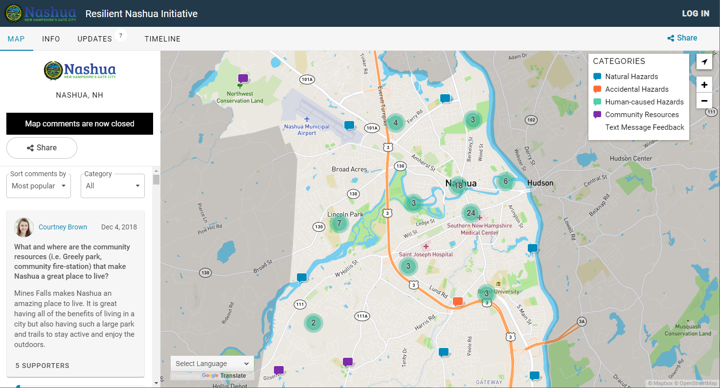
Case Study - Building Resilience
Resilient Nashua (NH) Initiative
Identify acute shocks impacting the City of Nashua
Identify chronic stressors impacting the City of Nashua
Encourage diverse stakeholder dialogue through an inclusive environment
Identify opportunities to improve the City of Nashua’s resilience
CoUrbanize Crowdsourcing Map
“Government Emergency Managers can't do it alone, … there are too many complex interconnected systems. Risk reduction is only possible through multidisciplinary collaboration between public safety, community development, economic development, engineering/infrastructure, and public health … inside and outside your jurisdiction. And then you need to involve businesses (owners of the majority of the infrastructure), non-profits (disaster relief experts), and citizens (the real 1st responders in an emergency) ...” - Resilient Nashua Summit, 2018
Notes:
Crowdsourced Map (pictured) was developed to enhance opportunities for the public to participate in the hazard mitigation planning process. Residents can share hazards of concern and community resources important to the City.

Slide 19
Risk, Vulnerability, or Resilience?
Indices and indicators on Risk, Vulnerability, and Resilience can all help provide a picture of a community and support a data-driven approach to mitigating against future disasters, such as:
Investing in measures that reduce risk
Including preparedness activities that support those who may need the most help and understanding their unique needs
Developing long-term strategies that focus on building a community’s resilience
Methodologies, variables included, scale, and intended purpose can inform which is suitable for a specific application.
Notes:
The various indices and indicators available whether it be for risk, vulnerability or resilience are complimentary and can help provide the full picture of a community – the hazards for which they are at risk, who might suffer disproportionately impacted, and their relative resilience to potential hazards.
In the next sections we will cover briefly examples of indices and indicators publicly available for the Continental US. First, we will get a better understanding of how these measures are produced focusing on how FEMA developed their Community Resilience Indicator Analysis or CRIA.

Slide 20
Section 2.
How are Indices created?

Slide 21
Section 2 Topics
Index vs. Indicator
Examples of Indices and Indicators
Detail how FEMA identified commonly used community resilience indicators in multiple indices to develop the Community Resilience Indicator Analysis (CRIA)
Notes:
Notice to Congress: Monthly Updates on Flood Mapping 2019 (https://www.fema.gov/flood-maps/guidance-reports/congress-notice/2019)

Slide 22
Index vs. Indicator
An index is an aggregate of two or more indicators
An indicator provides a measure of a concept that is less directly quantifiable (a community’s relative resilience) but correlates to the concept.
ReviseSociology (https://revisesociology.com/)
Notes:
Index
A combination of indicators into a single score is called an index https://www.qualityresearchinternational.com/socialresearch/indicator.htm#index
Indicator
Excerpt:
…concept of a link between a factor in the environment and a health outcome
Indicators thus give data added value by converting them into information which is of direct use to the decision-maker, helping to shed light on a problem. They have become well-established and are widely used in many fields, from economics to ecology to health, and can be used at the global, regional, national, local or neighborhood levels, as well as at the sectoral level (23).
Source: von Schirnding, Yasmin. “Health in Sustainable Development Planning: The Role of Indicators.” World Health Organization, World Health Organization, 6 Dec. 2010, (https://apps.who.int/handle/10665/67391).
Additional Topics:
Composite Versus ‘Single Variable’ Indicators
1) Some of the indicators are ‘composite’ indicators – which are formed when individual indicators are combined into a single index
single variable’ indicators just measure one thing.
Source: “Seminar on the Role of National Statistical Offices in the Production of Leading, Composite and Sentiment Indicators.” UNECE, United Nations Economic Commission for Europe, 2017, https://unece.org/statistics/events/seminar-role-national-statistical-offices-production-leading-composite-and.
Direct Link - https://unece.org/fileadmin/DAM/stats/documents/ece/ces/ge.42/2017/Seminar/Chapter_3_-_Typology_of_indicators_2017.05.18_-_for_seminar.pdf
2) … reasons for considering both composite and single indicators of development are that while composite indicators crunch more data into a single figure, and thus allow you to make more ‘in-depth’ snap-shot comparisons, single numbers simply don’t give you a sense of the real difference between countries, so these are necessary to highlight the extent of the difference between countries in terms of economic, social and political development, or lack of it.
Source: Thompson, Karl. “What Are the Most Useful Indicators of Development?” ReviseSociology, 19 July 2017, (https://revisesociology.com/2017/07/23/most-useful-indicators-development/).

Slide 23
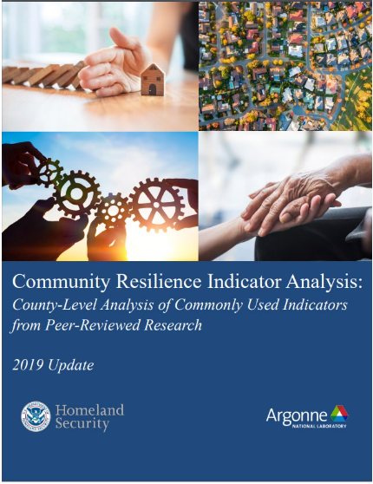
Community Resilience Indicator Analysis:
Background
In 2018, the Federal Emergency Management Agency (FEMA) National Integration Center (NIC) Technical Assistance (TA) Branch tasked Argonne National Laboratory (Argonne) with analyzing current community resilience research to provide a data-driven basis to prioritize locations for TA investment and to inform community resilience–related TA content.
Argonne’s analysis identified 20 commonly used indicators from peer-reviewed research. Fifteen of the 20 indicators use the American Community Survey 5-year average.
Notes:
American Community Survey (ACS) is different from the decennial census. It asked more questions to provide information about education housing jobs and more. The ACS is conducted each month in order to provide current information to communities every year. Communities depend on information from this survey to decide where schools highways hospitals and other important services are needed by law. Both the 2020 census and the ACS provide critical information that is used by businesses to provide goods and services as well as by local state tribal and federal government to provide support and assistance for individuals and communities.
Data for each community collected through the ACS can be found on the Census website through tables and reports. In the self-guided tutorials that accompany this module, we provide information on other ways to leverage ACS data for analysis.

Slide 24
5-Step Methodology to Identify and Map Commonly Used Indicators of Community Resilience
1
2
3
Conducted Literature Review of Meta-Analyses
Cataloged 73 Distinct Methodologies/ Indices
Created and Applied Inclusion Criteria
County-level
Generalized hazard risk
Pre-disaster focus
Quantitative
Public methodology
Public data
4
5
Binned Indicator Data for Visual Display
Identified 20
Commonly Used
Indicators
Analysis and Recommendation
The National Integration Center (NIC) – Community Resilience Indicator Analysis
Notes:
CRIA was developed using a five-step process to identify commonly used indicators from current community resilience research. Indicators, as referenced here, are quantitative datasets describing the inherent characteristics of a community that contribute to disaster resilience.
Shown here is the high-level methodology in which Commonly used indicators were identified and mapped.
In Step 1, The research team conducted a literature review to identify peer-reviewed meta-analyses from the previous 5 years of different methodologies that measure community resilience to disasters. The literature review identified six meta-analysis.
Step 2. Next, the research team reviewed the six meta-analyses to catalog each distinct assessment methodology they referenced, ultimately identifying 73 distinct methodologies cited in the research.
Step 3. Argonne then reviewed these 73 methodologies and retained those that met the following criteria listed in the light blue. Applying these criteria narrowed the pool of methodologies to eight.
Step 4. This process identified 20 indicators that were found in 3 or more methodologies which suggests researchers have all come to agree these or important factors to resilience.

Slide 25
Meta-Analyses
A study of studies. Combining and analyzing data from more than one study at once.
– Scientific American
This search identified eight relevant methodologies:
Australian National Disaster Resilience Index (ANDRI)
Baseline Resilience Indicators for Communities (BRIC)
Community Disaster Resilience Index (CDRI)
Community Resilience Index (CRI2)
Disaster Resilience of Place (DROP)
Resilient Capacity Index (RCI)
Social Vulnerability Index (SVI)
The Composite Resilience Index (TCRI)
Notes:
This is a very simplified definition of meta-analysis. This type of research methodology is well known in the health field to assess the clinical effectiveness of healthcare interventions from independent trials.
Using this process, the research team to conducted a literature review and were able to identify meta-analyses of peer-reviewed community resilience assessment methodologies published within the past five years.
This search identified six relevant meta-analyses. In those six relevant analysis listed here, there were 73 citations
Definition Sources:
Bastian, Hilda. “5 Key Things to Know about Meta-Analysis.” Scientific American Blog Network, Scientific American, 20 Jan. 2014, (https://blogs.scientificamerican.com/absolutely-maybe/5-key-things-to-know-about-meta-analysis/).
Iain K Crombie PhD FFPHM Professor of Public Health, University of Dundee; Huw TO Davies PhD Professor of Health Care Policy and Management, University of St Andrews, (https://www.dundee.ac.uk/people/iain-Crombie)

Slide 26
Commonly Used Indicators
Population-Focused Indicators (11) | Number of Methodologies in Which the Indicator is Used
Educational Attainment (lack of HS diploma) | 7
Unemployment | 7
Disability | 6
English Language Proficiency | 6
Home Ownership | 6
Mobility (lack of vehicle) | 6
Age | 5
Household Income | 5
Income Inequality | 4
Health Insurance | 4
Single-Parent Households | 3
Within the eight methodologies, identified 100 unique indicators.
Narrowed down to 20 that met the following criteria:
County-level
Generalized hazard risk
Pre-disaster focus
Quantitative
Public methodology
Public data
Community-Focused Indicators (9) | Number of Methodologies in Which the Indicator is Used
Connection to Civic and Social Organizations | 6
Hospital Capacity | 5
Medical Professional Capacity | 5
Affiliation with a Religion | 4
Presence of Mobile Homes | 4
Public School Capacity | 4
Population Change | 4
Hotel/Motel Capacity | 3
Rental Property Capacity | 3
Notes:
Next, the research team reviewed the set of eight community resilience methodologies and cataloged all of the indicators used in these methodologies, which came to more than 100 unique indicators. Using the inclusion criteria listed here, the team narrowed down the methodologies to 8. Then, after using the criteria to narrow down to 8 methodologies, they selected all indicators that were found in at least 3 of the methodologies.
The use of an indicator in three or more methodologies suggests areas where researchers have coalesced on an indicator’s importance relative to resilience. This process identified 20 indicators: 11 that are population focused and 9 that are community focused.
they used a unit of analysis that corresponded to U.S. county-level data – ideal for national level analysis
applied to multiple hazards – this ruled out methodologies that focused on one specific hazard
had a pre-disaster focus – methods of pre-disaster assessments of resilience vs how well a community rebounded after. This is because the FEMA NIC Technical Assistance supports communities with building resilience prior to a disaster.
used quantitative measures – for easy comparison across methodologies
used a publicly available methodology and used publicly available data sources – to ensure transparency, replicability, and allow for updates over time.

Slide 27
Population-Focused Resilience Indicators
11 Population-Focused Indicators and Metric Used
Educational Attainment: % population over 25 without high school diploma
Unemployment Rate: % of labor force unemployed
Disability: % of population with a disability
English Language Proficiency: % limited English-speaking households
Mobility: % of occupied housing units with no vehicles available
Home Ownership: % owner-occupied housing units
Age: % of population 65 years and over
Household Income: Median household income
Income Inequality: Gini Index
Health Insurance: % of population with no health insurance coverage (private or public)
Single-parent Households: % of single-parent households
Notes:
Population-related measures describe attributes that would influence an individual’s ability to cope with disasters (e.g., age, income, employment).
The data source for many indicators is the U.S. Census Bureau American Community Survey (ACS) five year estimate. The primary advantage of using multiyear estimates is the increased statistical reliability of the data compared with that of single-year estimates, particularly for small geographic areas and small population subgroups

Slide 28
Population-Focused Resilience Indicators
Indicator
Lack of High School Diploma
Unemployment Rate
Disability
English Language Proficiency
Home Ownership
Age 65 and Older
Mobility – Lack of Vehicle
Median Household Income
Income Inequality: Gini Index
Health Insurance
Single-parent Households
Connections to Resilience
Effective communication interactions in the event of a disaster; better access to community resources
… support their livelihoods and provides critical mobility to adapt to the extreme circumstances of a disaster
Population Data Sources: U.S. Census Bureau county and census tract data; ACS five-year estimates
Notes:
Population-related measures describe attributes that would influence an individual’s ability to cope with disasters (e.g., age, income, employment). (US Census)
The data source for many indicators is the U.S. Census Bureau American Community Survey (ACS) five-year estimate. The primary advantage of using multiyear estimates is the increased statistical reliability of the data compared with that of single-year estimates, particularly for small geographic areas and small population subgroups.
Potential Interactive Portion: Solicit ideas for how some of the remaining Indicators may be connected to Resilience.
Median household income - ability to withstand outages in banking services/access to funds, unemployment.
Home ownership - increased investment in safety solutions e.g. fire alarms, security systems, etc.
The Gini Index is a summary measure of income inequality. The Gini coefficient incorporates the detailed shares data into a single statistic, which summarizes the dispersion of income across the entire income distribution. The Gini coefficient ranges from 0, indicating perfect equality (where everyone receives an equal share), to 1, perfect inequality (where only one recipient or group of recipients receives all the income). The Gini is based on the difference between the Lorenz curve (the observed cumulative income distribution) and the notion of a perfectly equal income distribution. (US Census)
https://www.census.gov/topics/income-poverty/income-inequality/about/metrics/gini-index.html

Slide 29
Community-Focused Resilience Indicators
9 Community-Focused Indicators and Metric Used
Connection to Civic and Social Organizations: # of organizations per 10,000 people
Hospital Capacity: # of hospitals per 10,000 people
Medical Professional Capacity: # of health diagnosing and treating practitioners per 1,000 people
Affiliation with a Religion: % of population that are religious adherents
Mobile Homes: % of mobile homes
Population Change: % change in residents who have lived in same county for more than 5 years
Public School Capacity: # of public schools per 5,000 population
Hotel/Motel Capacity: # of hotels/motels per 5,000 population
Rental Property Capacity: % vacant rental housing units
Notes:
Community-related measures are qualities inherent to the local community environment that could enhance or detract from the community’s ability to prepare for, respond to, or recover from a disaster (e.g., presence of civic associations, hospitals, mobile homes).

Slide 30
Community-Focused Resilience Indicators
Indicator
Connection to Civic and Social Organizations
Hospital Capacity
Medical Professional Capacity
Affiliation with a Religion
Mobile Homes
Population Change
Public School Capacity
Hotel/Motel Capacity
Rental Property Capacity
Connections to Resilience
… can be used as a proxy measure for social connectedness
… may mean that individuals have to leave an area, making recovery from a disaster more difficult
Population Data Sources: U.S. Census Bureau county and census tract data; ACS five-year estimates
Notes:
Community-related measures are qualities inherent to the local community environment that could enhance or detract from the community’s ability to prepare for, respond to, or recover from a disaster (e.g., presence of civic associations, hospitals, mobile homes).
Potential Interactive Portion: Solicit ideas for how some of the remaining Indicators may be connected to Resilience.
Example Responses
Connection to Civic and Social Organizations - the level of civic infrastructure through which residents support their communities
Hospital Capacity - represents the capacity of the healthcare system to support residents’ overall health as well as to provide critical emergency medical care
Medical Professional Capacity - Physicians are a critical emergency resource in the response to and recovery from a disaster.
Mobile Homes - he lower-quality construction of these homes and lack of basements, which makes them particularly susceptible to damage from hazards; frequently found outside of metropolitan areas that may not be readily accessible by interstate highways or public transportation
Population Change - Communities where large numbers of residents have lived for extended periods are likely to have strong place attachment, be invested in the well-being of the community before a disaster, and willing to respond to revitalize a community after a disaster.
Public School Capacity - represent the community’s ability to provide safe shelter for individuals and facilitate evacuations
Rental Property Capacity - could does denote a lack of physical capacity to house individuals who have been displaced by a disaster

Slide 31
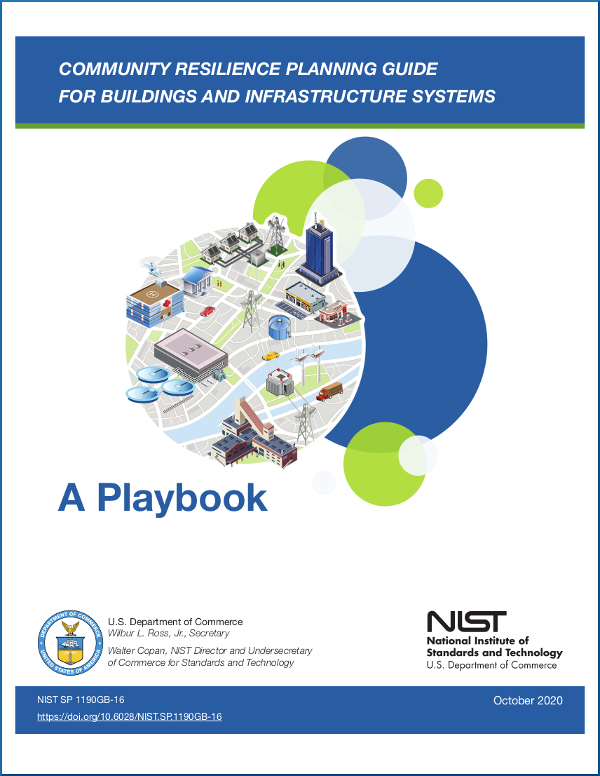
Community Functions
Qualities inherent to the local community environment that could enhance or detract from the community’s ability to prepare for, respond to, or recover from a disaster, i.e., presence of civic associations, hospitals, mobile home.
National Institute of Standards and Technology (NIST) Community Resilience Program:
Developing science-based tools and guidance for engaging community stakeholders.
Planning Guide focuses on the buildings and infrastructure systems, the function and services that support the community and underpin the social and economic fabric of their community.
Define ‘Social functions’ as those that address the needs of individuals and social institutions, such as government, health care, manufacturers, retail and service businesses, faith-based and nonprofit organizations, educational institutions, day care centers, finance, and news media.
Data, Information, and Tools Needed for Community Resilience Planning and Decision-Making (https://nvlpubs.nist.gov/nistpubs/specialpublications/NIST.SP.1240.pdf)
Notes:
The 2020 Community Resilience Indicator Analysis update describes community functions as the “Qualities inherent to the local community environment that could enhance or detract from the community’s ability to prepare for, respond to, or recover from a disaster, i.e., presence of civic associations, hospitals, mobile home.”
This concept of community focused measures as an indicator of resilience and the need for a data-driven and science-based approach is found in programs like the NIST Community Resilience Program which is developing science-based tools and guidance. The Playbook for example is an approach that is intended to compliment programs like Hazard Mitigation Planning focusing on the built environment and how it supports community social and economic functions.
Community resilience requires understanding of the community social and economic needs to determine when its buildings and infrastructure systems need to recover their functions to support community recovery without major disruption.
connections and dependencies between the built environment and social and economic systems present in the community
"Action 2-3: Characterize the community social functions and dependencies. The planning team should inventory and describe the various social dimensions of the community and the functions provided for residents, including vital services, important social and economic institutions, and characteristics that make the community desirable to residents and businesses.
Identifying social functions and dependencies, as well as key contacts or representatives who can provide information about social and economic institutions and decision making, is essential. Social functions address the needs of individuals and social institutions, such as government, health care, manufacturers, retail and service businesses, faith-based and nonprofit organizations, educational institutions, day care centers, finance, and news media. Much of the information may already be contained in existing planning documents."

Slide 32
Section 3.
Overview of GIS and Mapping Technology

Slide 33
Section 3 Topics
What is GIS?
What makes GIS so special?
GIS Data Types
GIS Products

Slide 34
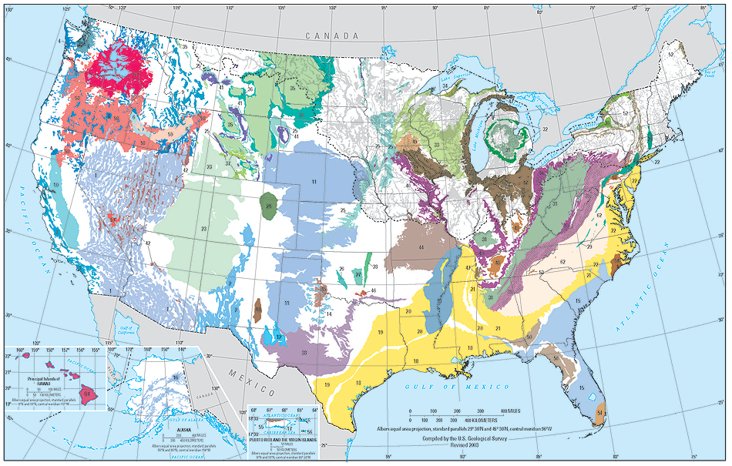
What is GIS?
GIS stands for Geographic Information Systems.
GIS is an information system that understands location.
It’s much more than a map; a true GIS is intelligent and interactive.
Why? Because of two universal characteristics that make GIS a unique information system…
Notes:
Image Source: https://www.usgs.gov/mission-areas/water-resources/science/principal-aquifers-united-states

Slide 35
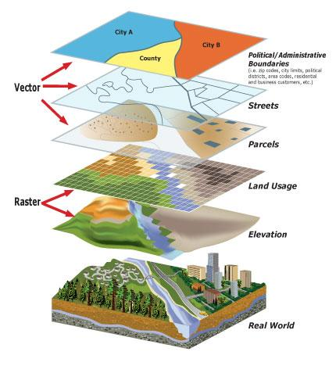
What Makes GIS So Special?
1. GIS is layer-centric.
Map projects are built with layers of data. Each of these layers can be stored in a standard relational database management system (RDBMS). In this way, a GIS combines the visual benefit of a map with the power of a database. Data can include:
Basemaps
Roads/Infrastructure
Land use/Land cover
Environment
Weather information
Vehicle locations
Notes:
First, GIS is layer-centric. This means that seemingly disparate information about a given geography can be overlayed, visualized, and analyzed.
Image Source: https://www.newbergoregon.gov/engineering/page/about-newberg-gis

Slide 36
What Makes GIS So Special?
2. GIS is more than a map; its spatial analysis.
In a map project, GIS sorts all these different types of data by their common geography. This is what gives GIS its distinctive analytic ability. Because information can be organized by a specific place on the earth, you can see relationships between otherwise disparate datasets. GIS provides you with the type of situational awareness that enhances incident-level decision making and saves lives.
Notes:
Second, is the power of that analysis. GIS allows you to see relationships that could otherwise go overlooked. GIS allows for very complex modeling in both the spatial and temporal dimensions.
Definition Source: https://www.napsgfoundation.org/carat/gis-basics/
Image Source: https://data.nal.usda.gov/dataset/ssn-stars-tools-spatial-statistical-modeling-stream-networks

Slide 37
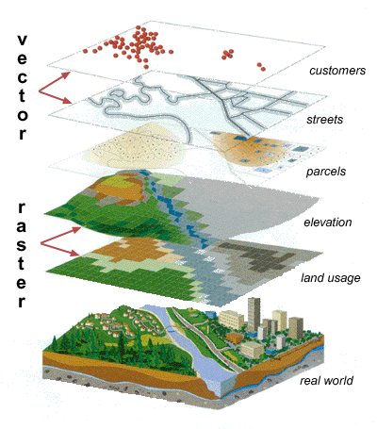
GIS Data Types
Vector data are spatial features (points, lines, and polygons) with associated attributes (descriptive information) about those data pieces.
Raster (or grid) data are matrices of numbers stored as electronic images (e.g., pictures taken as an aerial photograph, satellite images, digital elevation models).
Notes:
A simplified way of understanding the different types of GIS data is that Vector data is discrete – a point on a map like a single cell tower, a line representing a street, or a polygon could be a city boundary.
A Raster is continuous, think of the pixels that make up of photograph. A raster could be a satellite image or LiDAR (think laser light pulses pointed at the earth to collect topography (map the land) or bathymetry (penetrates water to map the sea floor). These pixels each represent information like vegetation or elevation.
Image: https://www.cherokeecounty.iowa.gov/offices/gis/index.htm

Slide 38
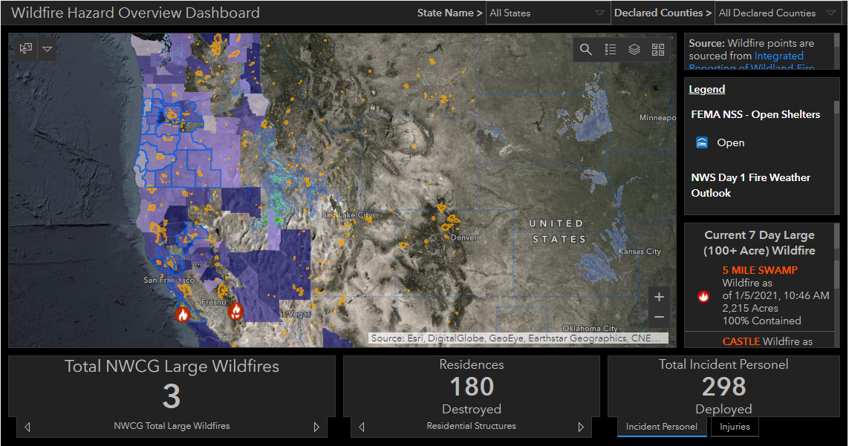
GIS Products
GIS products are evolving.
Complex geospatial analysis is being packaged into products that non-technical, non-GIS people can leverage:
Real time information
FEMA Lifeline Dashboards (https://www.arcgis.com/apps/MinimalGallery/index.html?appid=f5d016d2cf6a4ea9941740ab28e8ac04)
FEMA Wildfire Dashboards (https://gis-fema.hub.arcgis.com/pages/wildfires)
Crowdsourced information
NAPSG Disasters Crowdsourced Photos (https://2020-crowdsourced-disaster-photos-napsg.hub.arcgis.com/)
Notes:
There is a lot more to GIS. What is important is that you do not have to be a GIS professional to benefit from geospatial data or analysis. The outputs of vigorous data collection and complex models are getting served up to support workflows by other professionals and the public seeking to understand more about their communities and their risk for hazards.
Examples:
One superpower of GIS is that it can connect directly to live data streams. Think about how your car navigation is consuming real-time road closures. FEMA has adopted the Community Lifelines Construct to focus response and recovery efforts to stabilizing critical infrastructure to help prioritize actions following a disaster. While it is important to know where infrastructure is that could be impacted, it is more critical to know the status of the Wastewater Treatment Plant. You can view FEMA’s dashboards that are pulling in these types of real-time data.
The second example is NAPSG’s Crowdsourced Photos. Geospatial volunteers map images from social media and from news outlets giving emergency managers and first responders very early situational awareness in the after-math of a disaster as well as data points supporting disaster declarations and validate models.

Slide 39
Section 4.
Review of Available Indices and Tools

Slide 40
Section 4 Topics
FEMA’s Community Resilience Indicator Analysis (CRIA)
CDC Social Vulnerability Index (SVI)
Social Vulnerability Index for the United States (SoVI)
Baseline Resilience Indicators for Communities (BRIC)
National Risk Index (NRI)
Additional Indices and Resources
Notes:
There are numerous indices available to support risk, vulnerability, and resilience analysis. We will provide a brief introduction into these 5 specifically which are freely available, national in coverage, and do not focus on a specific hazard.
The goal of this section is to show the myriad of data and analysis available to support a data-driven approach to preparedness planning through response and recovery.
Instructor Notes: These slides can be reviewed in detail or gone over at a high-level and simply provided as a resource. Alternatively, the NAPSG Guidance on Risk, Resilience, and Vulnerability Indices can be used as an interactive way to review the content in this section. Guidance Link: https://experience.arcgis.com/experience/376770c1113943b6b5f6b58ff1c2fb5c%20

Slide 41
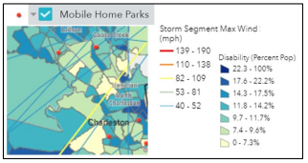
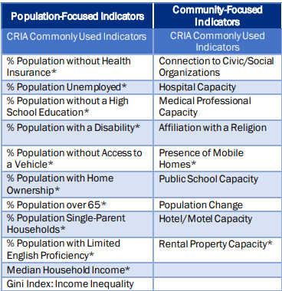
Community Resilience Indicator Analysis (CRIA)
Objective: Community Resilience
Owner: FEMA National Integration Center (NIC) – Argonne National Lab
Brief Description: CRIA is the underlying data for the FEMA Resilience Analysis and Planning Tool (RAPT). FEMA and Argonne National Laboratory (Argonne) created RAPT to support state, local, tribal, territorial analysis in identifying focus areas for building resilience and response capabilities. CRIA allows emergency managers to see demographic characteristics that could increase or decrease a community’s ability to cope with disasters.
Coverage: CONUS, Alaska, Hawaii, & Puerto Rico
Granularity: County
Access Data: Data download via Shapefile or Feature Layer Rest Service.
RAPT (http://fema.maps.arcgis.com/apps/webappviewer/index.html?id=90c0c996a5e242a79345cdbc5f758fc6)
AGOL Group (https://fema.maps.arcgis.com/home/group.html?id=f8d7324e880444f8b79d1a3f03035561&view=list#content)
Analysis: FEMA and Argonne conducted analysis of peer-reviewed research and identified 20 commonly used community resilience indicators, 11 with a population focus and 9 with a community focus.

Slide 42
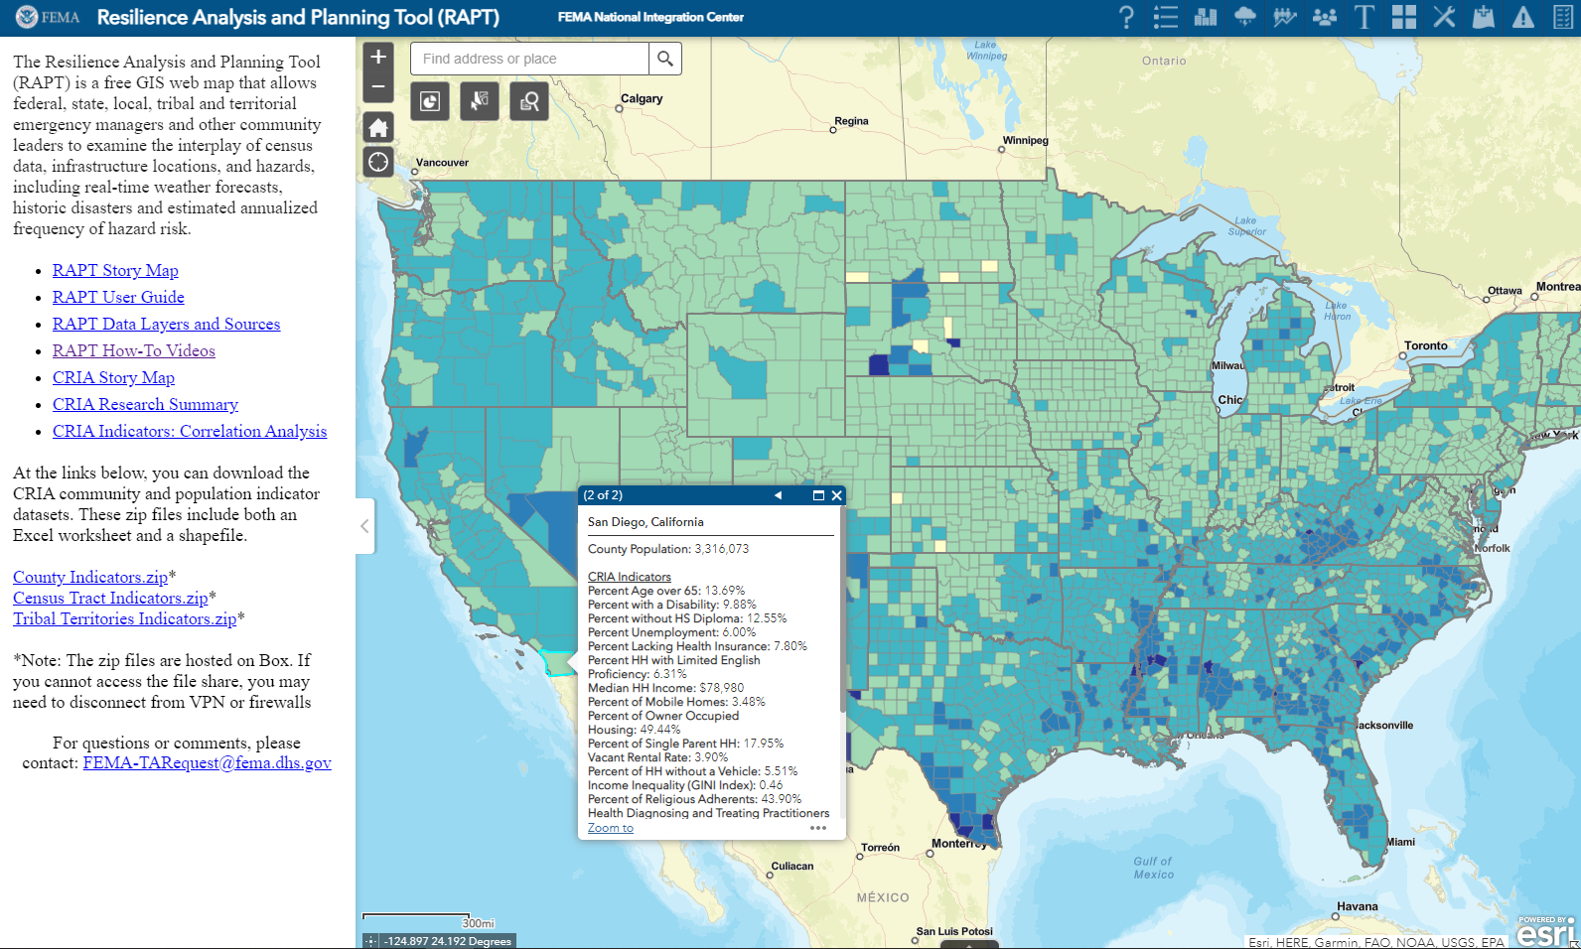
Community Resilience Indicator Analysis (CRIA)
Output: CRIA provides a relative assessment of a community's resilience and gives insights into community characteristics from which to build emergency operations plans and targeted outreach strategies.
Target Audience: State, Regional or Federal Level government, Emergency Planning Personnel
How does the data steward envision individuals to use the data?
Inform community resilience, response, and recovery planning
Support to emergency managers:
Helps inform capability targets for THIRA/SPR, exercises, and Emergency Operations Plans
Provide real-time analysis of severe weather events
Help prioritize recovery strategies
Why was the index developed?
In 2018, FEMA’s National Integration Center (NIC) Technical Assistance (TA) Branch tasked Argonne National Laboratory (Argonne) with analyzing current community resilience research to provide a data-driven basis to prioritize locations for TA investment and to inform community resilience–related TA content.
Supplemental Info:
Resilience Analysis and Planning Tool (RAPT) (https://www.fema.gov/rapt)
Resilience Analysis and Planning Tool (RAPT) (https://www.fema.gov/emergency-managers/practitioners/resilience-analysis-and-planning-tool)
Notes:
The analysis of these 20 community resilience indicators, used in multiple peer-reviewed research methodologies, has relevance for many FEMA program areas, as well as for state, local, territorial, and tribal emergency managers and other whole community partners to support initiatives across all phases of emergency management, including mitigation, preparedness, response, and recovery. By reviewing county data for these 20 indicators, emergency managers can gain insights for targeted outreach strategies and for adapting emergency operations plans to community characteristics.
CF-Rather focus on the interplay of resilience indicators, infrastructure and hazard. And focus on availability of analysis at the individual indicator level

Slide 43
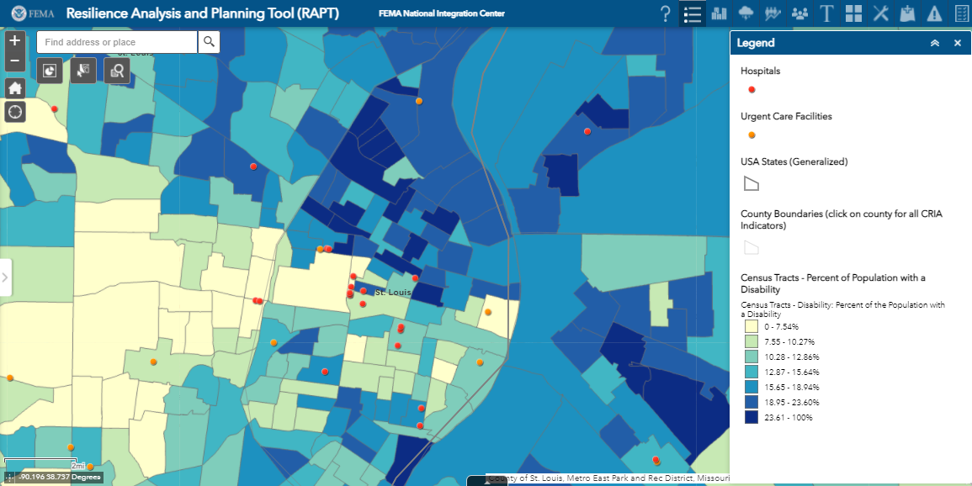
Community Resilience Indicator Analysis (CRIA)
Are hazards included in the analysis? NO. However, hazard data is available within the RAPT tool to view along with the CRIA data.
List of variables included in the analysis:
20 indicators: 11 that are population-focused and 9 that are community-focused. Population-focused measures describe attributes that influence an individual’s ability to cope with disasters (e.g., age, income, employment). Community-focused measures are qualities inherent to the local community environment that enhance or detract from the community’s ability to prepare for, respond to, or recover from a disaster (e.g., the presence of civic associations, hospitals, mobile homes).
Community-Focused:
Connection to Civic & Social Orgs
Hospital Capacity
Medical Professional Capacity
Affiliation with a Religion
Presence of Mobile Homes
Public School Capacity
Population Change
Hotel/Motel Capacity
Rental Property Capacity
Population-Focused:
Educational Attainment (lack of HS diploma)
Unemployment Rate
Disability
English Proficiency
Home Ownership
Mobility (lack of vehicle)
Age
Household Income
Income Inequality
Health Insurance
Single-parent Household

Slide 44
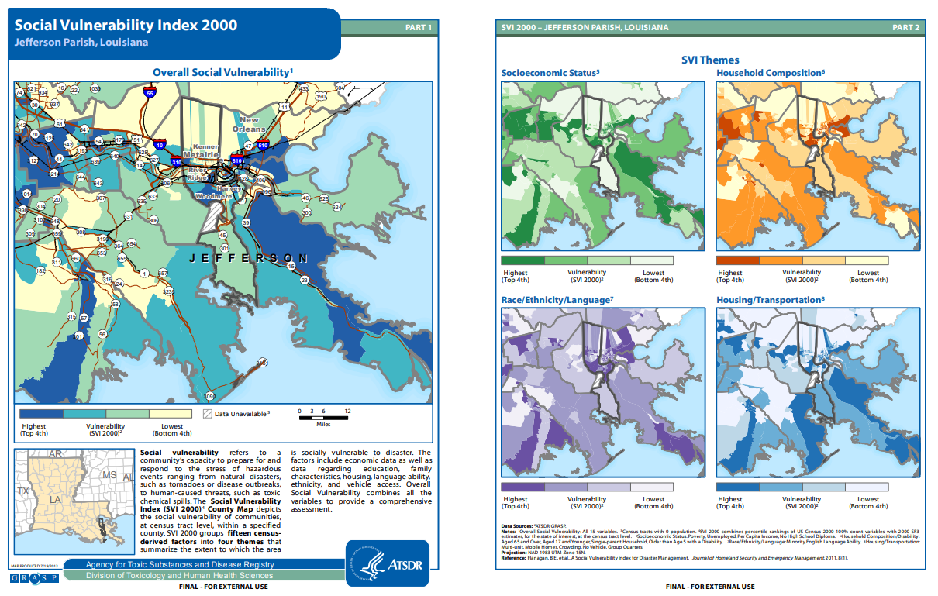
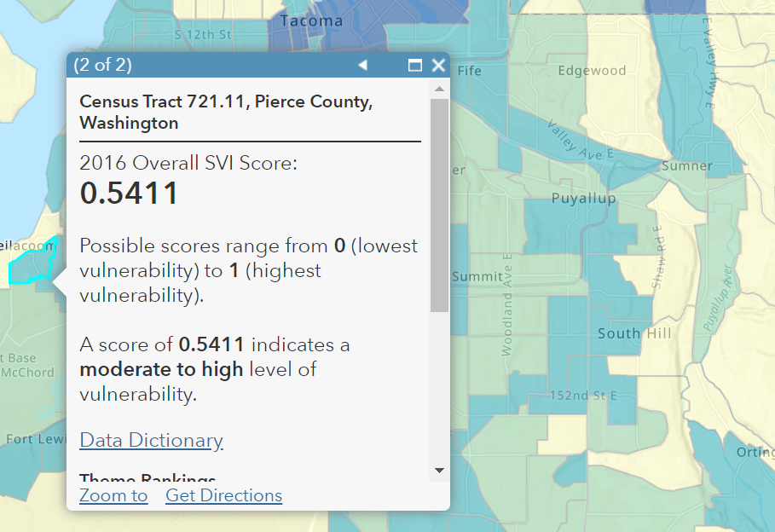
Social Vulnerability Index (SVI)
Objective: Social Vulnerability
Owner: Centers For Disease Control and Prevention (CDC)
Date Developed: 2018 update in March 2020 (updated every two years)
Brief Description: The CDC SVI measures community vulnerability to help
emergency response planners and public health officials identify and map
communities that will most likely need support before, during, and after a
hazardous event.
Coverage: CONUS, Alaska, Hawaii, & Puerto Rico
Granularity: County and Census Tract
Access Data: Download via PDF Maps, Shapefile, or CSV; (https://www.atsdr.cdc.gov/placeandhealth/svi/data_documentation_download.html)
Available as a feature layer in AGOL (https://www.arcgis.com/home/item.html?id=cbd68d9887574a10bc89ea4efe2b8087)
Analysis: The SVI ranks each tract on 15 social factors, including poverty, lack of vehicle access, and crowded housing, and groups them into four related themes. Each tract receives a separate ranking for each of the four themes, as well as an overall ranking.

Slide 45
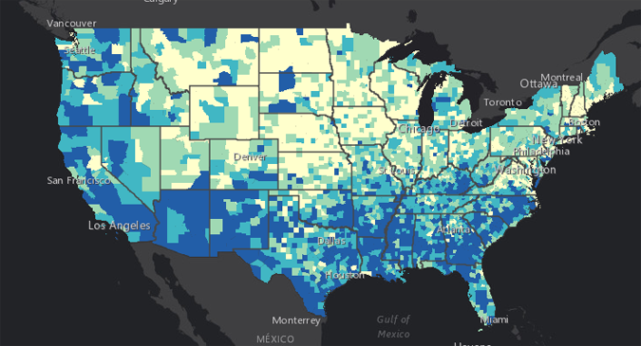
Social Vulnerability Index (SVI)
Output: The CDC SVI provides a vulnerability score between 0 (least vulnerable) to 1 (most vulnerable):
Describes areas in which the community is most socially vulnerable to disasters
Easily drill down into the sub-index level behind the social vulnerability scoring
Target Audience: Public Health Officials and Emergency Response Planners
How does the data steward envision individuals to use the data?
Allocate emergency preparedness funding by community need,
Estimate the amount and type of needed supplies like food, water, medicine, and bedding,
Decide how many emergency personnel are required to assist people,
Identify areas in need of emergency shelters,
Create a plan to evacuate people, accounting for those who have special needs, such as those without vehicles, the elderly, or people who do not understand English well, and
Identify communities that will need continued support to recover following an emergency or natural disaster.
Why was the index developed?
To identify and map the communities that will most likely need support before, during, and after a hazardous event

Slide 46
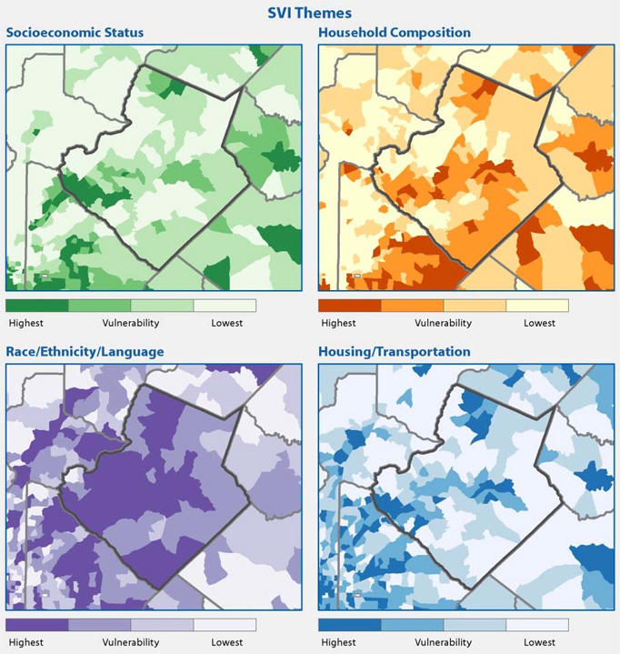
Social Vulnerability Index (SVI)
List of Social Variables Included in Analysis:
Below Poverty Level Unemployed Income No High School Diploma Aged 65 or Older
Aged 17 or Younger Older Than Age 5 with a Disability Single-parent Households Minority
Speak English "Less Than Well" Multi-Unit Structures Mobile Homes Crowding No Vehicle Group Quarters
Are hazards included in the analysis: No
Supplemental Info:
Introduction to CDC’s Social Vulnerability Index (SVI) (https://www.youtube.com/watch?v=u5m0Lb3B4UY&feature=youtu.be)
Methods for CDC’s Social Vulnerability Index (SVI) (https://www.youtube.com/watch?v=REKFHOryflA&feature=youtu.be)
CDC/ATSDR SVI Fact Sheet (https://svi.cdc.gov/factsheet.html)
CDC/ATSDR SVI Publications & Materials (https://svi.cdc.gov/publications.html)

Slide 47
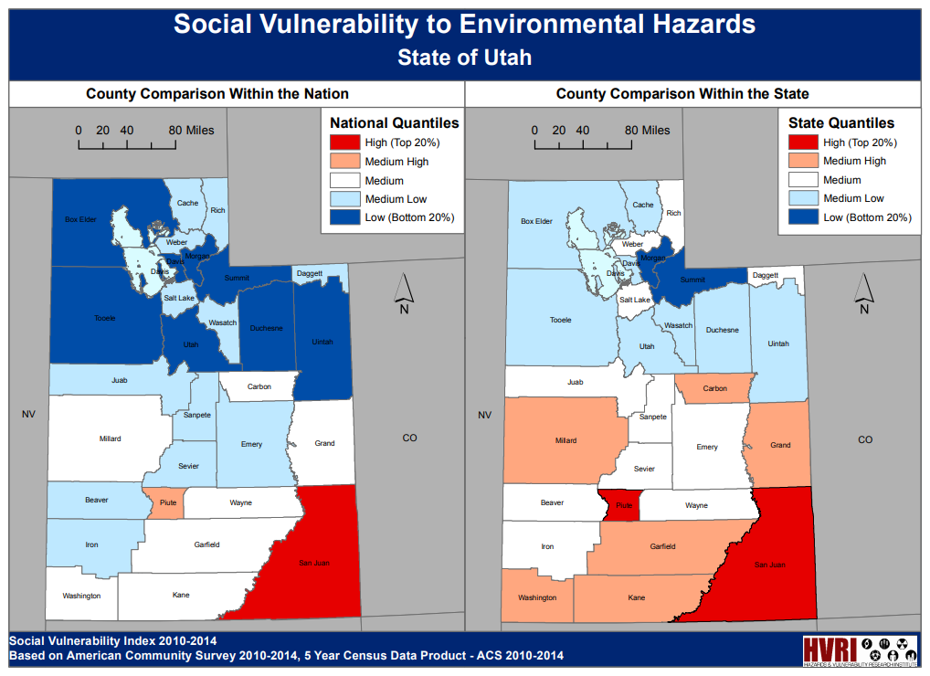
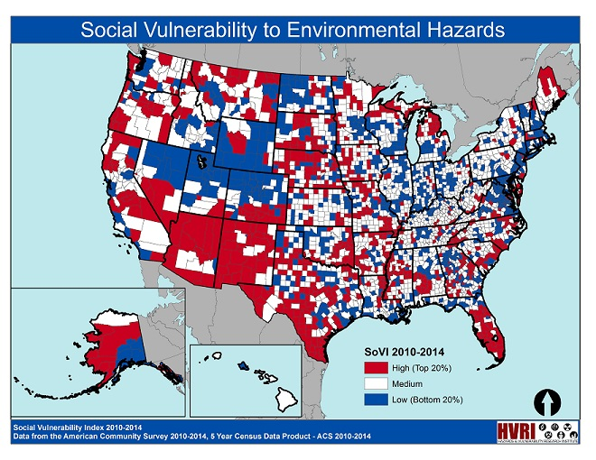
Social Vulnerability Index for the United States (SoVI)
Objective: Social Vulnerability
Owner: University of South Carolina - Hazards & Vulnerability Research Institute (HVRI)
Date Developed: 2010 - 2014
Brief Description: SoVI® measures a county's ability to prepare for, respond to, and recover from hazards in relation to other counties in that state and across the nation. The index is a comparative metric that facilitates the examination of the differences in social vulnerability among counties.
Coverage: CONUS, Alaska, & Hawaii
Granularity: County and Census Tract
Access Data: Download as PDF Maps and PDF Scores and Percentiles (http://artsandsciences.sc.edu/geog/hvri/sovi-data)
Analysis: The index synthesizes 29 socioeconomic variables, which the research literature suggests contribute to reduction in a community’s ability to prepare for, respond to, and recover from hazards. SoVI® data sources primarily include those from the United States Census Bureau.

Slide 48
Social Vulnerability Index for the United States (SoVI)
Are hazards included in the analysis: No
List of variables included in the analysis:
The index synthesizes 29 socioeconomic variables, which the research literature suggests contribute to reduction in a community’s ability to prepare for, respond to, and recover from hazards. SoVI ® data sources include primarily those from the United States Census Bureau. Hazards Vulnerability & Resilience Institute (http://artsandsciences.sc.edu/geog/hvri/faq)
In SoVI® 2010-14, eight significant components explain 78% of the variance in the data. These components include wealth; race and social status; elderly residents; Hispanic ethnicity and residents without health insurance; special needs individuals; service industry employment; Native American populations; and gender. Detailed information on these components can be found here in PDF format: Hazards Vulnerability & Resilience Institute (http://artsandsciences.sc.edu/geog/hvri/sites/sc.edu.geog.hvri/files/attachments/Us_County_SoVI_10_14_Readme.pdf#overlay-context=sovi%25C2%25AE-0)
Median gross rent for renter-occupied housing units Median Age Median dollar value of owner-occupied housing units Per capita income Average number of people per household % Population under 5 years or over age 65 % Asian Population | % African-American Population % Civilian labor force unemployed % Population over 25 with less than 12 years of education % Population speaking English as a second language with limited English proficiency % Employment in extractive industries (fishing, farming, mining, etc.) % Children living in married couple families % Female | % Female participation in the labor force % Families with female-headed households with no spouse present % Hispanic population % Population living in mobile homes % Native American population % Housing unit with no car available % Population living in nursing facilities | % Persons living in poverty % Renter-occupied housing units % Families earning more than $200,000 per year % Employment in service occupations % Households receiving Social Security benefits % Unoccupied housing units % population without health insurance (COUNTY SoVI® ONLY) Community hospitals per capita (COUNTY SoVI® ONLY)

Slide 49
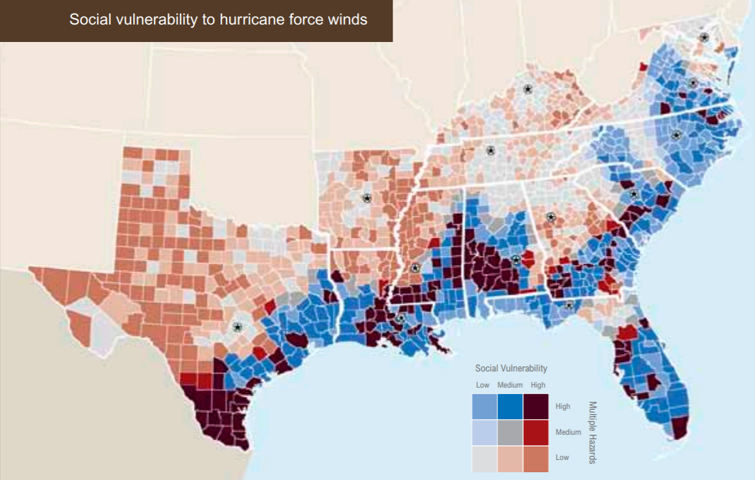
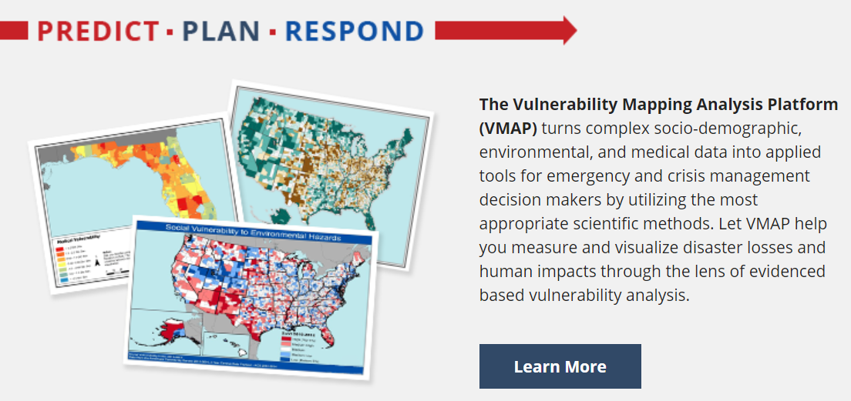
Social Vulnerability Index for the United States (SoVI)
Output: SoVI® provides a comparative social vulnerability score that enables user to:
Compare the social vulnerability among counties and census tracts within the state and within the nation
Compare or track social vulnerability changes over time
Supplemental Info:
Variables (http://artsandsciences.sc.edu/geog/hvri/faq)
Variables (http://artsandsciences.sc.edu/geog/hvri/sovi%C2%AE-0)
Applications:
Exposed: Vulnerability and Climate Change in the US Southeast, Oxfam America (https://www.oxfamamerica.org/explore/research-publications/exposed-social-vulnerability-and-climate-change-in-the-us-southeast/)
The Public Health Vulnerability Mapping System, Centers for Disease Control and Prevention & the Agency for Toxic Substances and Disease Registry (https://svi.cdc.gov/map.html)
Social Vulnerability Index-Explorer, US Army Corps of Engineers (https://www.iwr.usace.army.mil/Missions/Social-Vulnerability-Index-Explorer/)
Climate-Sensitive Hazards in Florida, HVRI for the Florida Department of Health (https://www.floridahealth.gov/environmental-health/climate-and-health/_documents/climate-sensitive-hazards-in-florida-final-report.pdf)
Vulnerability Mapping Analysis Platform, University of Central Florida (https://www.vulnerabilitymap.org/)

Slide 50
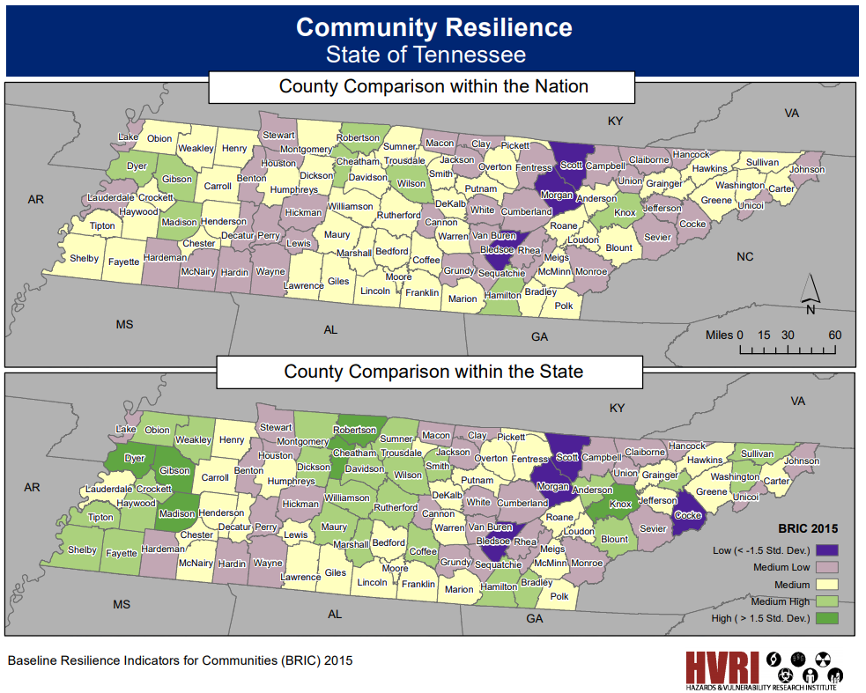
Baseline Resilience Indicators for Communities (BRIC)
Objective: Community Resilience
Owner: University of South Carolina – HVRI (same as SoVI)
Date Developed: 2015
Brief Description: BRIC describes the differences in community resilience among counties within the state and within the nation. Used as an initial baseline for monitoring existing attributes of resilience to natural hazards, BRIC can be used to compare places to one another, to determine the specific drivers of resilience for counties, and to monitor improvements in resilience over time.
Coverage: CONUS, Alaska, & Hawaii
Granularity: County
Access Data: No GIS data; only PDF maps or County List in XLS
Maps (http://artsandsciences.sc.edu/geog/hvri/bric-2015-state-maps)
County List (http://artsandsciences.sc.edu/geog/hvri/county-composite-bric-scores-download#overlay-context=front-page)
Analysis: The BRIC index considers six broad categories of community disaster resilience: social, economic, community capital, institutional, infrastructural, and environmental at the county level.

Slide 51
Baseline Resilience Indicators for Communities (BRIC)
Output: BRIC provides a comparative community resilience score that enables user to:
Compare the community resilience among counties and census tracts within the state and within the nation
Compare or track community resilience changes over time
Target Audience: Emergency Management, Emergency Planning Personnel, and Policy Makers
How does the data steward envision individuals to use the data?
To establish a baseline of resilience at a discrete point in time in order to have a starting point for monitoring progress over time and across space.
Why was this index developed?
To establish a baseline of resilience at a discrete point in time in order to have a starting point for monitoring progress over time and across space (Cutter & Derakhshan, 2018).
GEO.ID | Name | SOCIAL | ECONOMIC | INFRASTRUCTURE | COMCAPITAL | INSTITUTION | ENVIRONMENT | BRIC_2015
01001 | Autauga County, Alabama | 0.70269936 | 0.482894133 | 0.227119779 | 0.398117776 | 0.404122557 | 0.561537136 | 2.776490742
01003 | Baldwin County, Alabama | 0.674223121 | 0.438948533 | 0.257198662 | 0.349129535 | 0.414900938 | 0.603554949 | 2.737955738
01005 | Barbour County, Alabama | 0.609079725 | 0.427476785 | 0.187316249 | 0.363551932 | 0.393215778 | 0.558456987 | 2.539097456
01007 | Bibb County, Alabama | 0.6603981 | 0.44049172 | 0.143627 | 0.386563025 | 0.395962355 | 0.563335214 | 2.590377415
01009 | Blount County, Alabama | 0.682615656 | 0.472919526 | 0.17943581 | 0.389523695 | 0.392335513 | 0.551042364 | 2.667872563

Slide 52
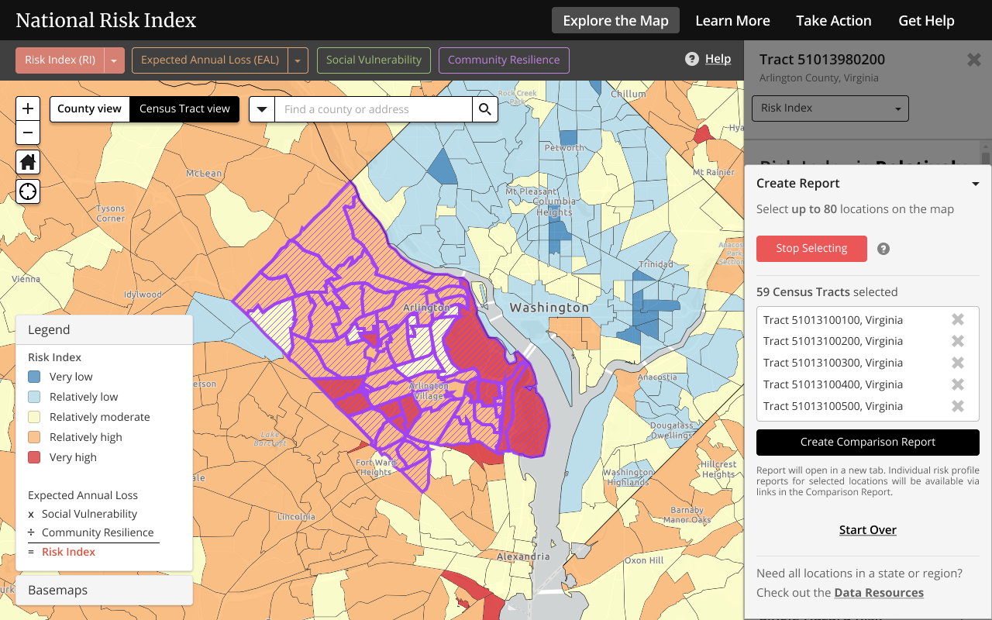
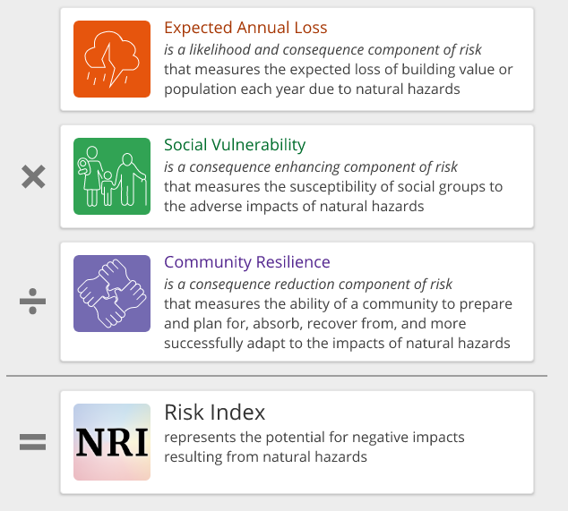
National Risk Index (NRI)
Objective: Risk, Social Vulnerability, and Community Resilience
Owner: FEMA
Date Developed: 2020
Brief Description: The National Risk Index (NRI) is an online tool to help illustrate the nation's communities most at risk of natural hazards. It incorporates three datasets (SoVI, BRIC, and Expected Annual Loss) to determine an overall risk percentage as well as risk percentages for 18 of the USA's most common natural hazards.
Coverage: CONUS, Alaska, & Hawaii Granularity: County and Census Tract
Access Data: Maps (https://hazards.geoplatform.gov/portal/apps/MapSeries/index.html?appid=ddf915a24fb24dc8863eed96bc3345f8)
Census Tracts Data: (https://hazards.geoplatform.gov/portal/home/item.html?id=e632a0478bfb4df3987ce9bec88605d2)
County Data: (https://hazards.geoplatform.gov/portal/home/item.html?id=cf60c608803e4ccd87ca13cbe40d9151)

Slide 53
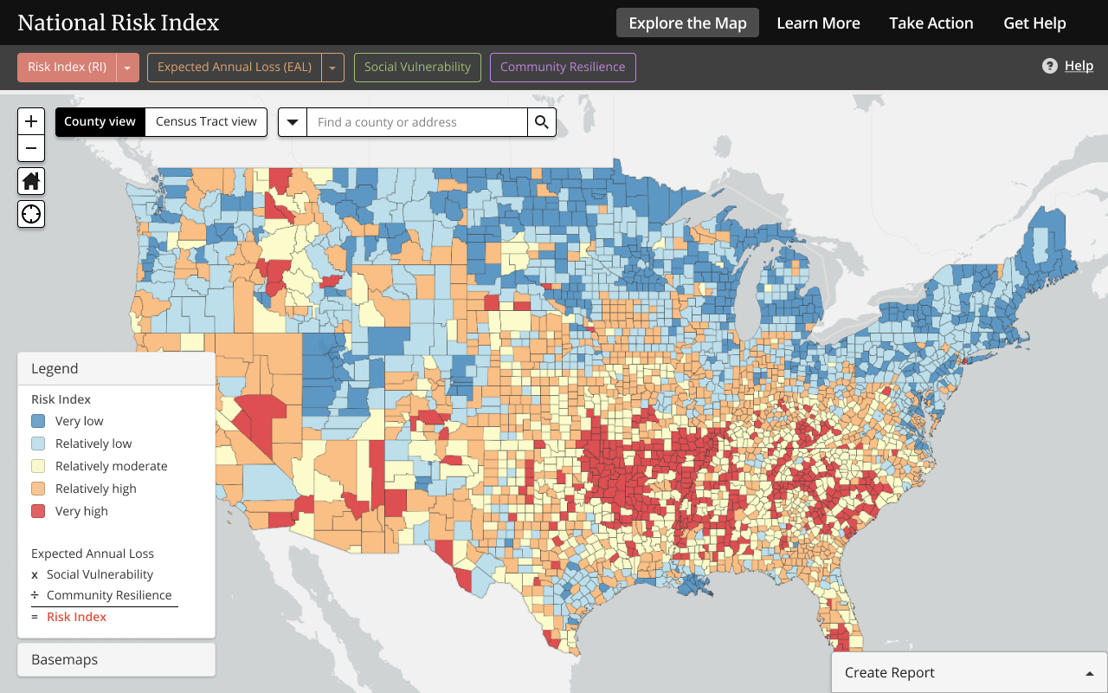
National Risk Index (NRI)
Output: The NRI uses social impact data from SoVI and BRIC, combined with potential economic loss impact estimates related to the built environment and/or agricultural properties to depict each community's risk from 18 of the most impactful natural hazards.
Target Audience: Local, State, and Federal government, Emergency Planning Personnel
How does the data steward envision individuals to use the data?
To find vulnerable areas in their community and use that information to better plan for and mitigate against natural hazards
Why was this index developed?
To help illustrate the nation's communities most at risk of natural hazards.
Are hazards included in the analysis? Yes
Avalanche, Coastal Flooding, Cold Wave, Drought, Earthquake, Hail, Heat Wave, Hurricane, Ice Storm, Riverine Flooding, Landslide, Lightning, Strong wind
Social variables: Same as BRIC and SoVI

Slide 54
Additional Indices & Resources
NAPSG Guidance on Risk Resilience, and Vulnerability Indices (https://experience.arcgis.com/experience/376770c1113943b6b5f6b58ff1c2fb5c)
Australian National Disaster Resilience Index (ANDRI) (https://www.bnhcrc.com.au/research/hazard-resilience/251)
Community Disaster Resilience Index (CDRI) (https://www.researchgate.net/profile/Walter_Peacock/publication/254862206_Final_Report_Advancing_the_Resilience_of_Coastal_Localities_10-02R/links/00b7d51feb3e3d0d4a000000.pdf)
Disaster Resilience of Place (DROP) (https://www.degruyter.com/abstract/j/jhsem.2010.7.1/jhsem.2010.7.1.1732/jhsem.2010.7.1.1732.xml)
Resilient Capacity Index (RCI) (https://www.macfound.org/networks/research-network-on-building-resilient-regions)
The Composite Resilience Index (TCRI) (https://theresilienceindex.weebly.com/our-solution.html)
PEOPLES Resilience Framework (PEOPLES) (http://peoplesresilience.org/wp-content/uploads/2013/07/2010_Renschler_PEOPLES_Resilience.pdf)
Argonne National Laboratory, Resilience Measurement Index: Indicator of Critical Infrastructure Resilience (RMI) (https://publications.anl.gov/anlpubs/2013/07/76797.pdf)
Notes:
There are numerous indices and indicators available to help communities conduct more in-depth analysis and planning. The top resource listed here is a tool available that compares the 5 indices presented in detail in this module intended to aid emergency managers, planners, and geospatial analysts in determining which may be most appropriate for a particular use.

Slide 55
Section 5.
Explore FEMA’s Resilience Analysis and Planning Tool (RAPT)

Slide 56
Section 5 Topics
Introduction to the RAPT Application
Interface
Tools and Functionality
Hand-on
Self-Guided Tutorials

Slide 57
RAPT Interface

Slide 58
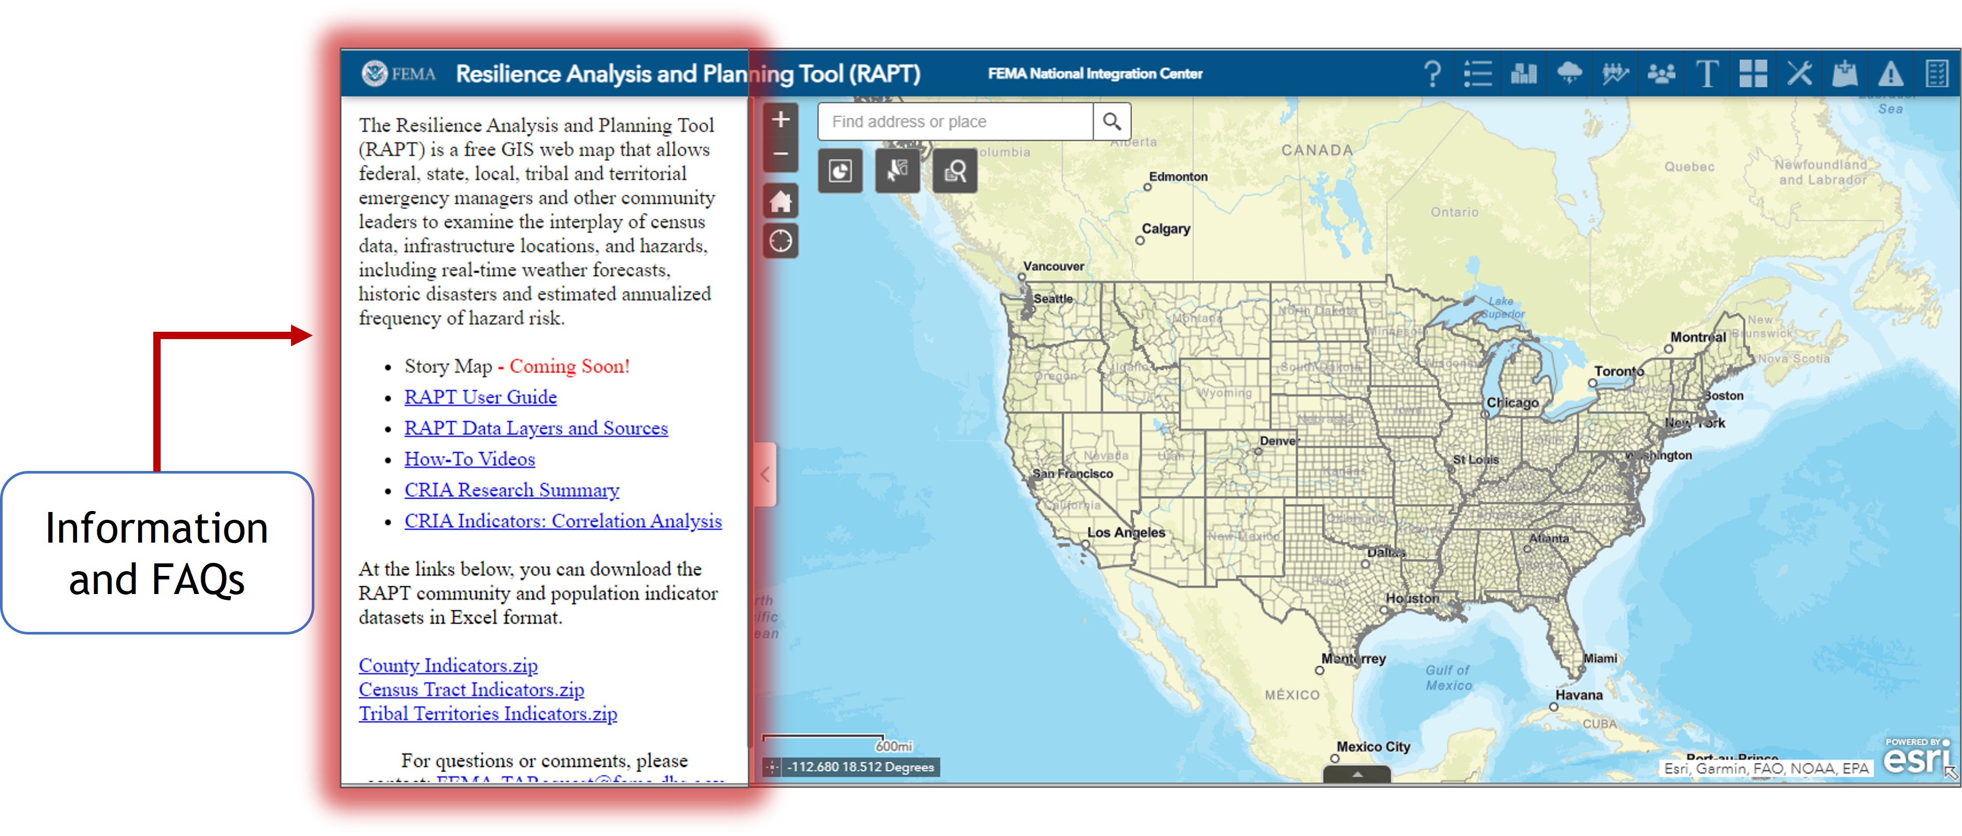
RAPT Tools
The left side of the initial screen provides Frequently Asked Questions (FAQs) and direct links to the following additional resources (all available at Resilience Analysis and Planning Tool (RAPT) | FEMA.gov [https://www.fema.gov/emergency-managers/practitioners/resilience-analysis-and-planning-tool]):
RAPT Overview: A one-page introduction to RAPT.
RAPT Data Layers and Sources: A complete list to the data layers and their sources of information.
Community Resilience Indicator Research Summary: Detailed information on each community resilience indicator, including its connection to resilience, data source, national average, and binning method.
CRIA Correlation Analysis: Describes how individual community resilience indicators may be related to each other.

Slide 59
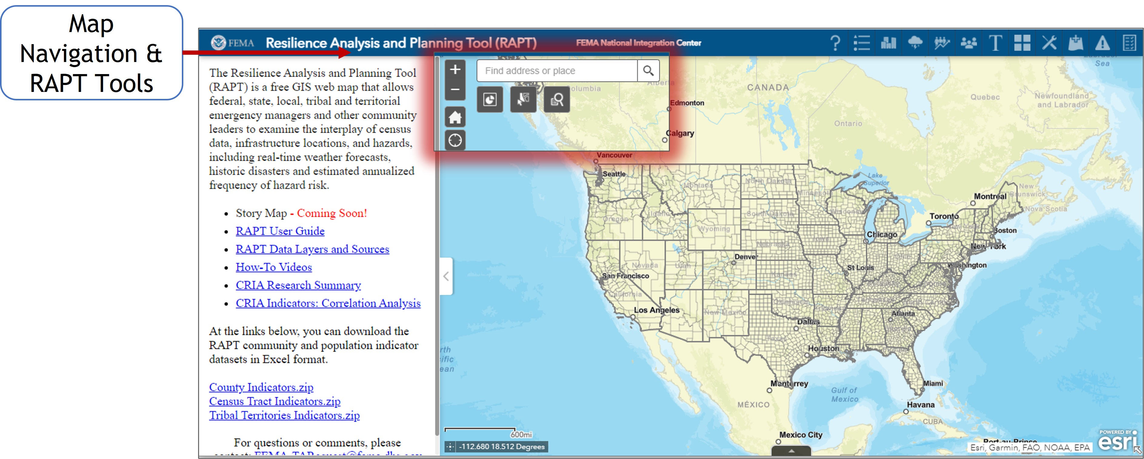
RAPT Interface
NAVIGATING THE MAP
You can move around the map and explore areas of interest. The initial view shows the continental United States, but you can move to other areas, such as Hawaii, Alaska, or Puerto Rico. Navigate with the following:
Location: Type the name of a specific county, city, or state in the search bar.
Zoom: Click the +/- boxes at the top left of the map to zoom in or out on a map location.
Home: Use the home button to bring the map back to the initial view.
Mouse: Use your mouse to move the whole map or click on a specific county.

Slide 60
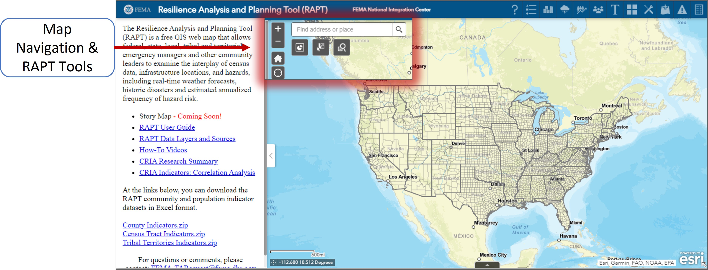
RAPT Interface
Query Tool: The Query Tool includes two different queries: The first allows you to zoom in and see all the census tracts in a specific county or state. The second provides specific information on the hospitals in a county or state, such as the trauma level.
Selection: The Selection tool allows you to select multiple infrastructure, hazard, county, or census tract datasets in a specified region (rectangle, polygon, circle etc.). The output provides a number, visual, and comprehensive list of those multiple datasets. You may export, save, or view these datasets in the Attribute Table.
Population Count: The Population Count tool calculates the total population of the census tracts that are selected by the Selection tool.

Slide 61
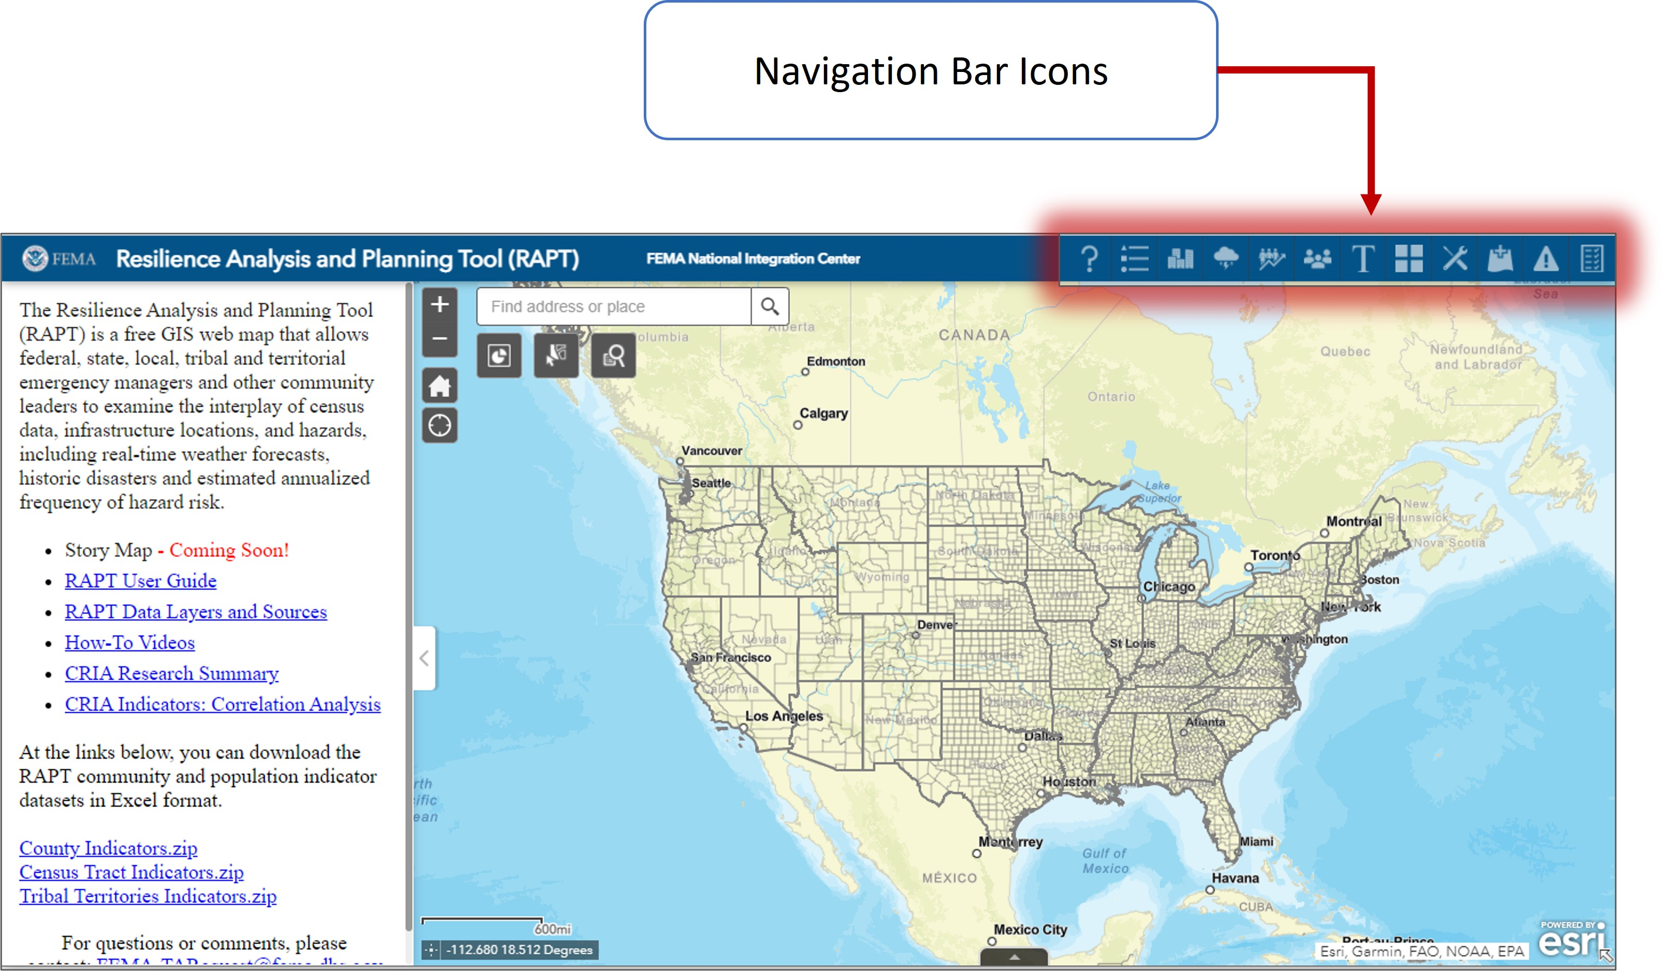
RAPT Interface
These icons are along a top navigation bar. Depending on your browser and your webpage’s zoom level, some of the icons may be hidden – in that case, you will see a “More” button to reveal the additional icons.
Frequently Asked Questions: Includes background information about the methodology behind CRIA, interface and navigation help, and where to find additional resources, Legend: Helps you keep track of all the layers (hazard, infrastructure, county and census tract indicators) you may have open on the map.
Infrastructure: Shows community infrastructure points available through the Homeland Infrastructure Foundation Level Data (HIFLD).

Slide 62
RAPT Interface
Hazards: Shows GIS layers of historical hazard data for tornadoes, tropical storms, and wildfire; risk assessments for seismic and flooding events; and real-time watch and warning notifications from the National Weather Service.
County Indicators: Includes all 20 community resilience indicator layers identified in the CRIA with data at the county level. Twelve of these indicators also have census tract data provided as a separate layer.
Census Tract Indicators: Twelve community resilience indicators are available with census tract data.

Slide 63
RAPT Interface
Basemap Gallery: The Basemap Gallery allows you to change the display of the base map. The default map is the Light Gray/Canvas; other options include satellite imagery, street maps, and terrain views. The street map view is especially helpful to assess evacuation routes, and the terrain views are useful when looking at hazards such as flood or wildfire.
Toolbox: The Toolbox opens in the upper-right corner of the screen. It contains three tools to help visualize areas on the map: Draw, Print, and Measurement.
Add Data: The Add Data tool allows you to add data to the map by searching for layers hosted on ArcGIS Online or on a Portal for ArcGIS, entering URLs to data sources, or uploading local files (appropriate data types include a zipped shapefile, KML, CSV, GPX, or GeoJSON). You can temporarily add layers to and remove layers from the map, but these layers cannot be saved to the map to be retained for future review.

Slide 64
RAPT Interface
Incident Analysis Tool: The Incident Analysis Tool allows you to create a buffer zone around an incident (single point, linear, and polygonal) and identify and visualize infrastructure entities within this zone. This tool can provide a comprehensive list and visuals of the locations of infrastructure entities within the buffer zone.
Summarize Selected Indicators Tool: The Summarize Selected Indicators Tool allows you to draw a specific shape on the map (circle, rectangle, polygon, etc.), select all the census tracts within or touching that shape, and calculate the population of individuals with specific resilience indicator characteristics (age over 65, disability, unemployment, etc.) in those selected census tracts. This tool can provide a visual and comprehensive list of census tracts located in the shape, as well as the total number of individuals with your desired indicator characteristic.

Slide 65
RAPT Interface

Slide 66
RAPT Interface

Slide 67
Hands-On
In this Hands-On Section, you will learn how to:
Select your FEMA Region
Access CRIA indicators
Locate and utilize the tools available within RAPT

Slide 68
Hands-On

Slide 69
Hands-On

Slide 70
Hands-On

Slide 71
Hands-On

Slide 72
Tutorials
Explore FEMA’s Resilience Analysis and Planning Tool (RAPT)

Slide 73
Tutorial #1
Use FEMA's Resilience Analysis and Planning Tool (RAPT) (https://www.arcgis.com/apps/webappviewer/index.html?id=90c0c996a5e242a79345cdbc5f758fc6) to develop a data-driven capability targets to support your community’s Threat and Hazard Identification and Risk Assessment (THIRA).
Scenario: The Richmond Planning District in the Commonwealth of Virginia has identified the Tornado Hazard as a high-risk in their Hazard Identification and Risk Assessment. Explore using geospatial data and analysis to give context to a hazardous event and begin identifying what core capabilities could be the most challenged under varying scenarios.
Steps:
Review a local plan to identify potential threats and hazards.
View the location of historical hazard events in RAPT identified by the local plan.
Use analytical tools in RAPT to visualize the people and built infrastructure that would be impacted by a similar event.
Explore community characteristics using the Community Resilience Indicator Analysis (CRIA) to further understand the unique challenges and planning requirements that may be required.
Overlay infrastructure and community resilience layers to view the interplay of the presence or lack of infrastructure may indicate a higher or lower relative resilience to threats and hazards.
Draft an initial description of a Tornado event that could stress your community's ability to deliver a core capability for potential inclusion in a THIRA/SPR.

Slide 74
Tutorial #2
Use FEMA's Resilience Analysis and Planning Tool (RAPT) (https://www.arcgis.com/apps/webappviewer/index.html?id=90c0c996a5e242a79345cdbc5f758fc6) to develop a targeted community outreach strategy to reach non-English speaking populations, with the goal to increase preparedness and resilience
Scenario: The County of San Diego is very diverse and has many non-English speaking populations. Use RAPT and geospatial data to explore non-English speaking communities that will need specialized preparedness outreach in various languages.
Steps:
Explore community characteristics using the Community Resilience Indicator Analysis (CRIA) to further understand the unique challenges and planning requirements that may be required.
View the locations of non-English speakers in San Diego via the Language barriers: R9 – Limited English Proficiency layer within RAPT.
Add in the US Census Bureau, ACS Language Spoken at Home Variables – Boundaries GIS data to view specifics on the various languages spoken in the community
Gather populations numbers and locations of populations that will need preparedness materials in various languages.

