Slide 1
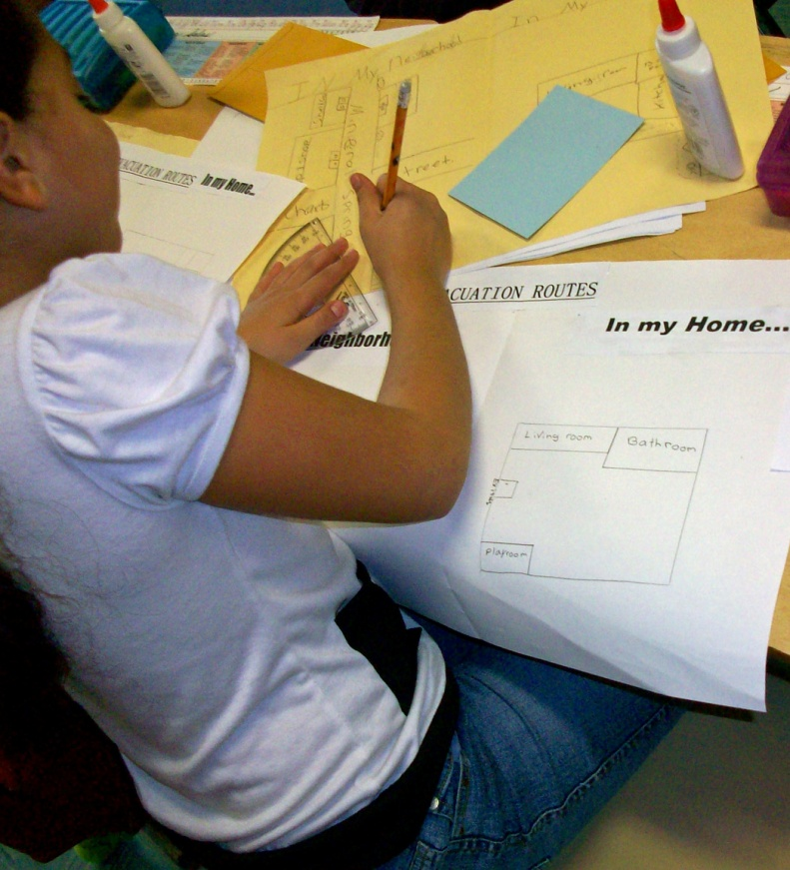
Module 4: Testing and Updating Your Plan

Slide 2
Module Objectives
  Describe how you will communicate, train, and practice your preparedness procedures.
  Identify the emergency preparedness information you will share with your community.
  Describe when to update your plan.

Slide 3



Ensuring Preparedness
Communicating
Training
Practicing

Slide 4

Communicating: Children
  Give children advance warning about drills and what to expect.
  Stay calm.
  Use activities to make emergency preparedness fun and memorable.
  Make your communication age-appropriate.

Slide 5
Communicating: Parents
  Provide information on:
  Your evacuation locations.
  How you will shelter when necessary.
  Where you will take any injured children.
  What you need from them for emergency kits.
  How you will notify them of site closure.
  The importance of family preparedness plans.

Slide 6
Communicating: First Responders
Include emergency management and first responders so they will:
  Be familiar with your site and plans.
  Know your evacuation locations.
  Know how to best communicate with you and alert you to area emergencies.
  Help you improve your plan and your procedures.
  Provide training.

Slide 7
Training
Briefings
Short meetings that provide information about a specific topic
Seminars
Used to introduce new programs, policies, or procedures
Workshops
Resemble a seminar but are used to build specific products, such as a draft plan or policy

Slide 8

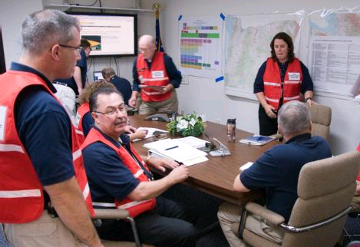
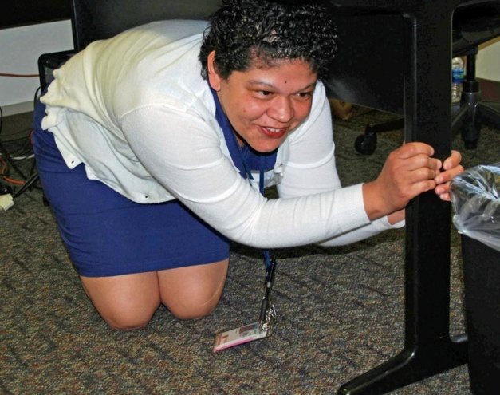
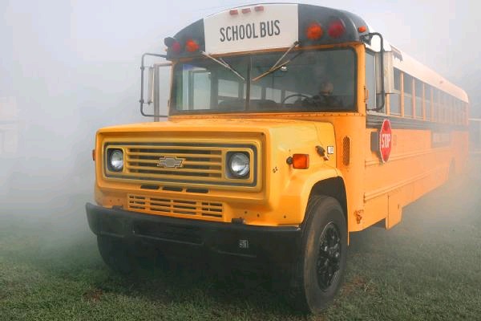
Practicing
Tabletop
Functional
Drill
Full-Scale

Slide 9
Activity
Instructions: Working in small groups . . .
  Develop a set of simple instructions for your assigned drill.
  Be prepared to share your results in 10 minutes.

Slide 10
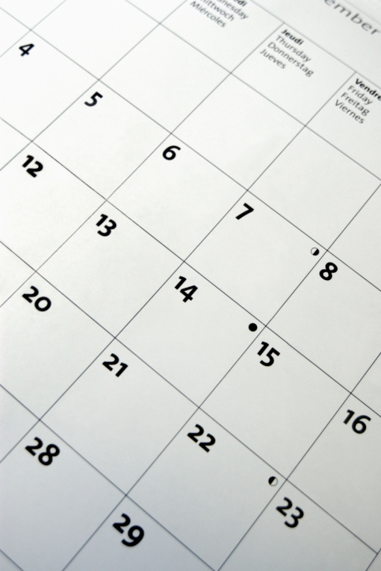
Scheduling
Prepare a schedule that identifies dates for training and practical exercises.

Slide 11
Updating Your Plan
Review and update your plan and procedures, based on:
  Training and exercise results.
  Community input.
  Changes in information/resources.
  Incident after-action findings.

Slide 12
Module Summary
  Can you now:
  Describe how you will communicate, train, and practice your preparedness procedures?
  Identify the emergency preparedness information you will share with your community?
  Describe when to update your plan?

