Slide 1

Module 3: Developing Plans

Slide 2
Module Objectives
  Describe procedures to follow when an emergency occurs.
  Identify how your childcare site will recover from an emergency.
  Describe how to develop and maintain your emergency plan.

Slide 3


Building a Plan
Having a plan helps you to:
  Protect yourself, the children in your care, and your staff.
  Get back to business quickly.

Slide 4

State Requirements
Make sure you develop a plan that is in accordance with your State’s regulations.

Slide 5

Planning and Preparedness Issues
  Child contact information
  Emergency contact information
  Documented procedures
  Emergency supplies

Slide 6
Activity
Instructions: Working individually . . .
  Review the list of planning and preparedness issues in your Student Manual.
  Determine if you have a process to address each issue at your childcare site.
  List any issues that you may need to address.

Slide 7
Child Contact Information
  Parent/guardian contact information
  Designated people with permission to pick up child
  Designated physician and hospital
  Child’s favorite toys, foods, and things to do
  Comforting techniques for the child
  Description from health provider of special health care needs

Slide 8
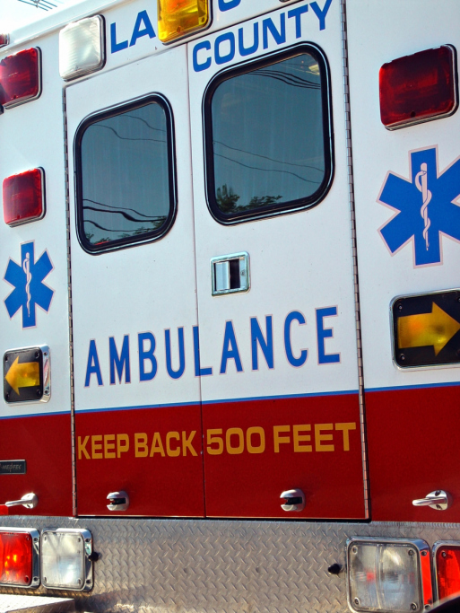
Parental Permission
Document parental permission for:
  Emergency transport.
  Emergency medical treatment.

Slide 9
Emergency Contact Information
  Medical personnel and hospital
  Police, fire, and rescue
  Poison control
  Local emergency management
  Utility companies
  Emergency information sources
  Insurance
  Neighbors

Slide 10

Procedures: Sign-In and Sign-Out
Enable you to:
  Know who is at your site and who is not.
  Easily account for children during an emergency.

Slide 11

Procedures: Closing
Include:
  Who will make the decision to close the site.
  How the decision will be made.
  How you will notify parents or guardians.
  When parents, guardians, and staff will be notified of site closing.

Slide 12
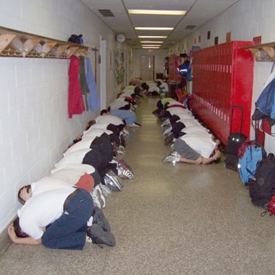
Procedures: Shelter-in-Place Location
Identify where you will take everyone for:
  Weather concerns.
  Contaminated air.
  Outside dangers.

Slide 13
Procedures: Sheltering-in-Place
  If outside, have children and staff go inside.
  Notify everyone of the need to shelter.
  Account for all children and staff.
  Have everyone go to the identified shelter location.
  Ensure you have emergency supplies in the shelter location.
  Listen to the radio for instructions.

Slide 14
Procedures: Contaminated Air
  Shut and lock doors and windows.
  Turn off air conditioner, heat, and/or fans.
  Seal the room by taping up windows, vents, and exhausts.
  Close curtains or blinds.
  If air starts to bother children or staff, hold wet cloths over the nose and mouth or go into the bathroom, close the door, and turn on the shower.

Slide 15

Procedures: Evacuation Location
Designate different locations for evacuation, based on the type of emergency:
  Neighborhood/area
  Out-of-neighborhood/area
  Out-of-town

Slide 16
Procedures: Evacuation
Determine:
  When an evacuation is necessary.
  Who will call 911.
  What evacuation routes and sites will be used.
  How you will get children out.
  Who will take emergency kits.
  When and how you will account for children.
  How children will be transported to evacuation sites.
  Any special considerations.

Slide 17
Procedures: Reunification
  Reunification locations
  Parent notification of your designated evacuation sites
  Requirements for release of children
  Procedures for:
    Documenting that the child was picked up
    Children that are missing or not present that day
    Children not picked up

Slide 18

Procedures: Additional Assistance
Your plan must address how you will support:
  Infants and toddlers.
  Children with additional needs such as medication or equipment.

Slide 19

Emergency Supplies
For sheltering:
  Enough food, water, and other items to last for 72 hours for each child and adult
For evacuating:
  Supplies in something easy to carry

Slide 20
Recovery (1 of 2)
  Identify where you will conduct operations if you are not able to use your site.
  List needed supplies and sources.
  Identify companies and resources for restoring your site.
  Take photographs of the interior and exterior of your site.
  Maintain a current inventory of equipment and supplies for insurance.

Slide 21
Recovery (2 of 2)
Identify:
  Where you will store your business records.
  How you will let parents and guardians know your site is closed and when it will reopen.
  Contracts or agreements to put in place for alternate sites and services.

Slide 22

Psychological and Emotional Recovery
  Observe children’s behavior and accept the changes.
  Listen to children’s concerns and feelings.
  Keep normal routines.
  Be calm and reassuring.
  Limit media exposure.
  Teach calming techniques.
  Provide support to the child’s family.

Slide 23

Support to Parents and Staff
Describe:
  Steps to take to assist others in regaining a positive attitude and reducing stress.
  Recovery resources that are available in the community.

Slide 24
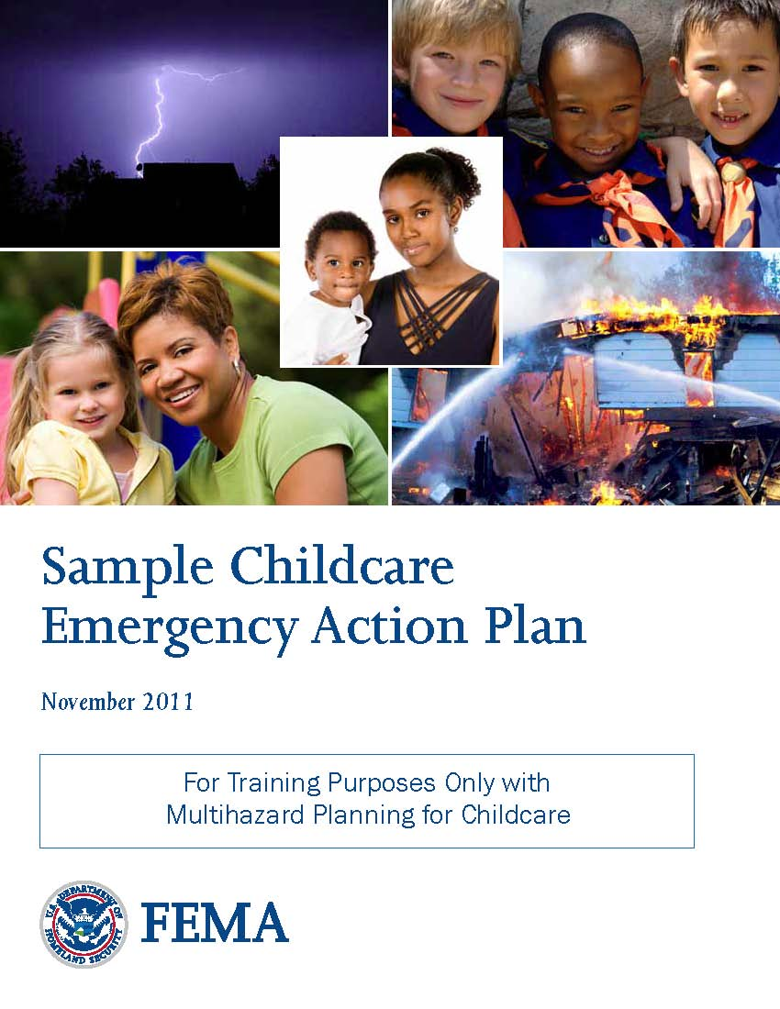
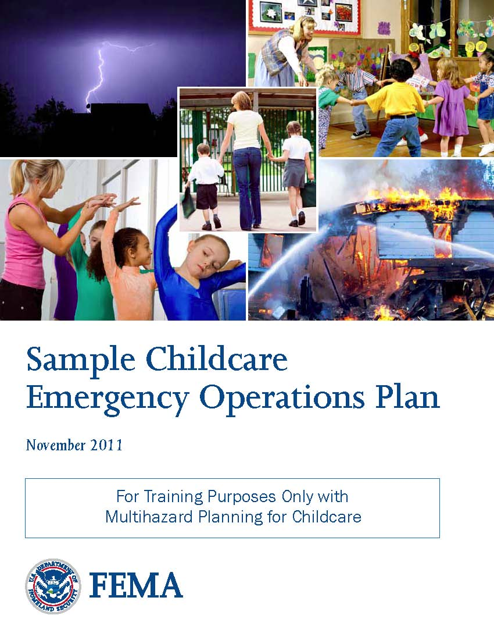
Developing Your Plan
Small sites may develop a simple emergency action plan.
Large sites may develop an emergency operations plan.

Slide 25
Who Reviews Your Plan?
  Local/county emergency manager
  Parents
  First responders
  Local schools and local school district
  State department of health
  Childcare site insurance carrier
  Utility company personnel
  Local business and industry personnel
  Childcare organizations

Slide 26
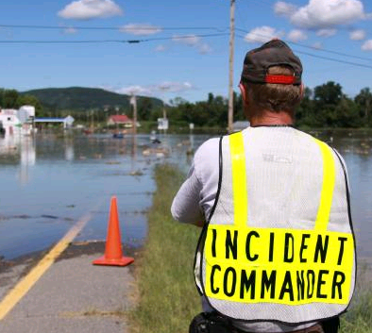
Incorporating ICS
The Incident Command System (ICS) provides a standardized incident management approach to ensure effective response during an emergency and to protect the children and staff.

Slide 27
Activity
Instructions: Working individually, answer the following questions:
  What processes and procedures are you missing?
  What do you need to add?
  What processes and procedures do you have in place?
  How can you improve existing processes and procedures?

Slide 28
Module Summary
  Can you now:
  Describe procedures to follow when an emergency occurs?
  Identify how your childcare site will recover from an emergency?
  Describe how to develop and maintain your emergency plan?

