Slide 1

Module 1: Course Introduction

Slide 2

Course Administration
  Sign-in sheet
  Site logistics
    Emergency procedures
    Breaks
    Restrooms
    Cell phones/ Blackberrys

Slide 3
Course Goal
Provide childcare providers with the knowledge and tools to:
  Analyze the hazards and threats at the site.
  Develop a plan to address these hazards and threats.
  Implement processes to update and practice the emergency plan.

Slide 4
Course Objectives (1 of 2)
  Describe why it is important to be prepared.
  Identify hazards and threats that impact your childcare site.
  Describe how to prevent or mitigate the impact of likely and high-consequence hazards and threats.
  Describe procedures for when an emergency occurs.
  Identify how your childcare site will recover from an emergency.

Slide 5
Course Objectives (2 of 2)
  Describe how to develop and maintain your plan.
  Describe how you will communicate, train, and practice your preparedness procedures.
  Identify the emergency preparedness information you will share with your community.
  Describe when to update your plan.

Slide 6
Discussion: Preparedness
  Why do childcare providers need to be prepared?

Slide 7
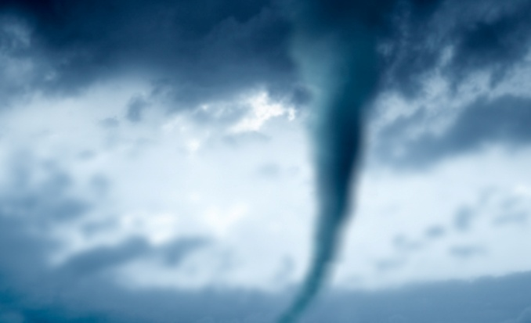
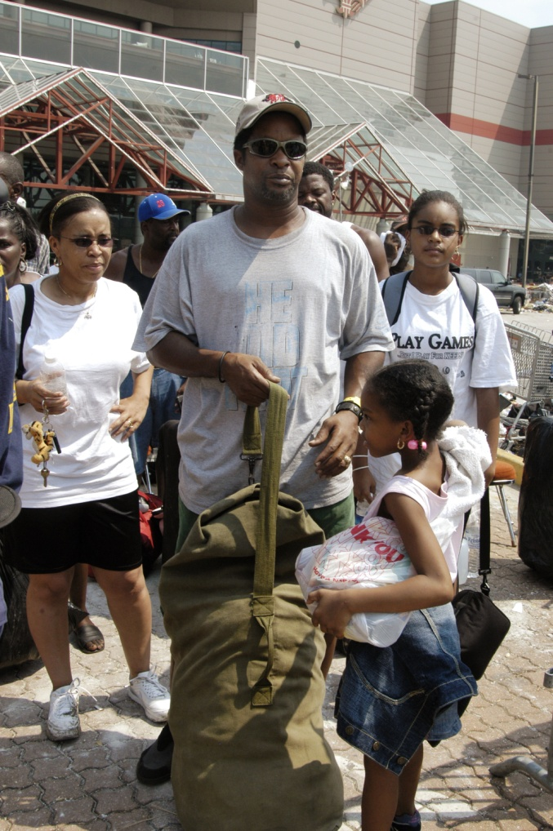
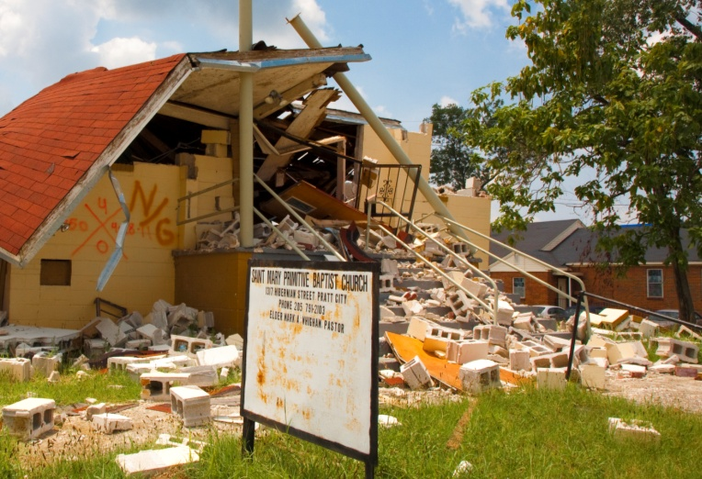
Are You Ready?

Slide 8
What Can You Do?
Being prepared helps you to:
  Save lives.
  Prevent incidents from happening.
  Minimize injury.
  Decrease damage to your property.
  Reduce fear and the emotional impact of an incident.
  Recover more quickly.

Slide 9
What Do Parents Expect?
Parents expect you to:
  Have a plan for emergencies.
  Be able to safely evacuate.
  Notify them when something happens.
  Care for their children.
  Teach their children what to do during an emergency.
  Have sufficient supplies.
  Have relationships with emergency management officials and first responders.

Slide 10
What Steps Can You Take?
Step 1: Know your hazards
Step 3: Test and update your plan
Step 2: Develop a plan

Slide 11
Discussion: Obstacles
What are some obstacles you might face in developing
the plan?

Slide 12
Obstacles to Planning
  Getting the right people involved
  Finding time to conduct planning.
  Being overwhelmed by possible hazards and threats.
  Lacking contacts in the emergency field.

Slide 13
Module Summary
Being prepared helps
you to save lives.

