Slide 1
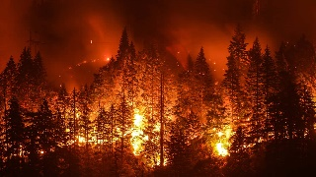
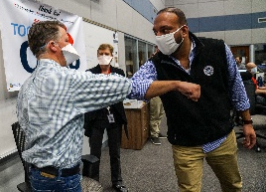
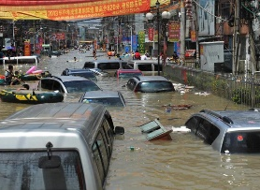
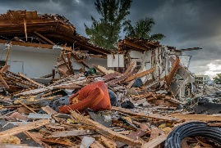
The Role of Emergent Systems in Identifying and Adapting to the Training Needs of Emergency Management Practitioners in the COVID-19 Era
Joshua DeVincenzo, Sr. Instructional Designer & Jeremy Brooks, Sr. Program Manager, NCDP, Columbia University

Slide 2
Scope and Learning Objectives
Discuss emergent training topic areas of interest analyzed through evaluation feedback gathered from trainings throughout the pandemic.
Analyze findings from cross-referencing emergent themes gathered from learners with national preparedness assessments.
Provide recommendations for the scholarship of teaching and learning in Emergency Management to adapt and address the learning needs of curriculum during a COVID-19 era based on adult learning theory and informed by actively conducting trainings throughout the pandemic.

Slide 3
Context: Organizational History
Originally funded as a CDC Center for Public Health Preparedness, 2001-2010
CDC funded Preparedness and Emergency Response Learning Center, 2010 - 2014
Established a Learning Management System with over 40 courses offered and over 100,000 users trained domestically and internationally
Home - National Center for Disaster Preparedness | NCDP (columbia.edu)
NCDP Training Center (FEMA Courses) (ncdpcourses.org)

Slide 4
Translating Science into Practice
National Disaster Readiness Surveys conducted annually for many years providing a detailed snapshot of U.S, population readiness for disasters.
Conducting some of the largest longitudinal cohort studies to follow the trajectory of children’s recovery after Katrina and the Deepwater Horizon Oil Spill.
Staff have served as principal investigators on research and training projects with the CDC, ASPR, the New York City Department of Health and Mental Hygiene, Commonwealth Edison Co, and GSK.

Slide 5
NCDP Training Program Overview
FY16 - Community Planning for Economic Recovery: 2016 - 2019: 1 Instructor-Led Training (ILT) and 2 Web-Based Trainings (WBT)
FY17 - Addressing Gaps in Housing Disaster Recovery: 2017 - 2020: 1 ILT and 3 WBTs
FY18 - Transitioning Disaster Survivors from Temporary to Permanent Housing: 2018 - 2021: 2 ILTs and 2 WBTs
FY18 - Improving Individuals’ and Business’ Financial Literacy and Management to Support Post-Disaster Economic Recovery: 2018 - 2021: 2 ILTs and 2 WBTs
FY19 - Innovative Disaster Recovery Strategies for Interim and Permanent Housing Construction: 2019 – 2022: 1 ILT and 1 WBT
FY20 - Designing and Administering Custom Housing Programs for State, Tribal, and Territorial Governments: 2020-2023: 1 ILT and 2 WBTs

Slide 6
Who are our Learners? Learning Management System Demographics
N = 3,289 learners as of 5/13.
States with most learners: FL, TX, NY
FEMA Region with most learners: 4 (AL, FL, GA, KY, MS, NC, SC, TN).

Slide 7
Emergent Themes…Beyond Systems Thinking
Emergent systems are often portrayed with gears.
Each gear consists of properties in isolation. However, when combined, a number of newer properties emerge (O'Reilly & Munakata, 2000).
The result is unearthing an emergent phenomenon from interactions that are not present in an isolated component but are activated when combined (O'Reilly & Munakata, 2000).

Slide 8
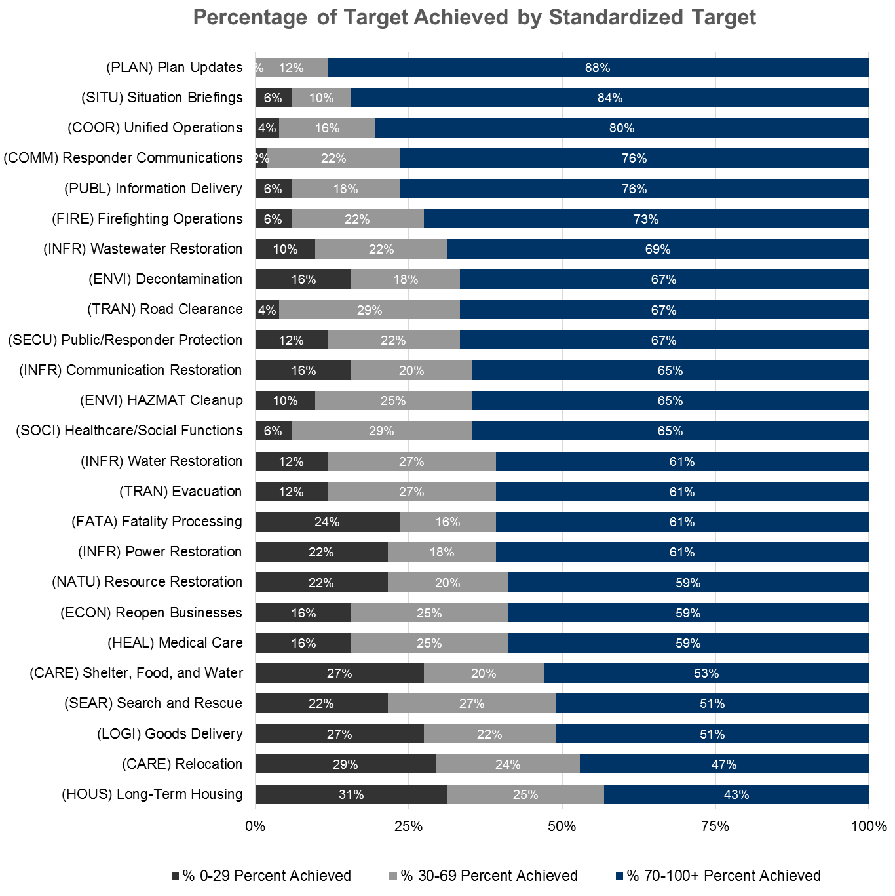
Emerging Themes in EM: THIRA/SPR
Threat and Hazard Identification and Risk Assessment (THIRA) and Stakeholder
Preparedness Review (SPR), is an annual assessment of hazards of interest and stakeholder capacity.
Some themes (housing, economic recovery) were also found in learner evaluations from trainings.
From THIRA/SPR 2019 Results and Presentation:
Consistent with past results, states/territories tend to report the most significant gaps in the Recovery core capabilities and the fewest gaps in the cross-cutting core capabilities
Randazzo, D. (2019, November). Thira/Spr Program and Results. Homeland Security National Training Program
(HSNTP) Kick-Off Meeting. Washington; District of Columbia.

Slide 9
Emerging Themes in EM: Learner Evaluations

Slide 10
Recommendations and Insights for SoTL
Move towards Action learning approaches that are conducted by using past knowledge supplemented by insights from questioning the current complexity (Revans, 1982).
Adapt training and education to reflect the modern threat and hazard environment
Continual evaluation and direct feedback through formative and summative assessments.
Flexible curriculum and learning objectives
Revisit models and definitions

Slide 11
Contact
Joshua DeVincenzo, M.Ed.
Sr. Instructional Designer
jld2225@columbia.edu
Jeremy Brooks, MPH
Sr. Program Manager
jb3860@Columbia.edu

