Slide 1
Presentation Template: Version August 2024

Slide 2
Presentation Template: Version August 2024

Slide 9
Presentation design do’s and don’ts
Do this
Don’t do this
Edit your slides down to the essentials.
Images should have space to breathe.
Use images, rather than text, to simplify complex ideas.
Include only one idea per slide.
Create an outline first.
Slide titles should be concise.
Don’t overfill your slides.
Don’t overlap the logo with content.
Don’t use colors that are not in the FEMA color theme.
Don’t use non FEMA fonts.
Don’t make text too small.

Slide 11
This is an example of a two-line header, if needed. We recommend keeping headlines to one line.

Slide 12
This is another title here
Add image here
This is a bullet
This is a bullet
Second bullet
Third bullet
This is a bullet

Slide 13
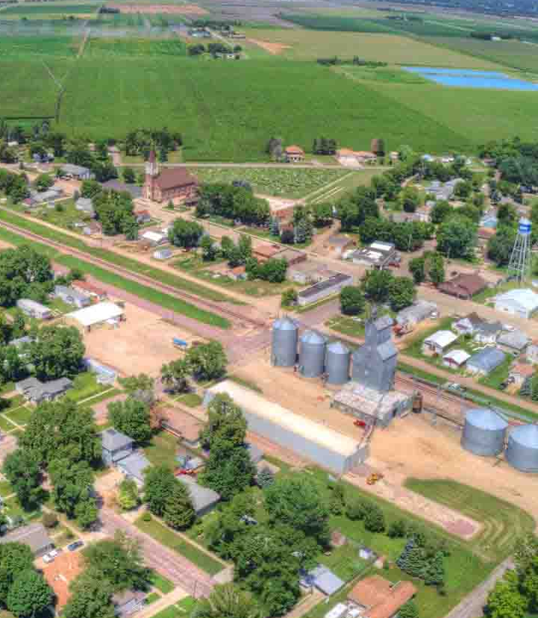
Change out Placeholder Image
View tab – select “Slide Master”
Select corner of image and grab blue overlay. Slide over to see image.
Right click image select “Change Picture”, select “From a File, select “Image, Open”
size new image to fit in the given frame.
Select corner of blue overlay and place blue overlay back over entire image.
Close Master View located in top ribbon.
Do not type while in Master Slides, exit the Master Slides view then type text.

Slide 14
This is a title
This is a subtitle
This is a subtitle
Background image is a place holder only, read slide #00 to change out
These are bullets
These are bullets
These are bullets
These are bullets

Slide 15
Helping people before, during and after disasters. The roles outlined in the Homeland Security Act define FEMA’s responsibility to carry out its mission to reduce the loss of life and property and protect the Nation from all hazards by leading and supporting a comprehensive, risk-based emergency management program. It accomplishes this vision through 3 strategic goals: Build a culture of preparedness, Ready the nation for catastrophic disasters, and Reduce the complexity of FEMA
What is FEMA's mission?

Slide 20
Primary color palette
The primary color palette is blue and black, including mid-tones and tints and a thoughtful use of whitespace.
Black
DHS Blue
Dark Gray
RGB 0/82/136
RGB 90/91/93
White
Gray
RGB 192/194/196

Slide 21
Helpful Resources
Branding Guidance Page
Request Forms
Templates
Graphics & Icons
Email Signatures
Logo standards
Design Guide
Writing Guide

Slide 22
Use a minimum amount of DHS colors per chart, monochrome is best when using multiple colors. Be sure to be 508 compliant with color dependency.

Slide 23
This is an example of a pie chart with description
Use a minimum amount of DHS colors per chart, monochrome is best when using multiple colors. Be sure to be 508 compliant with color dependency.

Slide 24
This is an example of a pie chart with description
Use a minimum amount of DHS colors per chart, monochrome is best when using multiple colors. Be sure to be 508 compliant with color dependency.

Slide 25
Chart title goes here
Subtitle in needed goes here
Column 1 | Column 2 | Column 3 | Column 4
Text | Text | Text | Text
Text | Text | Text | Text
Text | Text | Text | Text
Text | Text | Text | Text
Text | Text | Text | Text

Slide 26
How to use icons
An icon should never stand alone. It should always appear with descriptive text.
An icon size should never be larger than 1 inch.
Icons should always be one color.
Icon should either be filled or outlined and never use both in the same presentation.

Slide 27
First and Last Name
Title
Email.address@fema.dhs.gov
First and Last Name
Title
Email.address@fema.dhs.gov
First and Last Name
Title
Email.address@fema.dhs.gov

Slide 28
First and Last Name
Title
Email.address@fema.dhs.gov

