Slide 1
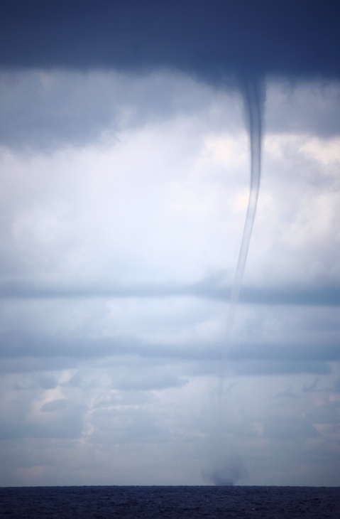
Module 2: Knowing Your Hazards

Slide 2
Module Objectives
Identify hazards and threats that impact your childcare site.
Describe how to prevent or mitigate the impact of likely and high-consequence hazards and threats.

Slide 3
Discussion: Everyday Hazards
What activities have you done today?
What hazards could you have encountered?

Slide 4
Hazard Awareness
Being aware of hazards helps:
Prioritize them.
Take the appropriate actions.

Slide 5
Who Can Help Identify Hazards
Local/county emergency manager
Parents
First responders
Local schools and school district
State department of health
Childcare site insurance carrier
Utility company personnel
Local business and industry personnel
Childcare organizations

Slide 6
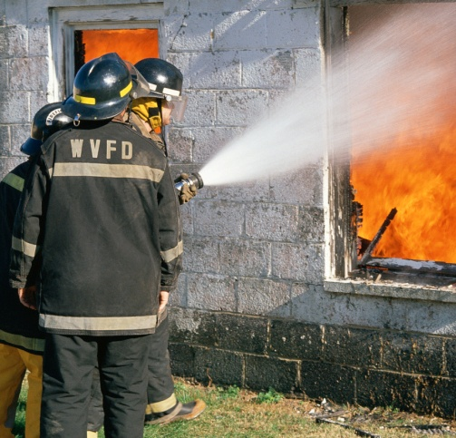
Hazards: Fire
Fires:
Are the most common of all business disasters.
Can spread quickly and are dangerous.
In childcare centers are usually started by a cooking accident.

Slide 7
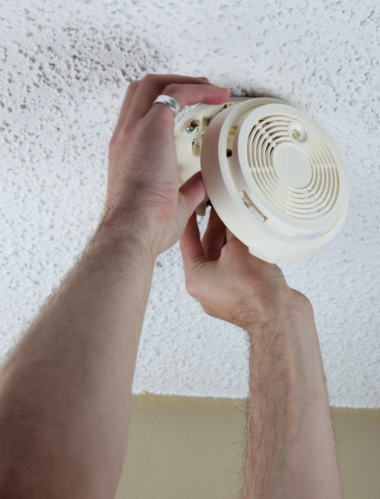
Fire Protection
Have an evacuation plan.
Practice your plan and make sure everyone can get out of each room.
Install, test, and clean smoke alarms.
Schedule visits from the fire department for fire safety information.

Slide 8
Activity
Instructions: Working as a team . . .
Create a list of three ways you might evacuate several children at one time, including infants, toddlers, and children with access and functional needs.
Record your list on chart paper.
Select a spokesperson and be prepared to present your list in 5 minutes.

Slide 9
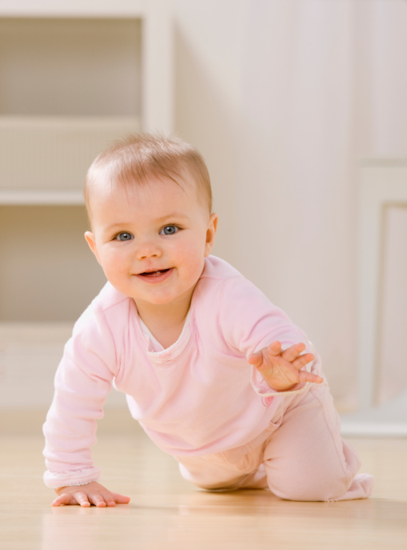
Hazards: General Safety
Childproof the facility.
Take a “child’s-eye view” survey, going from room to room and addressing the hazards at a child’s level.

Slide 10
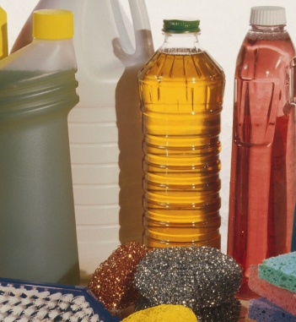
Hazards: Hazardous Materials
Make sure hazardous materials are:
Clearly marked.
Kept in their original containers.
Stored out of children’s reach.

Slide 11
Hazards: Utility Outages
Know how to use emergency shutoffs for water, gas, and electricity—and mark the shutoffs clearly.
Have surge protectors.
Have a land-line phone that does not require electricity.
Consider purchasing an emergency generator.

Slide 12
Hazards: Crime
Conduct background or reference checks.
Ensure doors and windows lock.
Be familiar with people who should be and should not be around your facility.
Build a relationship with local law enforcement.
Have a process for reporting suspicious activity.

Slide 13
Hazards: Abduction
Have a process for:
Releasing children only to designated individuals.
Accounting for children at all times.

Slide 14
Discussion: Obstacles
What would your response be if parents raised safety concerns about your facility?

Slide 15
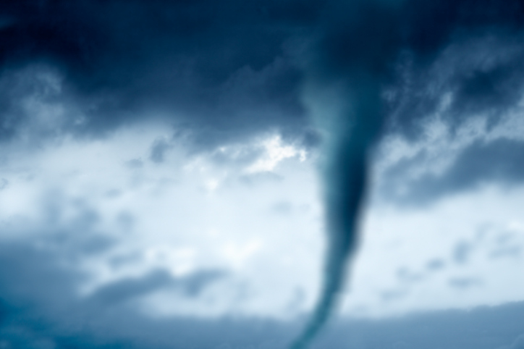
Hazards: Severe Weather
Listen to the radio and NOAA Weather Radio.
Follow instructions from local officials.
Stay inside.

Slide 16
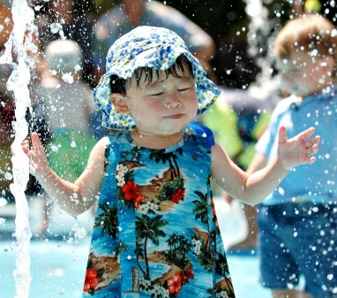
Severe Weather: Excessive Heat
To be prepared for excessive heat:
Ensure air conditioners are installed and insulated properly.
Cover windows.
Keep yourself, your staff, and children hydrated.
Learn the signs of heat-related health concerns.
Limit exposure during the hottest part of the day.

Slide 17
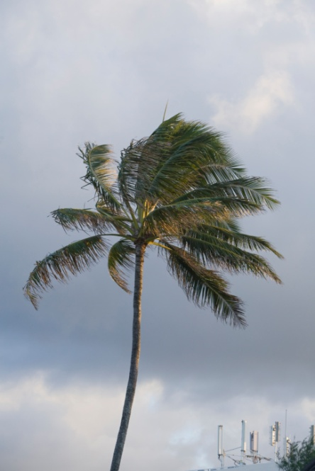
Severe Weather: Hurricanes
To be prepared for hurricanes:
Know the hurricane categories.
Secure outside items.
Cover windows.
Remove damaged limbs from trees.
Turn off propane tanks and utilities as instructed.
Ensure you have a supply of water for sanitary purposes.
Evacuate when instructed.

Slide 18
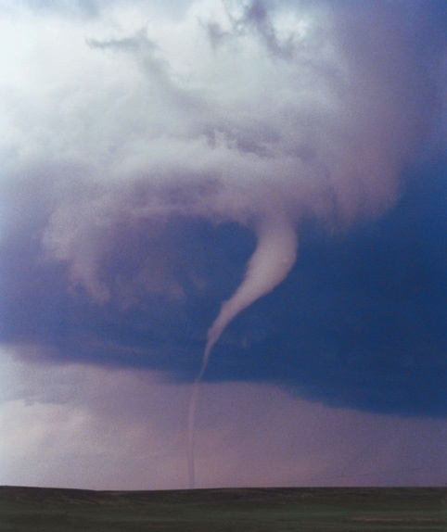
Severe Weather: Tornadoes
To be prepared for tornadoes:
Prepare a safe room in advance.
If there are tornado warnings:
Immediately take everyone to safe shelter.
Keep everyone away from windows, doors, outside walls, and corners.

Slide 19
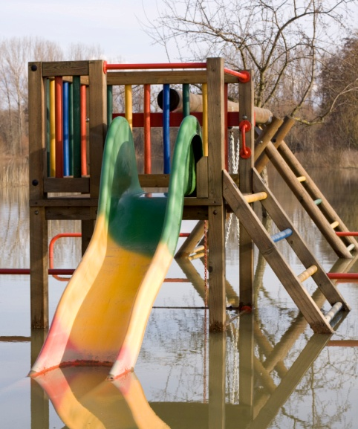
Severe Weather: Flooding
To be prepared for flooding:
Protect your building.
Talk with your insurance representative about flood protection insurance.
Identify evacuation sites.
Identify how you will transport children to evacuation sites.

Slide 20
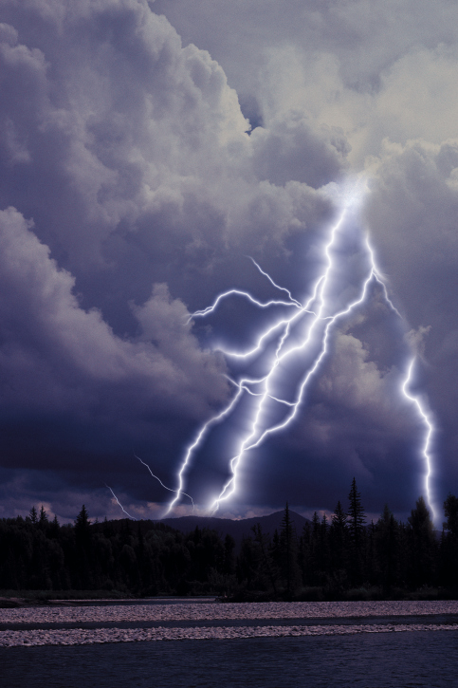
Severe Weather: Thunderstorms
To be prepared for thunderstorms:
Remove dead and rotting trees.
Secure outside objects.
Shutter windows (or close blinds, shades, curtains) and secure outside doors.

Slide 21
Severe Weather: Winter Storms
To be prepared for winter storms:
Have rock salt, sand, and snow shovels on hand.
Ensure you have extra blankets and adequate clothing for children.
Make sure your site is well insulated.
Insulate pipes and allow faucets to drip a little during cold weather.
Know how to shut off water valves.
Be careful when using alternate heat sources.
Have a supply of extra food and water.

Slide 22
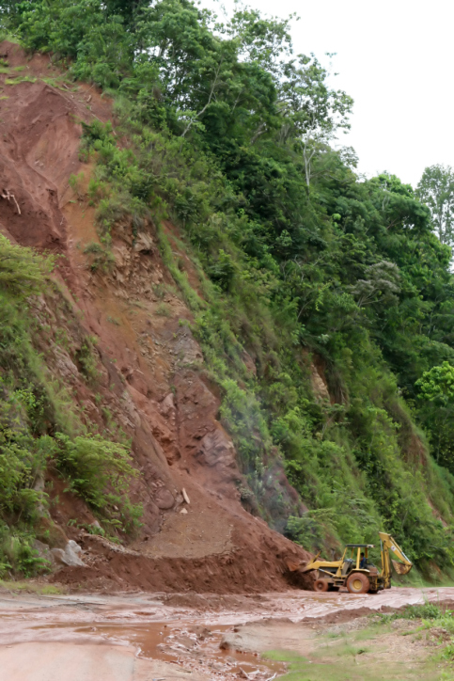
Hazards: Geological Events
Include earthquakes, tsunamis, landslides, and volcanoes.
Cause considerable human suffering and billions of dollars in losses in the United States every year.

Slide 23
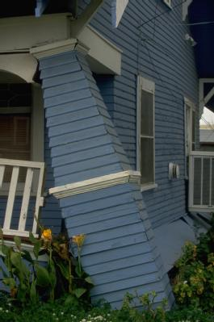
Geological Events: Earthquakes
To be prepared for an earthquake:
Familiarize yourself with earthquake terms.
Fasten/secure heavy items.
Place sleeping and sitting areas away from hazards (pictures, mirrors, lamps, etc.).
Mark and clear exits.
Know how to shut off gas valves.
Have an emergency kit ready.

Slide 24
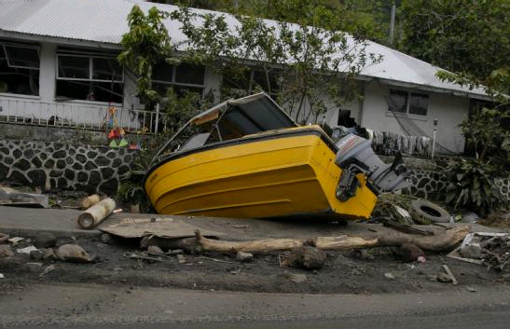
Geological Events: Tsunamis
If there is the possibility of a tsunami:
Listen to local officials.
Be prepared to act quickly and evacuate.
Stay away from low-lying coastal areas.

Slide 25
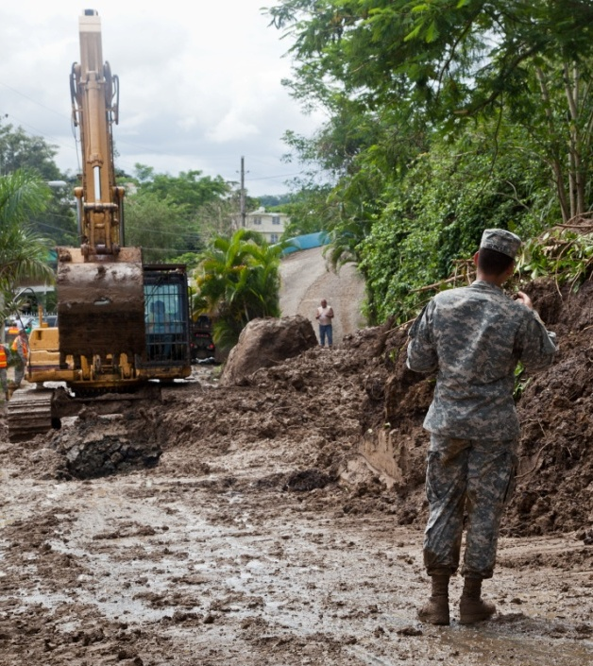
Hazards: Landslides
To be prepared for landslides and debris flows:
Be familiar with whether debris flows have occurred in your area.
Watch how water flows during storms.
If in imminent danger, evacuate your site immediately.

Slide 26
Hazards: Volcanoes
If there is the possibility of a volcanic eruption:
Listen to local officials.
Bring children inside.
Shut windows and doors to maintain air quality.
Be prepared to evacuate quickly.
Include goggles and nose and mouth protection in your emergency supply kits.

Slide 27
Hazards: Illness and Food Safety
Know:
Which illnesses require the child to be excluded.
How parents will be notified.
How regular health checks will be conducted.
Take steps to prevent food-borne illness.

Slide 28
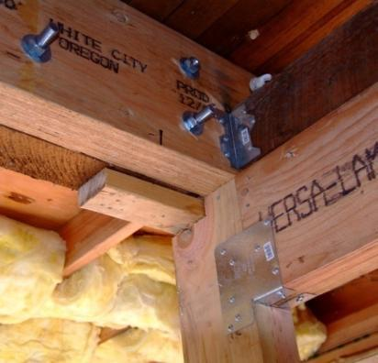
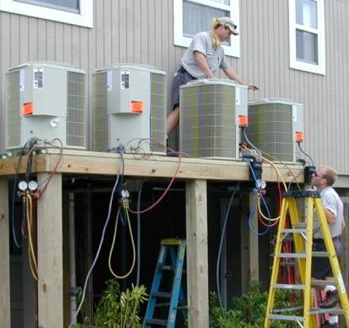
Mitigating Hazards
Structural Elements
Nonstructural Elements

Slide 29
Next Steps
Identify hazards and threats.
Develop strategies to address hazards and threats.
Identify members from the community to assist.
Develop and implement a process to identify and address new hazards.

Slide 30
Activity
Instructions: Working individually . . .
Identify three hazards that may affect your childcare facility.
Identify three actions you can take to reduce the risk of each hazard.
Be prepared to share your results in 15 minutes.

Slide 31
Module Summary
Can you now:
Identify hazards and threats that impact your childcare site?
Describe how to prevent or mitigate the impact of likely and high-consequence hazards and threats?

