Slide 1
IS-328 Plan Review for Local Mitigation Plans

Slide 2
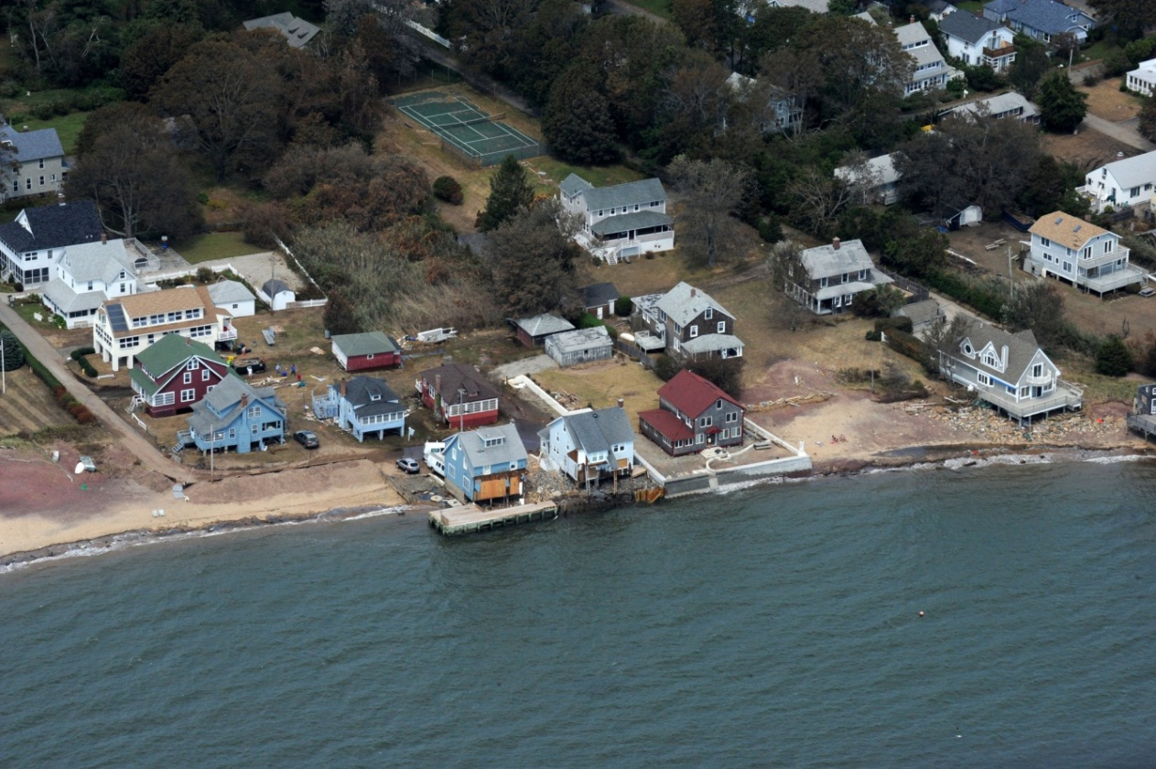
Administrative
Emergency exits
Restrooms
Cell phones
Course materials

Slide 3
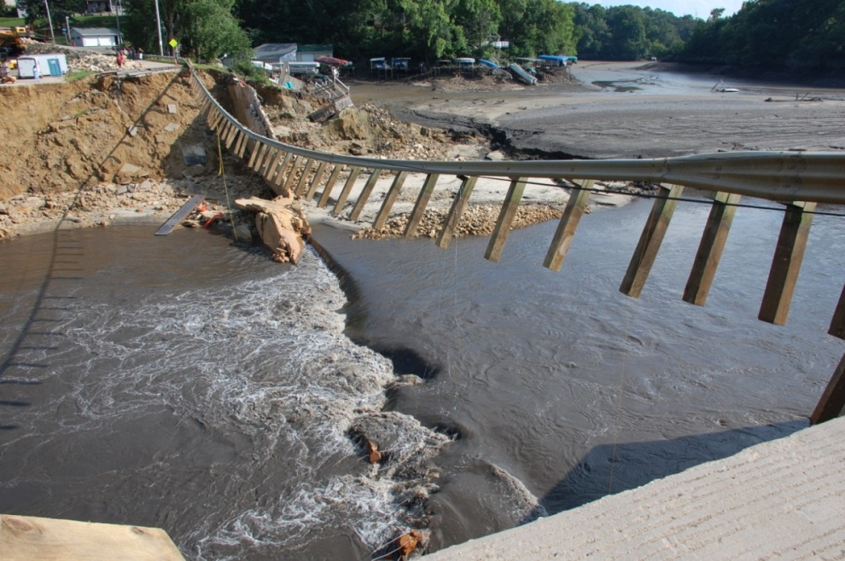
Course Goal
To provide plan approvers with the information necessary to review a local hazard mitigation plan

Slide 4
Objectives
At the end of this course, participants will be able to
Explain the purpose and intent of reviewing Local Mitigation Plans
Describe how to use the Plan Review Tool to communicate the results of the review to a State or local community
Determine whether a Local Mitigation Plan meets Federal mitigation planning requirements

Slide 5
Introductions
Name
Organization
Location
Plan review experience

Slide 6
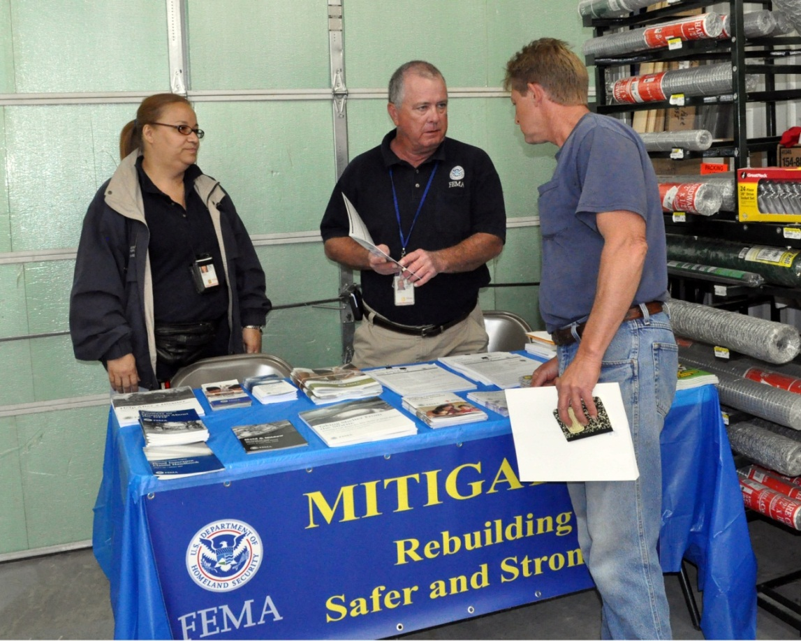
Course Organization
Background
Guiding Principles
Overview of Plan Review Tool
Regulation Checklist
Plan Assessment
Wrap-Up and Post-Course Assessment

Slide 7
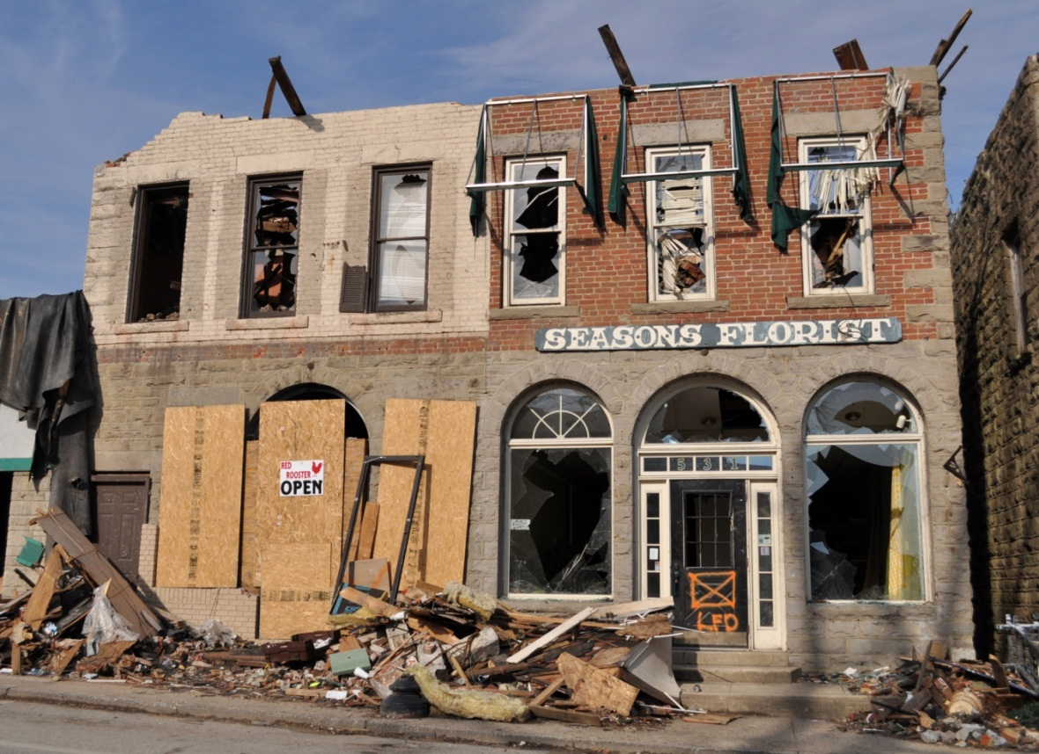
1. Background
This section covers
Hazard mitigation
Hazard mitigation planning process
Roles and responsibilities for plan review
Legislative authority for plan review

Slide 8
Hazard Mitigation
Reduces potential for
Loss of life
Injury
Property damage
Sustained action
Hazard mitigation actions
Implemented at any time
Based on an inclusive, comprehensive, long-term plan

Slide 9
Hazard Mitigation Planning Process
Local Community
Develops a local mitigation plan
Involves the public and other stakeholders
Identifies and examines ALL potential natural hazards
Assesses vulnerabilities and impacts
Develops strategies to mitigate risks
Adopts the plan
Updates the plan
No two communities are exactly alike; no two plans are exactly alike

Slide 10
Plan Review Procedure
Local Community
Prepares Plan
Submits to State
SHMO
Reviews Plan
Returns to Local Community or Submits to FEMA
FEMA
Reviews Plan
Approved / Approvable Pending Adoption / Not Approved

Slide 11
Procedural Notes
Timing
Communications
Submittal
Review and Revisions
Approval and Adoption

Slide 12
Authority
Congress established requirements for mitigation plans
Section 322 of the Robert T. Stafford Disaster Relief and Emergency Assistance Act (Stafford Act), as amended
The National Flood Insurance Act of 1968 (NFIA), as amended
Title 44 Code of Federal Regulations Section 201.6 (44 CFR 201.6)

Slide 13
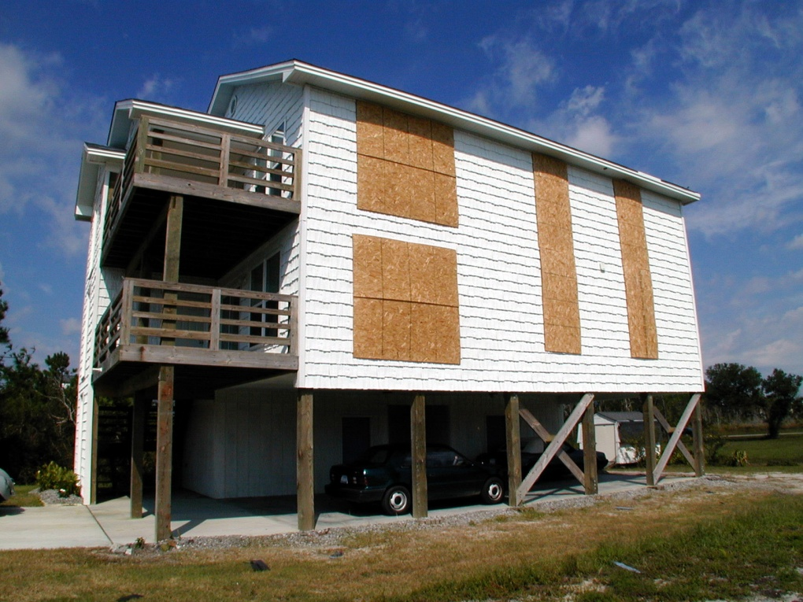
Questions?
The Background section provided information about:
Hazard mitigation
Mitigation planning process
Legislative authority
Roles and responsibilities of local communities, State, or FEMA
Questions?

Slide 14
2. Guiding Principles
This section covers the five Guiding Principles for plan reviewers
Guiding Principle #1: Focus on the mitigation strategy
Guiding Principle #2: Review for intent as well as compliance
Guiding Principle #3: Understand that the process is as important as the plan itself
Guiding Principle #4: Understand that this is the community’s plan
Guiding Principle #5: Use the plan review to foster relationships

Slide 15
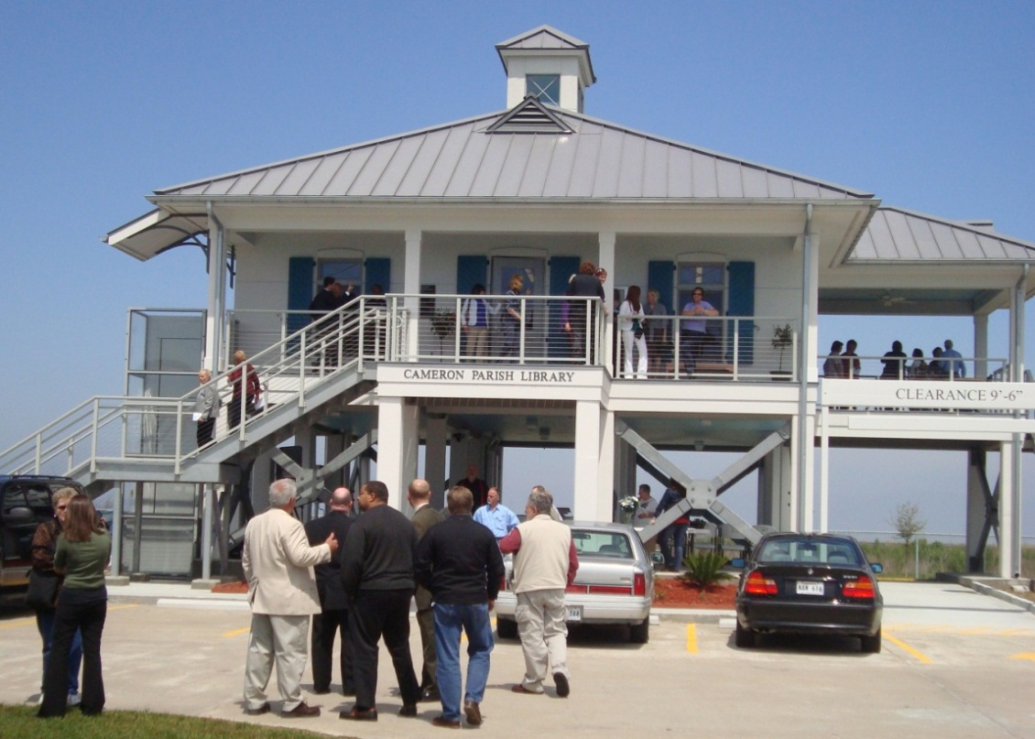
Guiding Principle #1
Focus on the mitigation strategy
Emphasize actions and implementation
Purpose of the planning process is to develop a sound mitigation strategy that will be effective in reducing losses

Slide 16
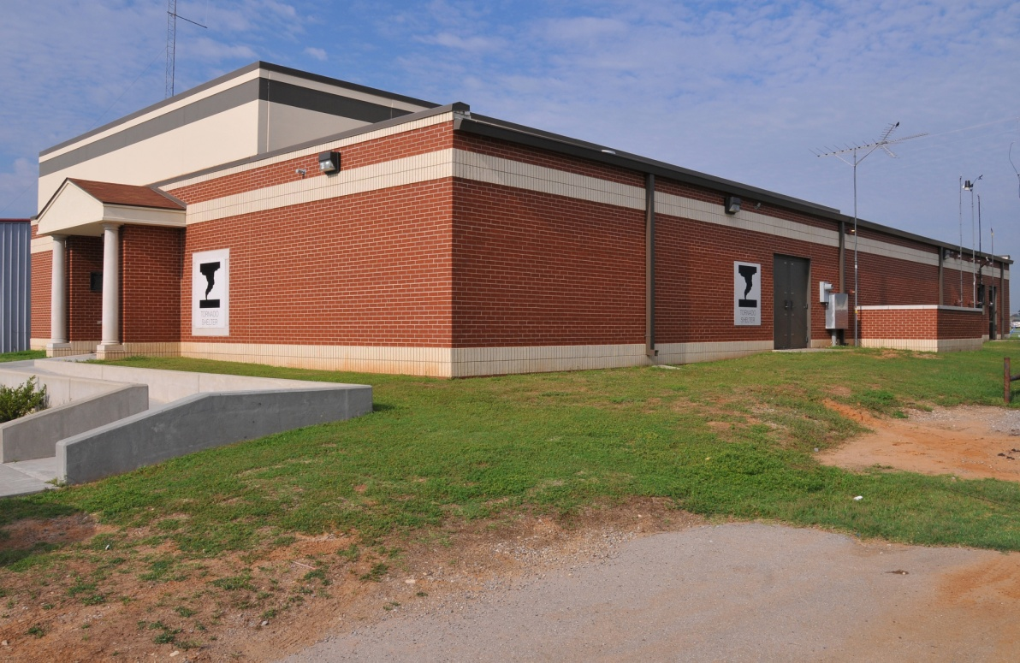
Guiding Principle #2
Review for intent as well as compliance
Required revisions should lead to substantial improvements in the strategy

Slide 17
Guiding Principle #3
Understand that the process of developing a local hazard mitigation plan is as important as the plan itself
Process is not defined by FEMA
Process is defined locally

Slide 18
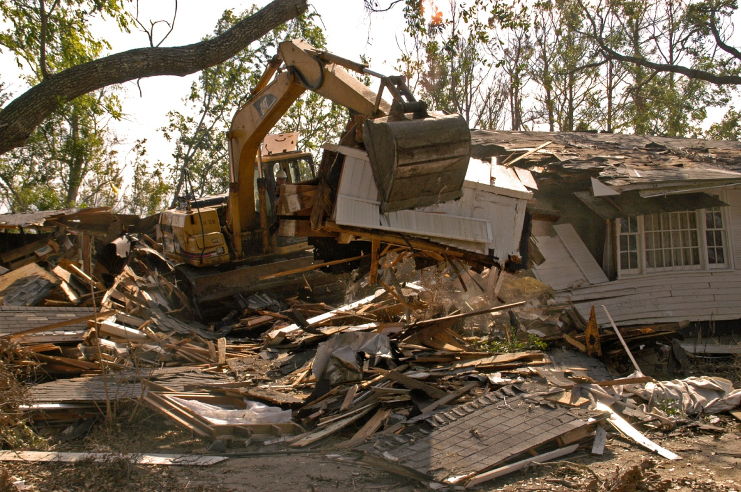
Guiding Principle #4
Understand that this is the community’s plan
FEMA does not require that plans have a particular organization

Slide 19
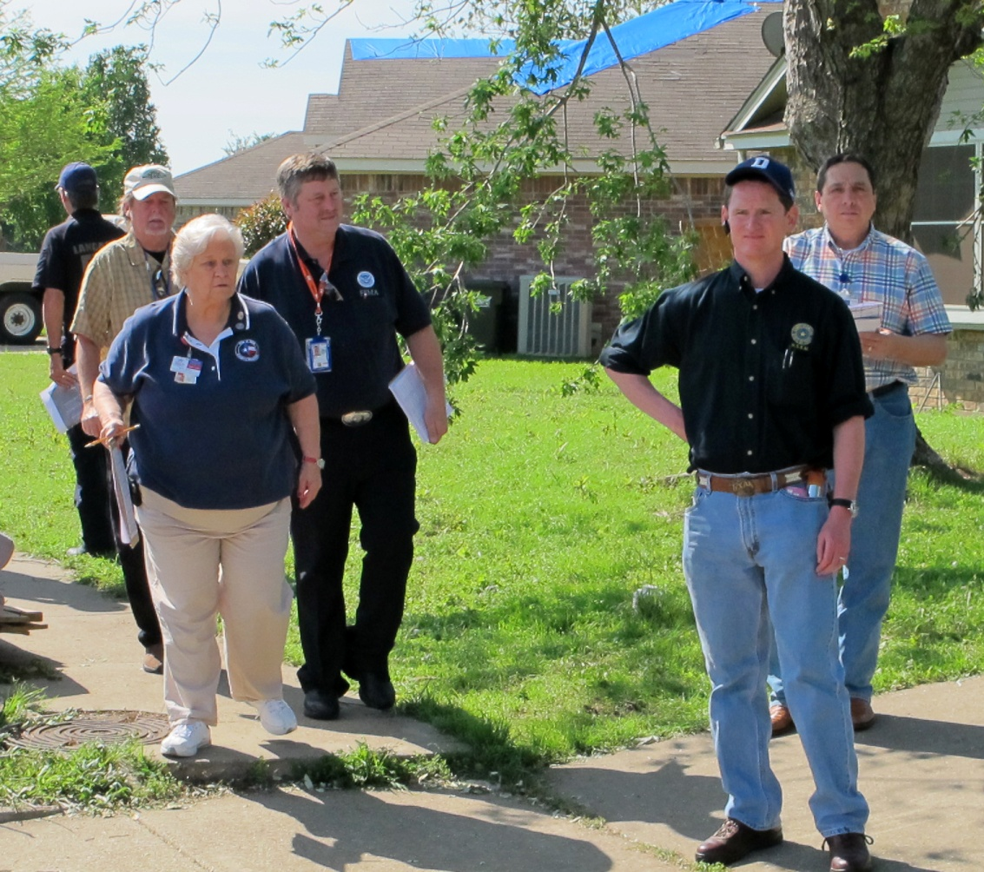
Guiding Principle #5
Use the plan review to foster relationships
FEMA, State, and local community officials work together

Slide 20
FEMA Approach
The FEMA approach to mitigation planning is performance based and identifies generally what should happen and what should be documented in the plan
The FEMA approach is not prescriptive and does not specify exactly how the planning process should be conducted.

Slide 21
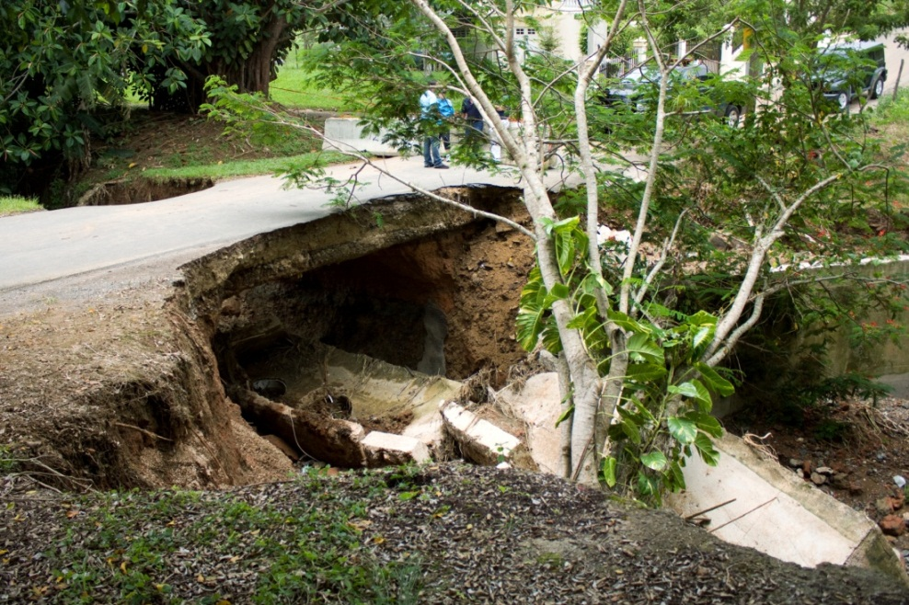
Questions?
Focus on the mitigation strategy
Review for intent as well as compliance
Understand that the process is as important as the plan itself
Understand that this is the community’s plan
Use the plan review to foster relationships
Questions?

Slide 22
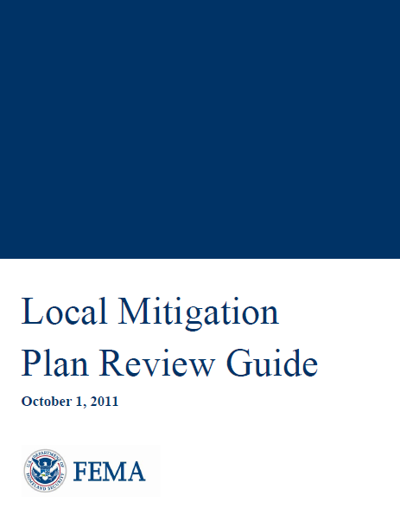
3. Overview of Plan Review Resources
This section covers:
Use of the Local Mitigation Plan Review Guide
Purpose and content of the Plan Review Tool

Slide 23
Local Mitigation Plan Review Guide
FEMA’s official interpretation of 44 CFR 201.6
FEMA’s standard operating procedure for review of a Local Mitigation Plan
Must be consulted by FEMA plan approvers when reviewing a Local Mitigation Plan

Slide 24
Plan Review Tool
The Local Mitigation Plan Review Tool is Appendix A of the Plan Review Guide
Plan reviewers use the Local Mitigation Plan Review Tool to:
Demonstrate how the plan meets the regulations in 44 CFR 201.6
Provide feedback to the community
The Tool has four parts
Cover Page
Regulation Checklist
Plan Assessment
Multi-jurisdiction Summary Sheet

Slide 25
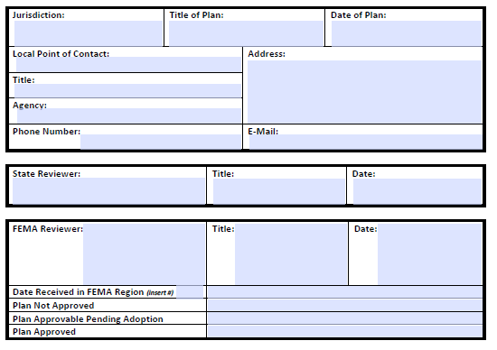
Cover Page
Includes Local Mitigation Plan information
Dates of State and FEMA review
Determination of review

Slide 26
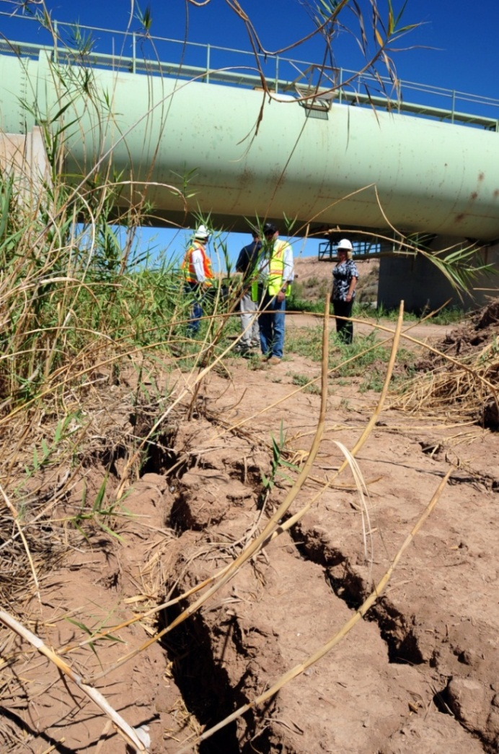
Regulation Checklist
Lists all Federal requirements that use the verb “shall”
Leads the plan reviewer through systematic consideration of each required element, with definitions and examples
Allows for additional State requirements

Slide 27
Plan Assessment
To offer more comprehensive feedback on the quality of the plan to the local community
Suggestions for improving the Plan
Strengths of the Plan
Recommendations for implementation
Lists regulations that use the verb “should”
FEMA plan approvers must complete the Plan Assessment

Slide 28
Multi-jurisdiction Summary Sheet
Optional
List each of the jurisdictions
Enter contact information
Keep track of which requirements were “Met” or “Not Met” for each jurisdiction
Plan reviewers cannot approve a plan unless each requirement is met for each participating jurisdiction

Slide 29
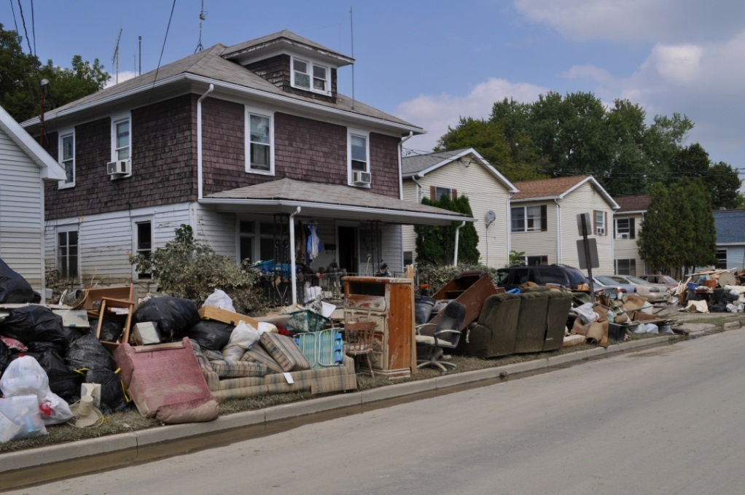
Questions?
This section provided an overview of:
The Local Mitigation Plan Review Guide
The Plan Review Tool
Cover Page
Regulation Checklist
Plan Assessment
Multi-jurisdiction Summary Sheet (optional)
Questions?

Slide 30
4. Regulation Checklist
Regulation Checklist has 6 Elements
Planning Process
Hazard Identification and Risk Assessment
Mitigation Strategy
Plan Review, Evaluation, and Implementation (for plan updates only)
Plan Adoption
Additional State Requirements (for State reviewers only)

Slide 31
Element A. Planning Process
Intent of Element A
Planning process is appropriate for the community
Plan provides a permanent record of how decisions were reached
An open public involvement process is required

Slide 32
A1. Document the Planning Process
How was the plan developed?
Schedule and summary of activities
Who was involved in the process for each jurisdiction?
Names or titles of agencies involved
Copies of meeting agendas
Sign-in sheets
How was the public engaged in the process?
Applies to new plans and plan updates
Questionnaires, surveys
Integration of feedback into the plan

Slide 33
A2. Stakeholder Engagement
An opportunity for broad involvement is required
Does the plan identify stakeholders given an opportunity to be involved?
Opportunity for involvement must be provided for
Local and regional agencies involved in mitigation
Agencies with the authority to regulate development
Neighboring communities

Slide 34
A3. Opportunity for Public Involvement
Does the Plan
Document opportunities for the public to be involved during the drafting stage?
Explain how public feedback was incorporated into the plan?

Slide 35
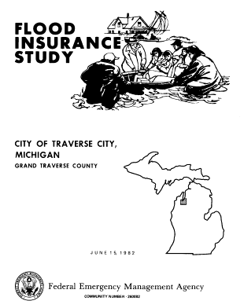
A4. Existing Information
Review and incorporation of existing data is required
Does the plan document the review and incorporation of data from
Plans
Studies
Reports
Technical documents

Slide 36
A5. Continued Public Participation
Continued public participation is required
Does the plan describe how jurisdiction(s) will seek public participation
After plan adoption?
During implementation, monitoring, and evaluation?

Slide 37
A6. Keeping the Plan Current
A method and schedule for keeping the plan current is required
Does the plan identify how, when, and by whom it will be:
Monitored?
Evaluated?
Updated?

Slide 38
Element B: Hazard Identification and Risk Assessment
The plan must describe potential hazards
Intent of Element B
Use of accurate, current, and relevant information
Basis for assessing vulnerability
Leads to mitigation strategy

Slide 39
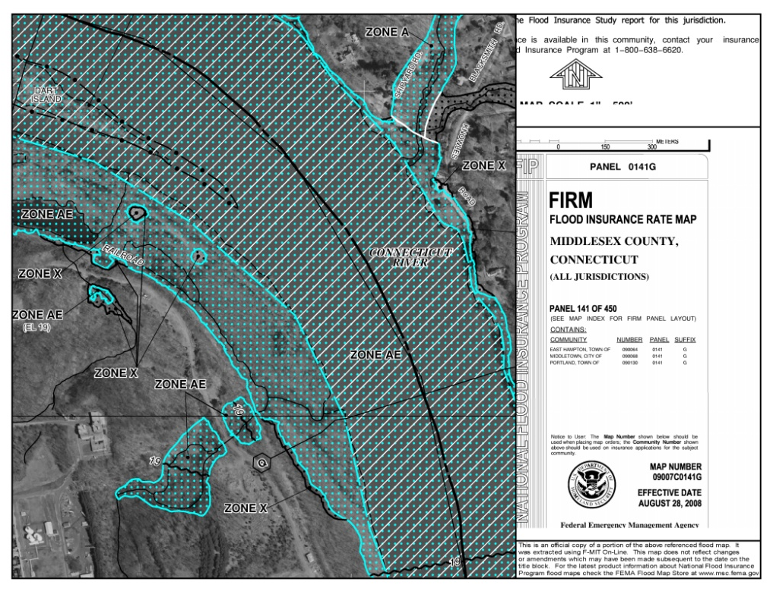
B1. Type, Location, and Extent
Description of natural hazards is required
Description of location and extent is required
Does the plan
Describe potential natural hazards?
Provide rationale for omitting a natural hazard?
Explain location and extent of each potential natural hazard?

Slide 40
B2. Previous Occurrences
Information on previous occurrences and future probability is required
Does the plan
List previous occurrences?
Discuss probability of future occurrences?

Slide 41
B3. Impact and Vulnerability
Description of impact and vulnerability is required
Does the plan
Describe potential impacts?
Describe assets such as
People?
Structures?
Facilities?
Systems?
Capabilities?
Activities?
Summarize vulnerabilities?
Issues or problems

Slide 42
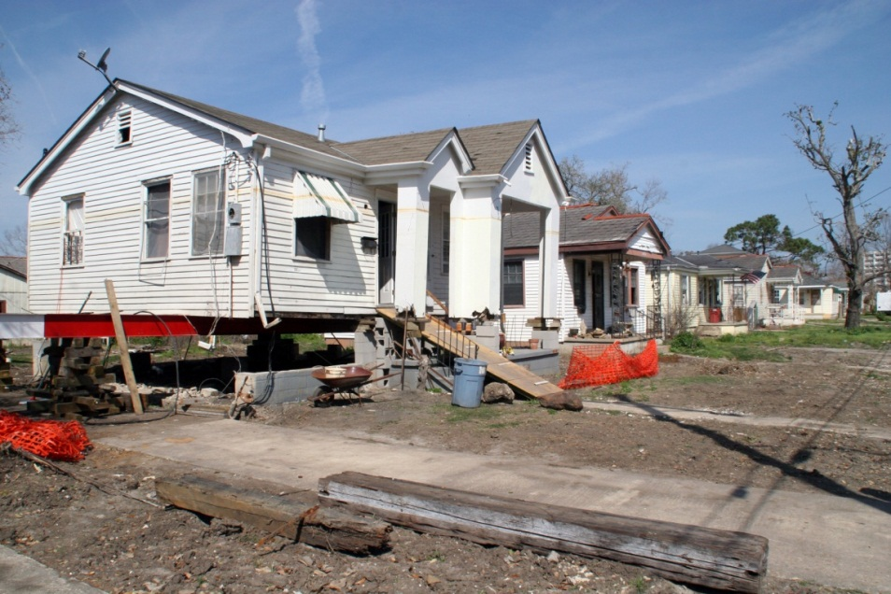
B4. NFIP-Insured Structures
Information about repetitively flooded NFIP-insured structures is required
Does the plan
Describe types of structures?
Estimate number of repetitive loss properties?
Not violate conditions of Privacy Act of 1974?

Slide 43
Additional Notes
FEMA does not require a specific format for the plan
The Regulation Checklist only includes requirements of 44 CFR 201.6 that use the words “shall” or “must”
Leadership in local government may fluctuate over time; therefore, describing the process and explaining how decisions were reached is important

Slide 44
Element C. Mitigation Strategy
The plan must include a mitigation strategy
A blueprint for reducing potential losses
Based on existing policies, programs, resources
Intent of Element C
Describe hazard mitigation goals and actions
Identify the community’s existing authorities, policies, programs, and resources that can be used to implement those actions
All other requirements lead to and support the mitigation strategy
Mitigation actions must be reaffirmed or updated when the plan is updated

Slide 45
C1. Existing Policies and Programs
The plan must document each jurisdiction’s
Existing authorities
Policies, programs, and resources
Ability to expand on and improve existing policies and programs
The plan might describe
Public works and/or emergency management staff
Zoning ordinances, building codes, subdivision regulation
Annual budgets
Comprehensive planning
Taxing authority

Slide 46
C2. NFIP Participation
Does the plan address
Participation in the NFIP?
Continued compliance with NFIP requirements?

Slide 47
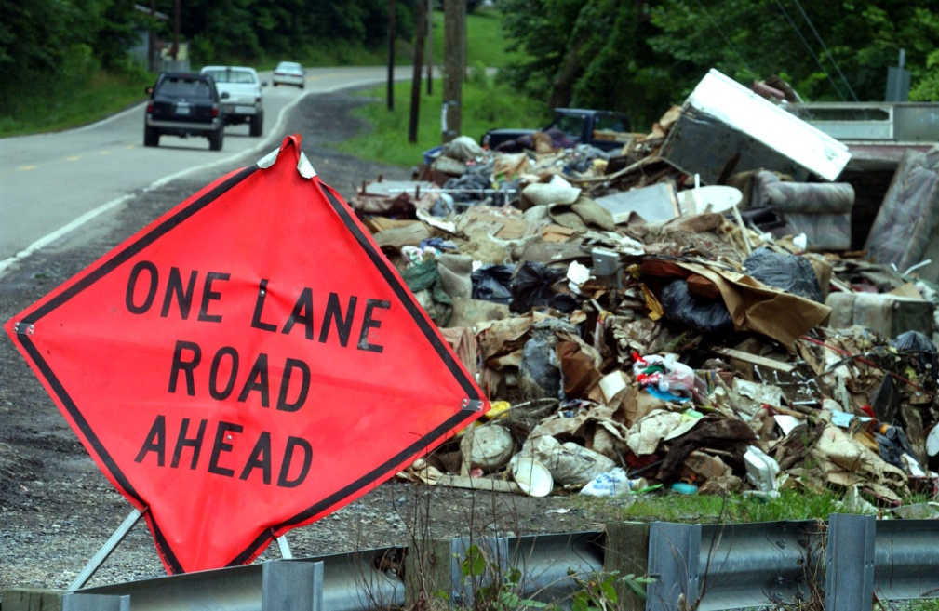
C3. Goals
Does the plan include goals to reduce or avoid long-term vulnerabilities to identified hazards?
Goals
Are broad policy statements
Must be consistent with the identified hazards

Slide 48
C4. Mitigation Actions
The plan must identify and analyze a range of mitigation actions
Actions
Is an activity, process, or physical project designed to reduce or eliminate long-term risk to one or more hazards identified in the risk assessment?
Does the plan include
Actions for new buildings and infrastructure?
Actions for existing buildings and infrastructure?
Actions for each jurisdiction?

Slide 49
C5. Action Plan
The plan must contain an action plan
For each jurisdiction, the plan must
Describe the criteria used for prioritizing implementation of mitigation actions
Demonstrate that the jurisdictions considered the benefits versus the costs
Identify who is responsible for implementing the action
Identify potential funding sources and expected timeframes for completion

Slide 50
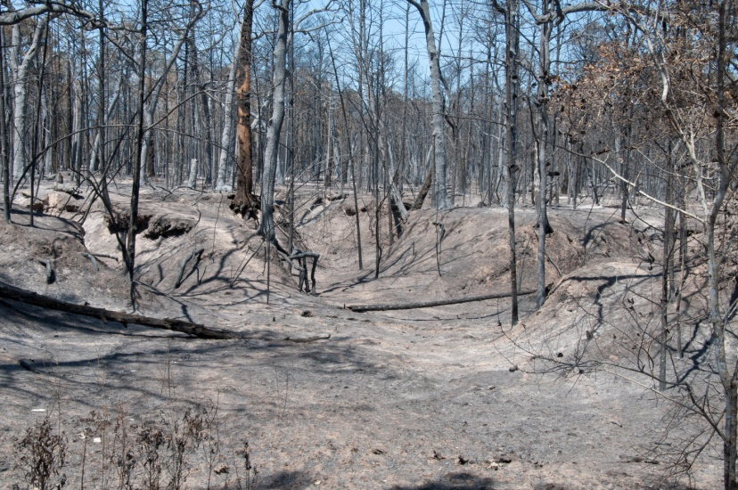
C6. Integration with Other Plans
The plan must describe a process for integration
Does the plan explain how mitigation will be integrated into
Other plans?
Ordinances?
Day-to-day operations?
Is this provided for each jurisdiction?

Slide 51
Element D. Plan Review, Evaluation, and Implementation
This element is reviewed for plan UPDATES only
The plan must reflect
Changes in development
Progress in mitigation
Changes in priorities
The plan must be resubmitted for approval every 5 years
Intent of Element D
The plan continues to be relevant
The plan reflects current conditions

Slide 52
D1. Changes in Development
Was the plan revised to reflect changes in development?

Slide 53
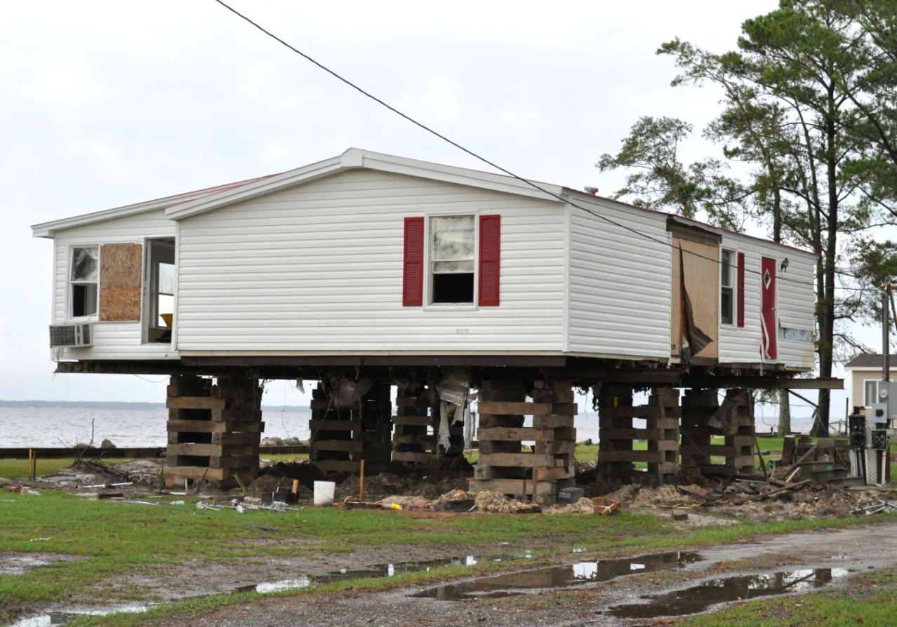
D2. Progress with Mitigation
Was the plan revised to reflect progress in local mitigation efforts?

Slide 54
D3. Changes in Priorities
Was the plan revised to reflect changes in priorities?

Slide 55
Element E. Plan Adoption
The plan must include documentation of adoption
For multi-jurisdictional plans, each jurisdiction must adopt
Intent of Element E
Adoption demonstrates commitment
Adoption legitimizes the plan
Updated plans must be adopted anew

Slide 56
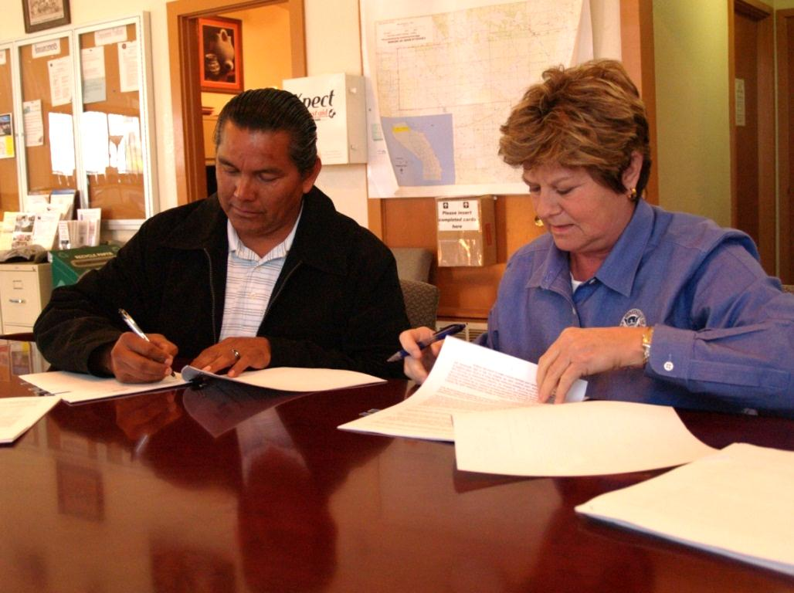
E1. Documentation of Adoption
The plan must include documentation of adoption
Does the plan include a
Signed resolution?
Other evidence?

Slide 57
F: Additional State Requirements

Slide 58
Required Revisions
Sub-elements consolidated
Plan approvers explain
Which sub-elements do not meet requirements
Why the information is required
What can be done to meet the requirements
Example
The plan does not explain how neighboring jurisdictions and other interested parties were given an opportunity to participate in the development of this plan. Describe the opportunities provided to these groups and explain how they were involved in the process.

Slide 59
Questions?
This section covered these elements
Planning Process
Hazard Identification and Risk Assessment
Mitigation Strategy
Plan Review, Evaluation, and Implementation
Plan Adoption
Additional State Requirements
Questions?

Slide 60
5. Plan Assessment
Intent of Plan Assessment
To offer more comprehensive feedback on plan quality
The Plan Assessment has two parts
A. Plan Strengths and Opportunities for Improvement
B. Resources for Implementation

Slide 61
Element A. Planning Process
How does the plan go above and beyond minimum requirements?
Does the plan demonstrate
Broad involvement of stakeholders?
Involvement of a large number of local agencies?
Diverse methods of public participation?
Open and inclusive public involvement process?
How can the planning process be improved in future plan updates?

Slide 62
Element B. Hazard Identification and Risk Assessment
Does the risk assessment include information about
Future development trends?
Existing structures and infrastructure?
Future structures and infrastructure?
Estimated dollar losses for each hazard?
Methods used to develop the estimates?
Does the plan demonstrate
Use of best available data?
Communication of risk to the public?

Slide 63
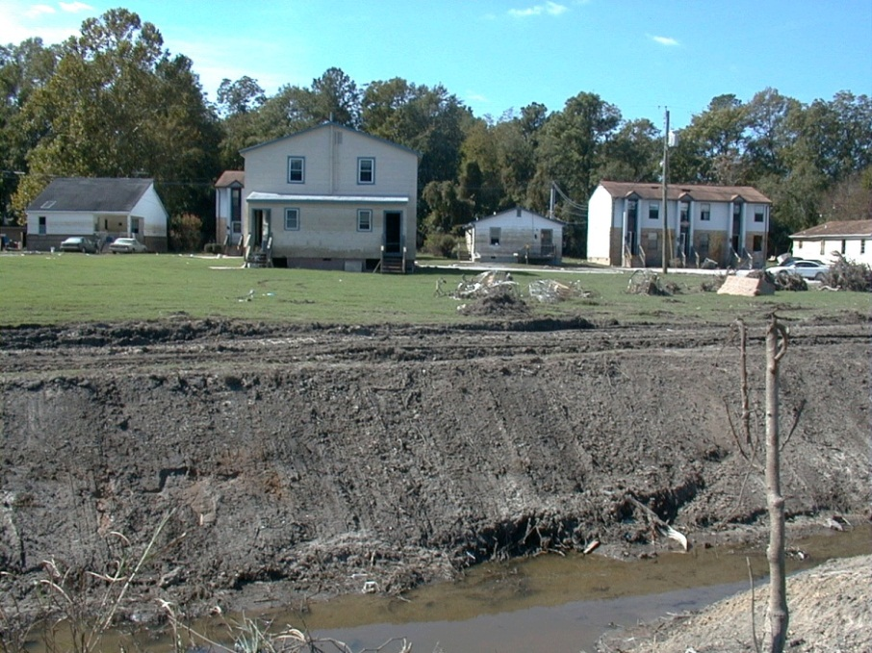
Element C. Mitigation Strategy
How well does the plan
Reflect the vulnerability assessment?
Set goals based on problems?
Provide a diversity of actions?
Plan approver may suggest opportunities for implementation

Slide 64
Element D. Plan Update, Evaluation, and Implementation
How does the plan document the 5-year evaluation with respect to
Status of mitigation actions?
Identification of obstacles to implementation of actions?
Solutions for overcoming the obstacles?
Reduction of risk?

Slide 65
Plan Assessment Discussion
Plan Assessment should
Provide a synopsis of overall strengths of the plan
Provide suggestions, not directions
Be relevant to the plan
Sections may be left blank
Delete italicized questions before completing
Remember Guiding Principle #5
The plan review should foster relationships

Slide 66
Resources for Implementation
FEMA funding programs
Other Federal programs
Publications, technical guidance
Upcoming trainings or workshops

Slide 67
Good Example of Plan Assessment Comment
The comment
Identifies a strength of the plan
Suggests an opportunity for using the information developed during the planning process to apply for mitigation funding
Is consistent with the Guiding Principle to Focus on the Mitigation Strategy
The plan links the results of the risk assessment directly to goals and to proposed mitigation actions. The community can use the results of the risk assessment to develop applications for mitigation project funding.

Slide 68
Not a Good Example of Plan Assessment Comment
The comment
Does not provide information about an opportunity for improvement
May actually belong as a required revision in the Regulation Checklist
Is not helpful in building a relationship with the local community and, therefore, violates one of the Guiding Principles
There is no clear connection between the risk assessment and the mitigation actions listed in this plan. Plan developers should find a workshop on developing a mitigation plan and attend it before resubmitting the plan for review.

Slide 69
Questions?
This section provided information about
How to relay feedback about strengths and opportunities for improvement
Ideas for resources for implementing the plan
Questions?

Slide 70
Additional Resources
For further information about mitigation planning:
https://www.fema.gov/multi-hazard-mitigation-planning
For information about mitigation plan procedures:
https://www.fema.gov/risk-mapping-assessment-planning/regional-contact-information
For information about implementing a mitigation plan:
https://www.fema.gov/media-library/assets/documents/34953

Slide 71
6. Wrap-Up and Post-Course Assessment
This course briefly reviewed the
Background of hazard mitigation planning
Guiding Principles
The Plan Review Tool
Regulation Checklist
Plan Assessment
Questions?

